Slide 1
Establishing the Learning Center as the Nucleus in a Learner Centered Institution
Saundra Yancy McGuire, Ph.D.
Director Emerita, Center for Academic Success
Retired Asst. Vice Chancellor & Professor of Chemistry
NCLCA Certified Learning Center Professional - Level 4
Elected Fellow of CLADEA, ACS, AAAS

Slide 2
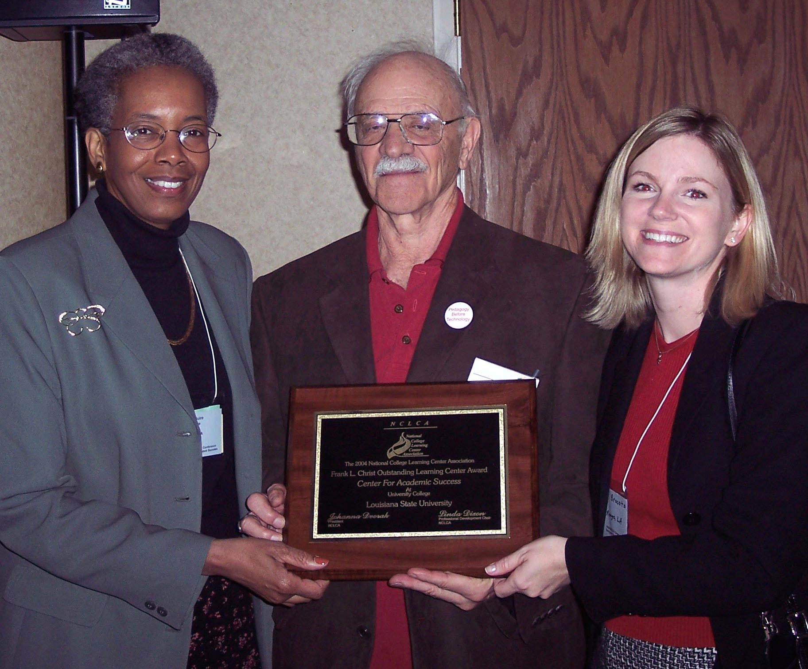
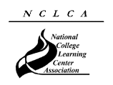
2004 National College Learning Center Association Frank L. Christ Outstanding Learning Center Award
Center for Academic Success
Center for Academic Success

Slide 3
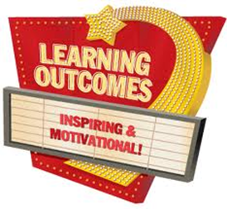
Desired Outcomes
We will be able to identify the departments, administrative units and individuals that will be allies in making the learning center the nucleus
We will be able to describe the local and national initiatives mandating the importance of the learning center
We will be able to identify specific strategies that will successfully move the learning center to a more central position on campus
We will be able to describe the first steps in an action plan that we can begin implementing immediately to move our learning center to a position of prominence

Slide 4
Reflection Questions
What is a major driver for making the learning center the nucleus of your institution?
What is a major barrier to making the learning center the nucleus of your institution?

Slide 5
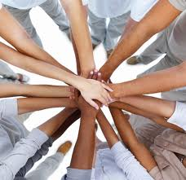
Learning Support Center Potential Partners
Faculty
Student Organizations
Departments
Colleges
University Centers
Others?

Slide 6
Reflection Question
What are some important characteristics of departments that are highly regarded at your institution?

Slide 7
The Role of Learning Support Centers in Academic Improvement
Provide faculty and TA’s with information on the learning process, characteristics of their students, and learning strategies they can teach students
Assist faculty in advising students about effective learning strategies (Absent Professor Program)
Help students identify the problem with their performance (e.g. memorizing vs understanding)
Help the institution improve retention and graduation rates (through graduate and professional programs!)

Slide 8
Scientific and Theoretical Bases Supporting the Learning Center Programs
Cognitive/Brain Science Principles
Constructivist Learning Theory
Metacognition

Slide 9
Metacognition
The ability to:
think about your own thinking
be consciously aware of yourself as a problem solver
monitor, plan, and control your mental processing (e.g. “Am I understanding this material, or just memorizing it?”)
accurately judge your level of learning
know what you know and what you don’t know
Flavell, J. H. (1976). Metacognitive aspects of problem solving. In L. B. Resnick (Ed.), The nature of intelligence (pp.231-236). Hillsdale, NJ: Erlbaum

Slide 10
Reflection Questions
What’s the difference, if any, between studying and learning?
For which task would you work harder?
A. Make an A on the test
B. Teach the material to the class

Slide 11
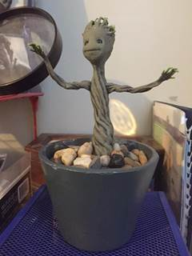
Power of Teaching to Master Learning Clint’s Story: Baby Groot and the Licensure Exam
Guardians of the Galaxy
First encounter on October 29, 2015 at EKU
Email on January 18, 2016
Msg on April 14, 2016
Msg on June 11, 2016
https://www.youtube.com/watch?v=BEPbXYzE5_Y

Slide 12
This pyramid depicts the different levels of thinking we use when learning. Notice how each level builds on the foundation that precedes it. It is required that we learn the lower levels before we can effectively use the skills above.
Bloom’s Taxonomy
Creating
Putting elements together to form a coherent or functional whole; reorganizing elements into a new pattern or structure through generating,
planning, or producing.
Making judgments based on criteria and standards through checking and critiquing.
Evaluating
Breaking material into constituent parts, determining how the parts relate to one another and to an overall structure .
Analyzing
Carrying out or using a procedure through executing, or implementing.
Applying
Constructing meaning from oral, written, and graphic messages through interpreting, exemplifying, classifying, summarizing, inferring, comparing, and explaining.
Understanding
Retrieving, recognizing, and recalling relevant knowledge from
long-term memory.
Remembering
http://www.odu.edu/educ/llschult/blooms_taxonomy.htm

Slide 13
The Study Cycle

Slide 14
The Story of Two Students
Travis, junior psychology student
47, 52, 82, 86 B in course
Dana, first year physics student
80, 54, 91, 97, 90 (final) A in course

Slide 15
A Reading Strategy that Works: SQ5R
Survey (look at intro, summary, bold print, italicized words, etc.)
Question (devise questions survey that you think the reading will answer)
Read (one paragraph at a time)
Recite (summarize in your own words)
Record or wRite (annotate in margins)
Review (summarize the information in your words)
Reflect (other views, remaining questions)

Slide 16
A Homework System That Can Be Taught
Study information before looking at the problems/questions
Work example problems (without looking at the solutions) until you get to the answer
Check to see if answer is correct
If answer is not correct, figure out where mistake was made, without consulting solution
Work homework problems/answer questions as if taking a test

Slide 17
Why Can Students Make Fast and Dramatic Increases in Performance?
It’s all about the strategies, and getting them to engage their brains!

Slide 18
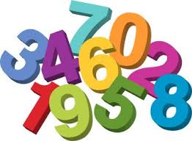
Finding Numbers in Sequential Order
How many can you find in
15 seconds?

Slide 19
Center for Academic Success

Slide 20
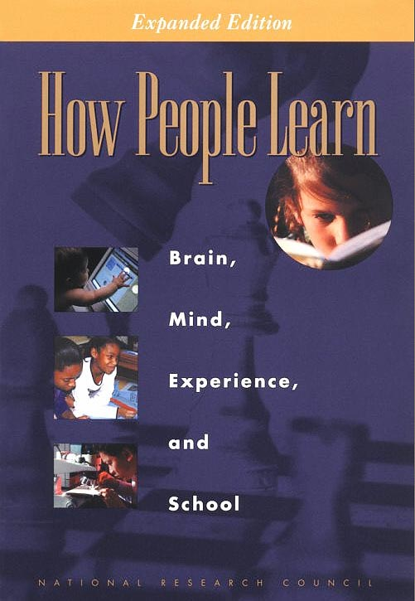
Bransford, J.D., Brown, A.L., Cocking, R.R. (Eds.), 2000. How people learn: Brain, Mind, Experience, and School. Washington, DC: National Academy Press.

Slide 21
How Can Learning Centers Significantly Impact Retention and Graduation Rates?
Bridge Programs
Tutoring
Supplemental Instruction
Faculty Workshops

Slide 22
Comparison of DFW versus FW Rates for SI
Fall 2008
Louisiana State University

Slide 23
Spring 2013 Statistics
42 SI Sections in:
Biology
Chemistry
Physics
History
Geography
Psychology
Accounting
Economics
Geology
Kinesiology
 | SI | Non-SI
Participation Rates | 42% (3475) | 58% (4762)
Average Grade | 2.66 | 2.24
DFW Rate | 18% | 30%

Slide 24
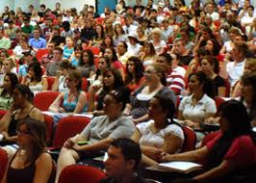
What happens when we teach metacognitive learning strategies, Bloom’s Taxonomy, and the Study Cycle to an entire class, not just individuals?

Slide 25
Performance in Gen Chem I in 2011 Based on One Learning Strategies Session*
Attended Absent
Exam 1 Avg: 71.65% 70.45%
Exam 2 Avg: 77.18% 68.90%
Final course Avg*: 81.60% 70.43%
Final Course Grade: B C
The one 50-min presentation on study and learning strategies was followed by an improvement of one full letter grade
*Cook, E.; Kennedy, E.; McGuire, S. Y. J. Chem. Educ., 2013, 90 (8), 961–967

Slide 26
Performance in Gen Chem 1202 Sp 2013 Based on One Learning Strategies Session
Attended Absent
Exam 1 Avg: 71.33% 69.27%
Homework Total: 169.8 119.1
Final course Avg*: 82.36% 67.71%
Final Course Grade: B D
The 50-min presentation on study and learning strategies was followed by an improvement of two letter grades

Slide 27
Performance in Gen Chem 1202 Sp 2015 Based on One Learning Strategies Session
Attended Absent
Exam 1, 2, 3 Avg: 68.14% 69.67%
Exam 4 Avg: 83.45% 75.91%
Final Exam Avg: 80.98% 75.24%
Final course Avg*: 84.90% 78.83%
Final Course Grade: B C
The 50-min presentation on study and learning strategies
after exam 3 was followed by an improvement of one letter grade

Slide 28
Metacognition: An Effective Tool to Promote Success
in College Science Learning*
Ningfeng Zhao¹, Jeffrey Wardeska¹, Saundra McGuire², Elzbieta Cook²
¹Department of Chemistry, East Tennessee State University
²Department of Chemistry, Louisiana State University
*March/April 2014 issue of JCST, Vol. 43, No. 4, pages 48-54

Slide 29
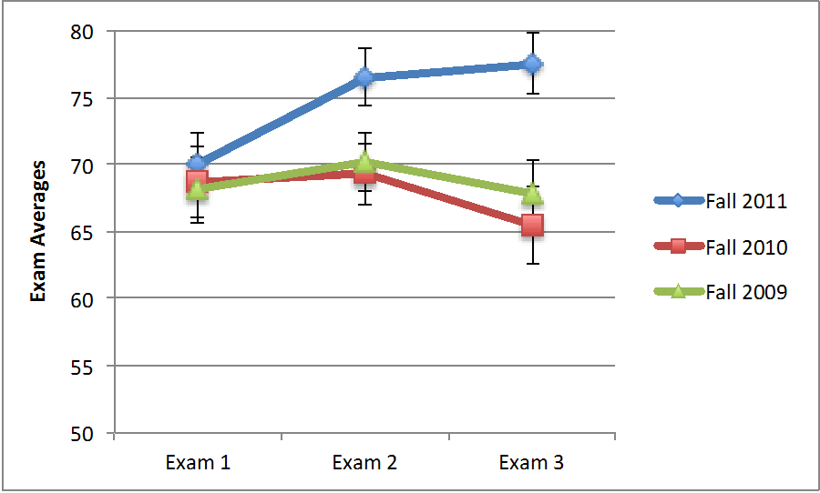
Professor Ningfeng Zhao’s Exam Averages
Intervention:
One fifty minute learning strategies session after Exam 1
Zhao, N., Wardeska, J. G., McGuire, S. Y., & Cook, E. (2014). Metacognition: An effective tool to promote success in college science learning. Journal of College Science Teaching, 43(4), 48–54.

Slide 30
Five Barriers to LC Recognition
Mindset that it is only for remedial students
Teaching and Learning Centers that focus only on faculty development
Attitude that any good, student friendly faculty or student can effectively tutor
Learning centers that are not connected to the community of scholars in this field
The absence of a clear academic pathway to a career in this area
Location, location, location!

Slide 31
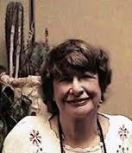
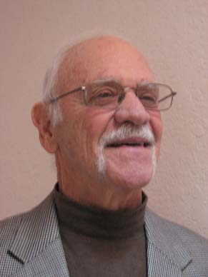
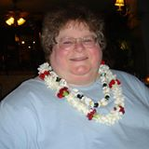
Ten Habits of Highly Effective LC Professionals
Martha
Maxwell
Frank L Christ
Claire Ellen Weinstein
How many have you adopted?

Slide 32
Present workshops at accreditation body meetings (SACS, WASC, NEASC)
Publish in learning center and discipline specific journals (with faculty)
Obtain NCLCA leadership certification; certify tutors; apply the CAS standards; etc.
Present center work at meetings outside of the learning center community (POD, NISOD, discipline specific meetings)
Offer to help the daughter, son, or other relative of an influential administrator

Slide 33
Develop a message that is NOT threatening to faculty, and present faculty development workshops
Get recognition for learning center professionals and learning centers
Work with all students – first year through graduate school, Greeks, Honor Societies, etc.
Partner with other units on campus to secure funding (e.g. Student Success & Retention, Research faculty)
Become active in national organizations such as NCLCA (nclca.org) and CRLA (crla.net)

Slide 34
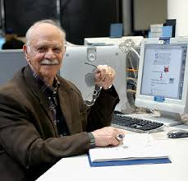
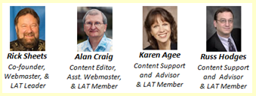
www.lsche.net
an invaluable resource
LSCHE Founders
Frank L. Christ

Slide 35
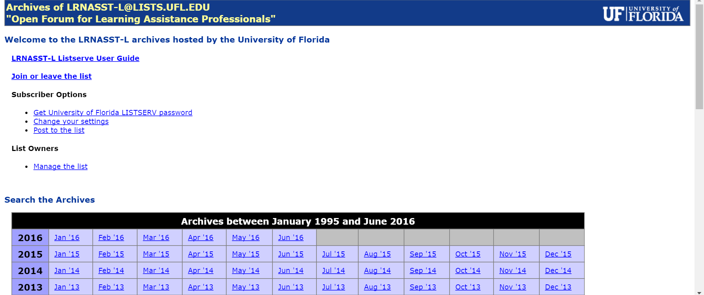
LRNASST-L Archives – A Rich Source of Information!
https://lists.ufl.edu/archives/lrnasst-l.html
Thanks to Winnie Cooke for hosting LRNASST-L!

Slide 36
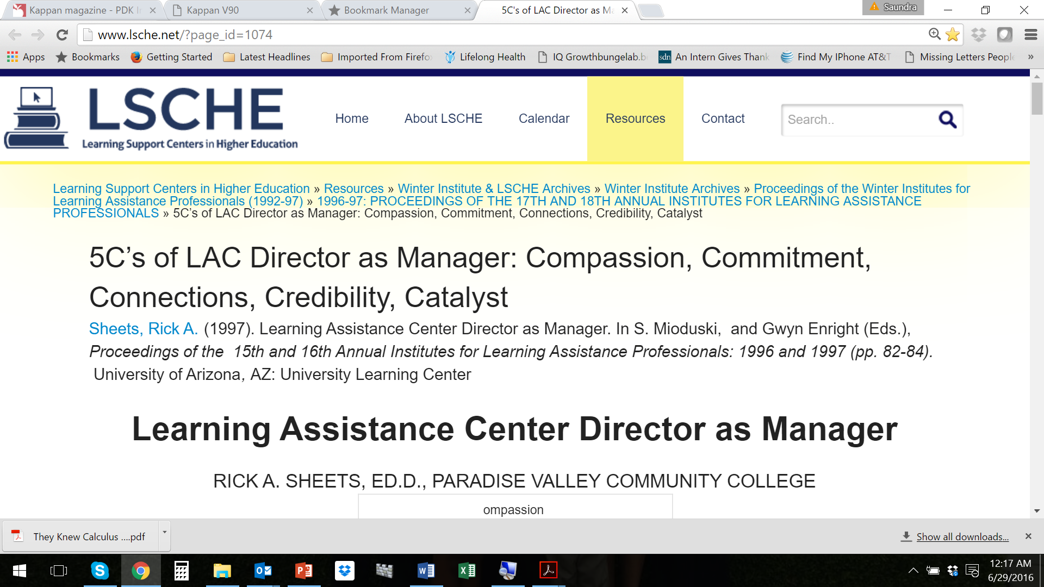
Great Reference found on LSCHE website

Slide 37
Questions to Answer
What are the characteristics of your institution and learning center (or services)
Who will be involved in moving to the center?
What actions need to be taken?
What human and financial resources will be needed?
How will you go about getting them?
What will success look like?

Slide 38
We can significantly increase the influence of the learning center!
Our institutions must value what LSCs do for ALL students
LSCs must partner with other units
LSCs must continue to be data informed, and present the data to others
LSCs must continue to improve services
LSCs must increase their presence on the national stage and pursue national and international recognition

Slide 39
LSU Center for Academic Success Recognitions
2015 NCLCA Learning Center of Excellence
2015 Division of SLE Innovation Award
2015 Division of SLE Assessment Award
2013 NASPA Promising Practices between Academic and Student Affairs Award
2012 International SI Leader Award
2012 Division of SLE Model Collaboration Award for Academic Intervention Team
2011 Division of SLE Model Collaboration Award for Success Quest
2010 NASPA Program Excellence Award for IMPACT
2004 Frank Christ Outstanding Learning Center Award
2000 Learning Support Centers in Higher Education (LSCHE) Outstanding Web Portal

Slide 40
Additional Useful Websites
www.howtostudy.org
www.drearlbloch.com
www.cas.lsu.edu
www.oncourseworkshop.com
www.khanacademy.org
Other learning support center sites

Slide 41
References
Bruer, John T. , 2000. Schools For Thought: A Science of Learning in the Classroom. MIT Press.
Burns, James MacGregor, 1978. Leadership. New York: Harper and Row.
Bransford, J.D., Brown, A.L., Cocking, R.R. (Eds.), 2000. How people learn: Brain, Mind, Experience, and School. Washington, DC: National Academy Press.
Christ, F. L., 1997. Seven Steps to Better Management of Your Study Time*. Clearwater, FL: H & H Publishing
Doyle, Terry, Zakrajsek, Todd. 2013. The New Science of Learning: How to Learn in Harmony With Your Brain. Sterling, VA: Stylus
Ellis, David, 2014. Becoming a Master Student. Boston: Cengage Learning

Slide 42
References continued
Halpern, D.F and Hakel, M.D. (Eds.), 2002. Applying the Science of Learning to University Teaching and Beyond. New York, NY: John Wiley and Sons, Inc.
Medina, John. 2008. Brain Rules. Seattle, WA: Pear Press.
Nilson, Linda, 2004. Teaching at It’s Best: A Research-Based Resource for College Instructors. Bolton, MA: Anker Publishing Company.
Taylor, S. (1999). Better learning through better thinking: Developing students’ metacognitive abilities. Journal of College Reading and Learning, 30(1), 34ff. Retrieved November 9, 2002, from Expanded Academic Index ASAP.
Zull, James (2004). The Art of Changing the Brain. Sterling, VA: Stylus Publishing.

Slide 43
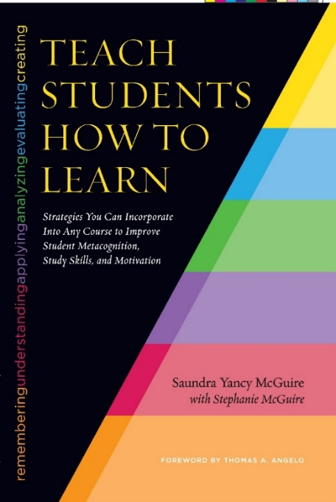
A New Reference
2016 CRLA One Book One Conference Selection
Available at 2016 NCLCA Conference Bookstore
(https://squareup.com/store/nclca)
McGuire, S.Y. & McGuire, S.N. (2015). Teach Students How to Learn: Strategies You Can Incorporate into Any Course to Improve Student Metacognition, Study Skills, and Motivation. Sterling, VA: Stylus

Slide 44
Acknowledgements
Colleagues at LSU, especially the Center for Academic Success, the Division of Student Life and Enrollment, and the Department of Chemistry
Sarah Baird, former CAS learning strategist
National College Learning Center Association (NCLCA)
College Reading and Learning Association (CRLA)
Dr. Frank Christ
The Professional and Organizational Development Network (POD)
The many students who have proven to us that metacognitive strategies really do work!

