Slide 1
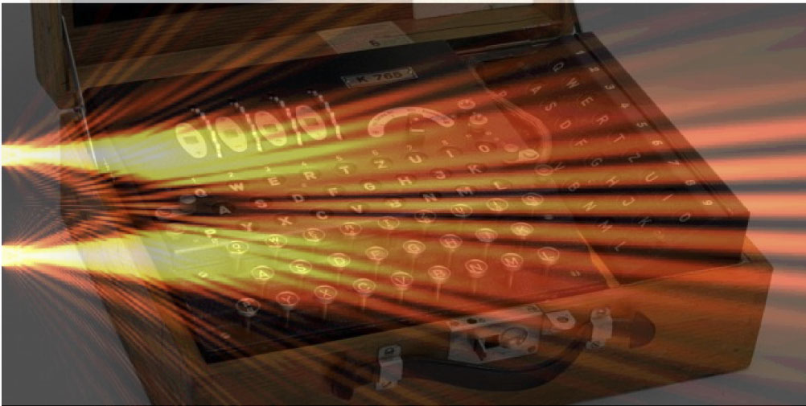
Quantum data locking, enigma machines and entropic uncertainty relations
Saikat Guha, Patrick Hayden, Hari Krovi, Seth Lloyd, Cosmo Lupo,
Jeffrey H. Shapiro, Masahiro Takeoka, Mark M. Wilde
Phys. Rev. X 4, 011016 (2014)
QUANTUM KRISPY KREME SEMINAR --- Louisiana State University --- FEB 17

Slide 2
Summary
A few words on classical cryptography
Quantum Data Locking
Cryptographic applications
Symmetric-key cryptography
(from the Caesar cipher to the enigma machine)
One time pad
(information theoretical security)
Uncertainty relations
Quantum enigma machines
Composability and robustness
Locking noisy channels
Coherent state quantum data locking
QUANTUM KRISPY KREME SEMINAR --- Louisiana State University --- FEB 17

Slide 3
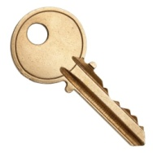
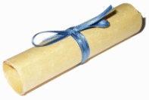
Symmetric-key cryptography
THERE IS A HOUSE IN NEW ORLEANS
Alice
(the sender)
Encryption
Eve
(the eavesdropper)
Physical medium
Decription
Bob
(the receiver)
THERE IS A HOUSE IN NEW ORLEANS

Slide 4
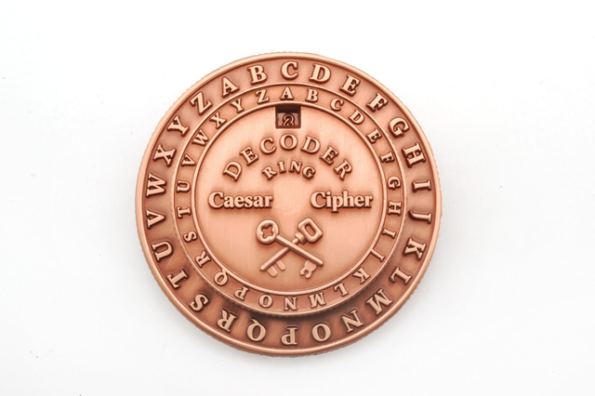
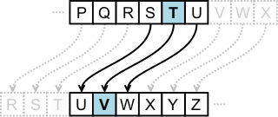
Mono-alphabetic ciphers
THERE IS A HOUSE IN NEW ORLEANS
Caesar’s cipher
T V
H J
G I
The secret key is the relative angle between the two discs
VJGTGKUCJQWUGKPPGYQTNGCPU
VJGTGKUCJQWUGKPPGYQTNGCPU
One letter is enough to uncover all the message!
Frequency analysis
THERE IS A HOUSE IN NEW ORLEANS

Slide 5
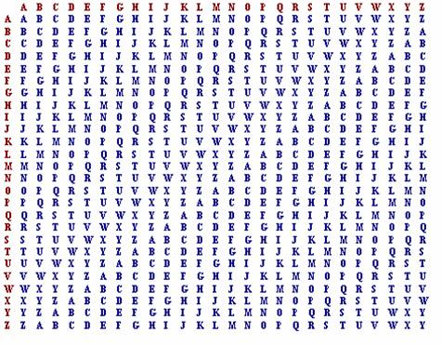
Poli-alphabetic ciphers
Alberti’s cipher Vigenère’s cipher
Plaintext
THEREISAHOUSEINNEWORLEANS
+
KEYKEYKEYKEYKEYKEYKEYKEYK
Key
DLCBIGCEFYYQOMLXIUYVIOELC
Frequency analysis on each sub-text
A 0
B 1
C 2
….
Z 25
Summation
modulo 26
The secret key is a word

Slide 6
Poli-alphabetic ciphers
Alberti’s cipher Vigenère’s cipher
0100010101000110101101001
+
Plaintext
0100100100100100100100100
0 1
0 0 1
1 1 0
Key
0000110001100010001001101
Summation
modulo 2
The secret key is a word

Slide 7
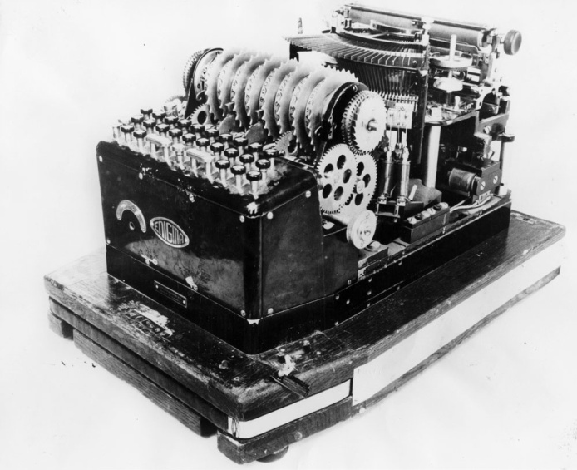
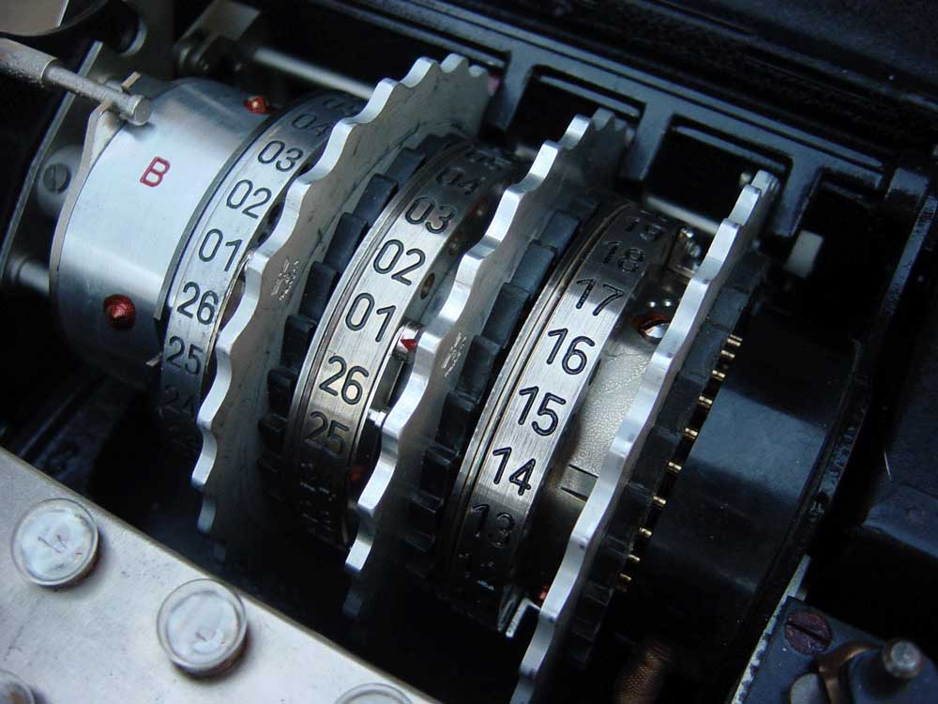
Poli-alphabetic ciphers
Enigma machine
Side information (espionage)
AND
Good algorithms (Alan Turing)
AND
Computational power (Bomba)
=
Enigma machine was cracked
Long pseudo-random key from a short random key
The secret key is the initial configuration of the rotors

Slide 8
Increasing computational power to crack

Slide 9
One time pad
Secret key is truly random
Increasing computational power to crack
We need a secret key which is truly random --- and of same length of the plaintext.
+
=
Encrypt by XOR operation (sum modulo 2)
Plaintext
Secret key
Ciphertext
Plaintext
010010110101001011…
+
100011010101010100…
=
110001100000011111…
Secret key
Ciphertext
+
=
Ciphertext
Secret key
Plaintext

Slide 10
Info-theory security
Label each message with a new variable
Ecryption with random secret key 01011
Eve try to crack the message using the best algorithm and the most powerful computer
She then guess a value of the label of the message.
00001
00010
…..
01010
01011
….
11111
10100

Slide 11
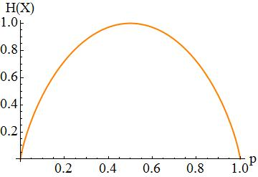
Shannon entropy
Quantify randomness and information
Example: binary variable

Slide 12
Info-theory security
Conditional probability distr.
we want it as uniform as possible
Shannon entropy:
Conditional entropy:
Mutual information:
Max number of bits of information that Eve gets about the message
Equals zero if the key is truly random and has same lenght of the message
+
=

Slide 13
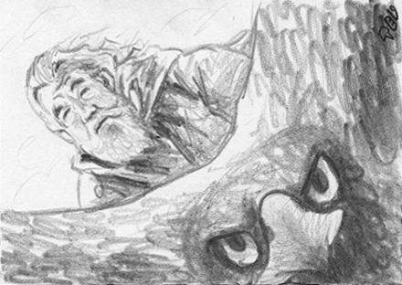
Quantum physics comes into play
QUANTUM KRISPY KREME SEMINAR --- Louisiana State University --- FEB 17
Shor algorithm (asymmetric cryptography)
Quantum key distribution (no cloning theorem)
Quantum data locking
Information theoretical security with an exponentially shorter secret key

Slide 14
Uncertainty principle
Canonically conjugate variables
Apply the log
Entropy of a Gaussian distribution
For any Gaussian state
Entropic uncertainty relations

Slide 15
Uncertainty principle
Qubit example
Basis of eigenvalues
Basis of eigenvalues
For any qubit state
Entropic uncertainty relations
Maassen and Uffink PRL 60, 1103 (1988)

Slide 16
Quantum Data Locking
0100110111101010..
n-bit message
Secret key is of 1 bit
Encryption
If 0
use basis
If 1
use basis
Physical medium
Decription
0100110111101010..
DiVincenzo et al. PRL 92, 067902 (2004)

Slide 17
Quantum Data Locking
0100110111101010..
n-bit message
Secret key is of 1 bit
Encryption
If 0
use basis
If 1
use basis
How much bits of information Eve can get at max?
“Accessible Information”
DiVincenzo et al. PRL 92, 067902 (2004)

Slide 18
Quantum Data Locking
secret bit allows us to encrypt bits. Chose one of 2 bases
secret bits allow us to encrypt bits, with K bases
Strong uncertainty relations for K observables
“Accessible Information”
with
for
Hayden et al. CMP 250, 371 (2004)
Fawzi et al. J. ACM 60 44 (2013)
Lupo et al. arXiv:1311.5212

Slide 19
m
The key corresponds to unitary transformation
Encryption
Physical medium

Slide 20
m
basis vectors
The key corresponds to unitary transformation
Encryption
Physical medium
Decription
To decrypt, apply inverse unitary and measure in standard basis
m

Slide 21
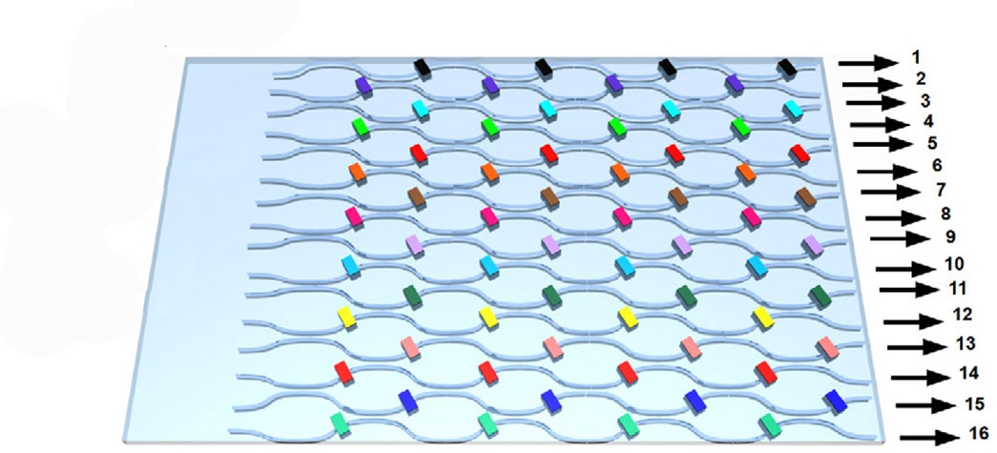
Quantum Enigma Machine
m
Encryption
Physical medium
Single photon over d modes.
Random phase-shifts generates strong data locking properties
Decription
The secret key is the combination of phase shifts
Lloyd, arXiv: 1307.0380
Lupo et al. arXiv:1311.5212
m

Slide 22
Towards cryptographic applications?
QUANTUM KRISPY KREME SEMINAR --- Louisiana State University --- FEB 17
Composability
Robustness
Locking of noisy channels

Slide 23
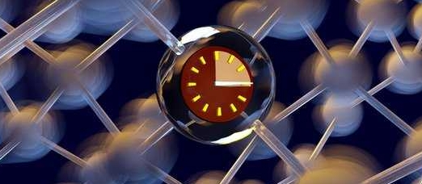
Composability
Secure
Secure
Secure??
Quantum Data Locking
Some other protocol
Composable security: The output of the protocol is still secure if used as input of another protocol
Standard security criterion in quantum cryptography.
Holevo information.
Guarantee composability.
Accessible information criterion is not composable in general
Solved by a physical assumption:
time-life of Eve’s quantum memory

Slide 24
Robustness
The strenght of quantum data locking is also its Achilles’ heel
Example:
If 1 bit can lock half of the message,
then if Eve correctly guess only 1 bit she could get half of the message.
Work in progress:
design data locking protocol which are robust under information leakage!

Slide 25
Locking noisy channels
m
All communication systems suffer from physical-layer noise
Error correction should be applied to achieve reliable (enigmatized) communication
Encryption
Decription
m

Slide 26
Locking noisy channels
m
All communication systems suffer from physical-layer noise
Error correction should be applied to achieve reliable (enigmatized) communication
Encryption
Noisy channel can always be complemented to a unitary transformation
Eve has access to the complement of Bob output.
Decription
m

Slide 27
Locking noisy channels
The price of error correction is to reduce the communication rate
The capacity of the channel is the max communication rate (with zero error for asymptotically long messages)
Thre notions of capacities:
Name Symbol Requirements
Classical capacity Reliable communication from Alice to Bob. No secrecy.
Locking capacity Reliable communication from A to B. Accessible inf. secrecy.
Private capacity Reliable communication from A to B. Holevo inf. secrecy.
Guha et al. PRX 4, 011016 (2014)

Slide 28
Locking vs Private Capacity
How big is the gap between the locking capacity and the private capacity?
Private capacity:
Composable security
Locking capacity:
Non-composable
Quantum discord
(at the output of the channel)
This gap can be very large (example by A. Winter)
Ollivier and Zurek PRL 88, 017901 (2001)
Guha et al. PRX 4, 011016 (2014)

Slide 29
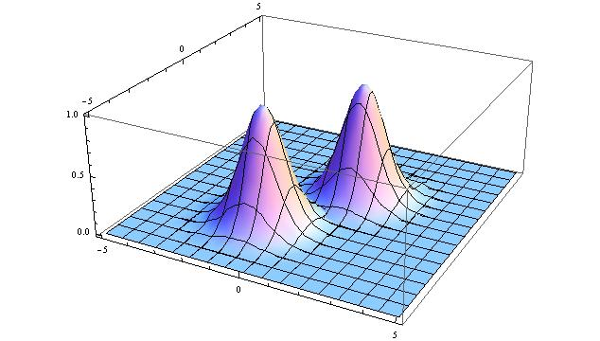
Coherent State Locking
We don’t expect strong quantum properties from semi-classical coherent-states..
Yet they are most robust and easy to prepare with current technologies.
A fundamental question is if and how coherent states can be used for data locking protocols
Encode information in multi-mode coherent states
Mean photon number per mode
bits per mode
(vacuum flucutations)
Guha et al. PRX 4, 011016 (2014)

Slide 30
Conclusions
Alternative to QKD. Quantum Enigma Machines may allow direct secret communication at higher rates.
Locking Capacity is greater than private capacity.
(Indications that the gap can be big!)
Weaker security criterion.
Physical assumption on Eve.
Robustness problem to be solved.
Explicit data locking protocol with coherent states?
QUANTUM KRISPY KREME SEMINAR --- Louisiana State University --- FEB 17
Lloyd, arXiv: 1307.0380
Guha et al. PRX 4, 011016 (2014)
Lupo et al. arXiv:1311.5212
DiVincenzo et al. PRL 92, 067902 (2004)
Hayden et al. CMP 250, 371 (2004)
Fawzi et al. J. ACM 60 44 (2013)

Slide 31
Entanglement and Locking
Entanglement
What channels have zero locking capacity?
Entanglement breaking channels have 0 locking capacity
Eve can measure her state and then recover Bob state
This implies that Eve’s accessible information cannot be lower than Bob’s one (data processing inequality)
Locking Capacity is zero for Entanglement Breaking Channels!
Guha et al. PRX 4, 011016 (2014)

