Slide 1
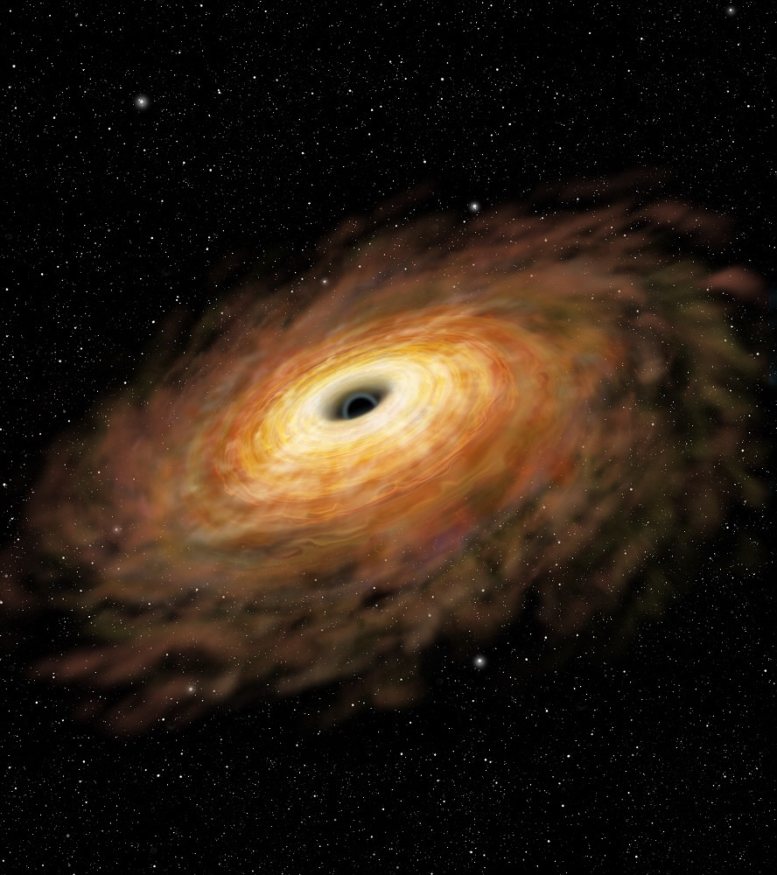


Expressibility and Trainability:
Balancing the ingredients of an effective variational quantum algorithm
Zoë Holmes, Kunal Sharma, Marco Cerezo, Andrew Arrasmith, Bin Yan, Patrick J. Coles, Andreas Albrecht, Andrew T. Sornborger
10th January 2021
LA-UR-21-31141

Slide 2
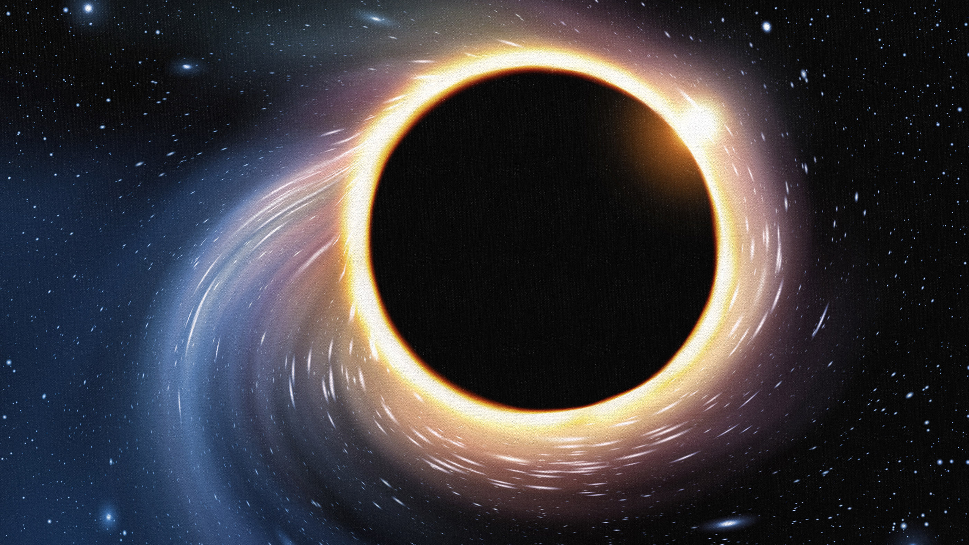

Overview
Requirements for a variational quantum algorithm to be effective:
Expressibility Trainability
1) Trade off. Can’t have both.
2) Pick your target problems carefully.
Trainability
Holmes, Z., Sharma, K., Cerezo, M., & Coles, P. J. (2021). Connecting ansatz expressibility to gradient magnitudes and barren plateaus. arXiv:2101.02138.
Holmes, Z., Arrasmith, A., Yan, B., Coles, P. J., Albrecht, A., & Sornborger, A. T. Barren plateaus preclude learning scramblers. Phys. Rev. Lett. 126, 190501, 2021.
Expressibility

Slide 3
Variational Quantum Algorithm (VQA)
Good algorithms for near term quantum computers.

Slide 4
Variational Quantum Algorithm (VQA)
Good algorithms for near term quantum computers.
Use quantum computer for classically hard subcomponent.
Off load rest of algorithm to classical computer.

Slide 5
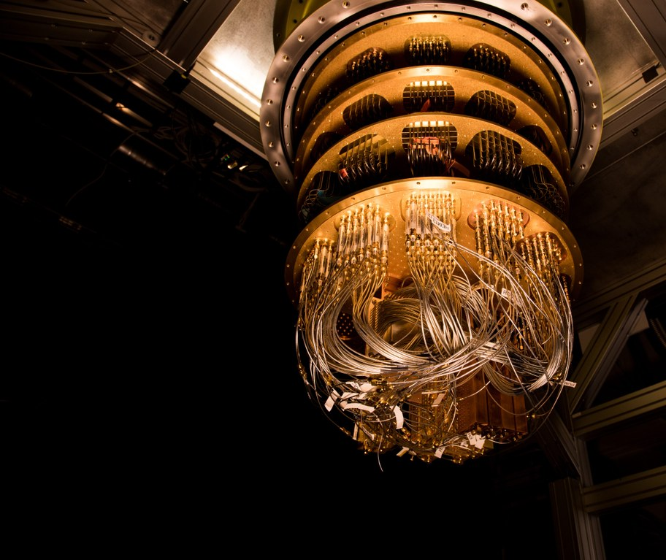

Variational Quantum Algorithm (VQA)
Good algorithms for near term quantum computers.
Use quantum computer for classically hard subcomponent.
Off load rest of algorithm to classical computer.
Quantum Computation
Classical
Computation
Measured cost function
Optimisation Loop
update circuit

Slide 6
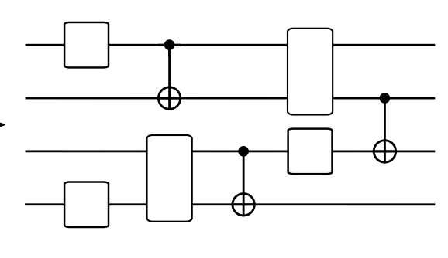
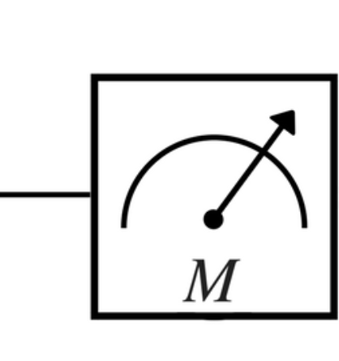
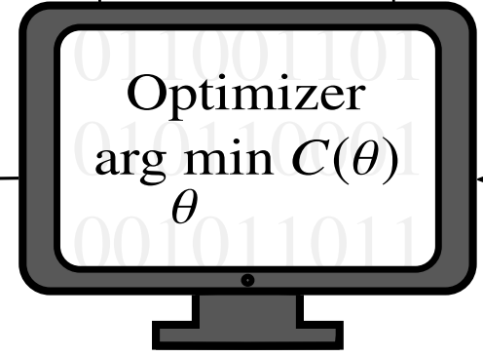





Variational Quantum Algorithm (VQA)
Quantum Computation
Measured
Cost
Classical Computation
$$θ_{1}$$
$$θ_{4}$$
$$θ_{5}$$
$$θ_{3}$$
$$θ_{2}$$
Update
parameters
Parameterised
Quantum Circuit

Slide 7



Example: The Variational Quantum Eigensolver
Quantum Computation
Measured
Cost
Classical Computation
$$θ_{1}$$
$$θ_{4}$$
$$θ_{5}$$
$$θ_{3}$$
$$θ_{2}$$
Update
parameters
Parameterised
Quantum Circuit
Minimize energy of Hamiltonian to find ground state & ground state energy
Peruzzo A, McClean, et al. Nat Commun. 2014; 5:4213.

Slide 8
Example: The Variational Quantum Eigensolver
Quantum Computation
Measured
Cost
Classical Computation
$$θ_{1}$$
$$θ_{4}$$
$$θ_{5}$$
$$θ_{3}$$
$$θ_{2}$$
Update
parameters
Parameterised
Quantum Circuit
Minimize energy of Hamiltonian to find ground state & ground state energy
Useful for:
quantum chemistry, condensed matter, + much more
Peruzzo A, McClean, et al. Nat Commun. 2014; 5:4213.

Slide 9
Example: Variational Quantum Algorithm to Learn a Unitary
Quantum Computation
Measured
Cost
Classical Computation
$$θ_{1}$$
$$θ_{4}$$
$$θ_{5}$$
$$θ_{3}$$
$$θ_{2}$$
Update
parameters
Parameterised
Quantum Circuit
Pick cost such that unitary that minimizes it matches the target unitary
Task:
Optimised
quantum circuit
Target unitary

Slide 10
Example: Variational Quantum Algorithm to Learn a Unitary
Quantum Computation
Measured
Cost
Classical Computation
$$θ_{1}$$
$$θ_{4}$$
$$θ_{5}$$
$$θ_{3}$$
$$θ_{2}$$
Update
parameters
Parameterised
Quantum Circuit
General form for compiling cost:
Task:
Optimised
quantum circuit
Target unitary
Prepare state

Slide 11
Example: Variational Quantum Algorithm to Learn a Unitary
Quantum Computation
Measured
Cost
Classical Computation
$$θ_{1}$$
$$θ_{4}$$
$$θ_{5}$$
$$θ_{3}$$
$$θ_{2}$$
Update
parameters
Parameterised
Quantum Circuit
General form for compiling cost:
Task:
Optimised
quantum circuit
Target unitary
Evolve under target unitary

Slide 12
Example: Variational Quantum Algorithm to Learn a Unitary
Quantum Computation
Measured
Cost
Classical Computation
$$θ_{1}$$
$$θ_{4}$$
$$θ_{5}$$
$$θ_{3}$$
$$θ_{2}$$
Update
parameters
Parameterised
Quantum Circuit
General form for compiling cost:
Task:
Optimised
quantum circuit
Target unitary
Apply inverse of parameterised quantum circuit

Slide 13
Example: Variational Quantum Algorithm to Learn a Unitary
Quantum Computation
Measured
Cost
Classical Computation
$$θ_{1}$$
$$θ_{4}$$
$$θ_{5}$$
$$θ_{3}$$
$$θ_{2}$$
Update
parameters
Parameterised
Quantum Circuit
General form for compiling cost:
Task:
Optimised
quantum circuit
Target unitary
measure

Slide 14
Example: Variational Quantum Algorithm to Learn a Unitary
Quantum Computation
Measured
Cost
Classical Computation
$$θ_{1}$$
$$θ_{4}$$
$$θ_{5}$$
$$θ_{3}$$
$$θ_{2}$$
Update
parameters
Parameterised
Quantum Circuit
General form for compiling cost:
Task:
Optimised
quantum circuit
Target unitary
Cost measures average gate fidelity
e.g. with

Slide 15
Example: Variational Quantum Algorithm to Learn a Unitary
Quantum Computation
Measured
Cost
Classical Computation
$$θ_{1}$$
$$θ_{4}$$
$$θ_{5}$$
$$θ_{3}$$
$$θ_{2}$$
Update
parameters
Parameterised
Quantum Circuit
Pick cost such that unitary that minimizes it matches the target unitary
Task:
Optimised
quantum circuit
Target unitary

Slide 16
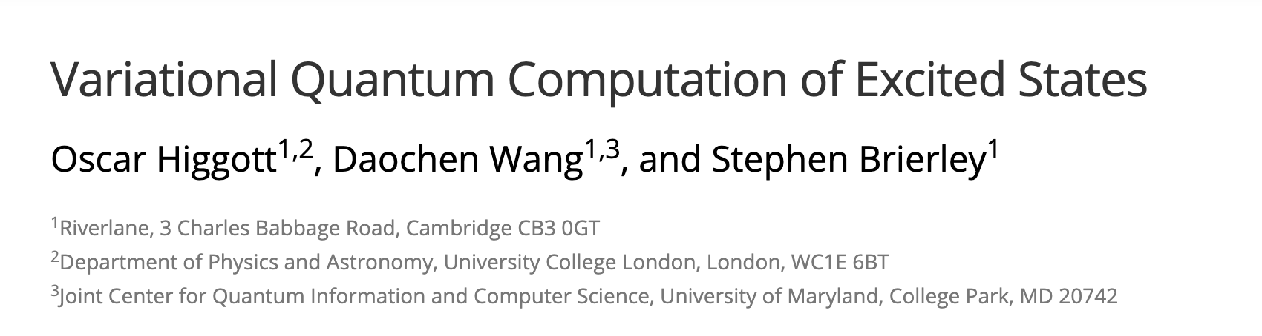

Slide 17
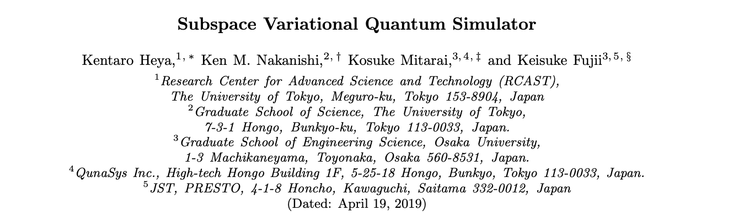

Slide 18
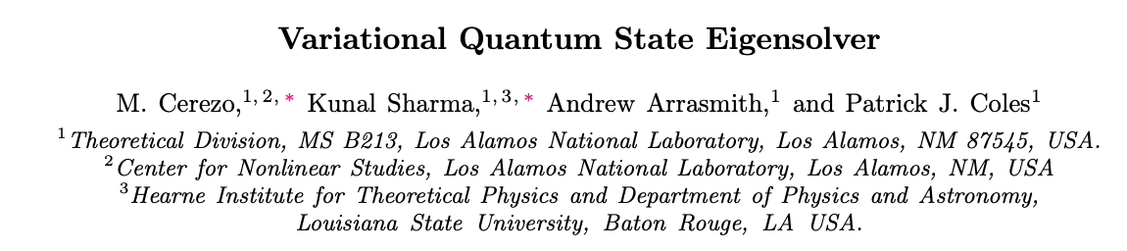

Slide 19
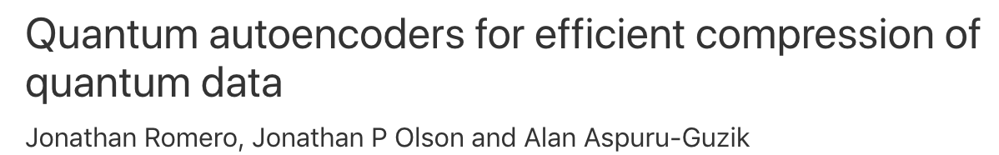

Slide 20
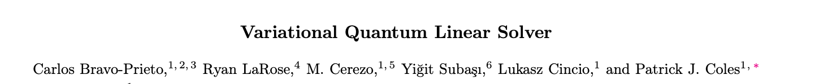

Slide 21


Slide 23
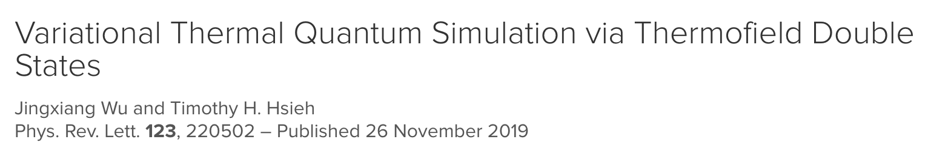

Slide 24
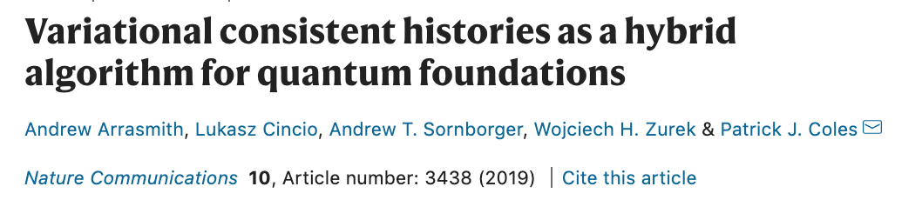

Slide 25
Lots of promising algorithms
But really need more analytic results to quantify their expected performance

Slide 26





Overview of framework
Consider cost functions of the form:
Initial state
Measurement Operator
Parameterized Quantum circuit
$$θ_{1}$$
$$θ_{4}$$
$$θ_{5}$$
$$θ_{3}$$
$$θ_{2}$$

Slide 27
Overview of framework
Consider cost functions of the form:
Need to pick your cost function such that it is faithful:
Set of
(approximate)
solutions

Slide 28
Overview of framework
Consider cost functions of the form:
Need to pick your cost function such that it is faithful:
Need to pick an ansatz for your parameterized quantum circuit
Set of
(approximate)
solutions

Slide 29
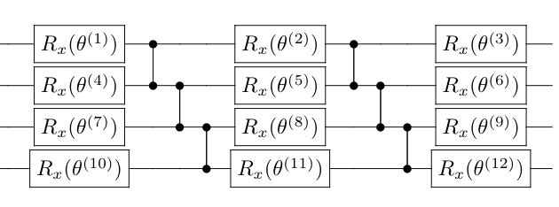
Overview of framework
Consider cost functions of the form:
Need to pick your cost function such that it is faithful:
Need to pick an ansatz for your parameterized quantum circuit
Set of
(approximate)
solutions
Generally,
Parameterised rotations:
Fixed gates

Slide 30
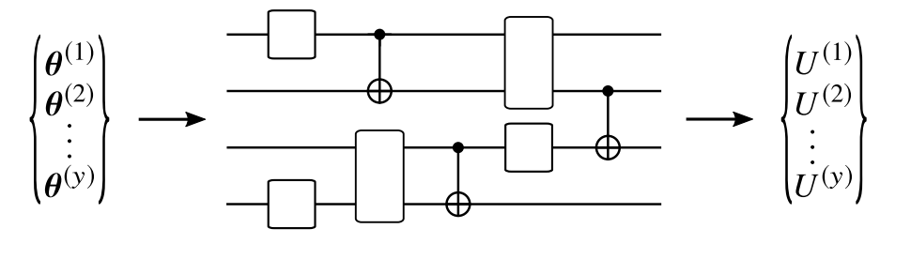
Overview of framework
Consider cost functions of the form:
Need to pick your cost function such that it is faithful:
Need to pick an ansatz for your parameterized quantum circuit
Set of
(approximate)
solutions
Generally,
Input parameters
Output unitary
Parameterised rotations:
Fixed gates

Slide 31
Overview of framework
Consider cost functions of the form:
Need to pick your cost function such that it is faithful:
Need to pick an ansatz for your parameterized quantum circuit
Set of
(approximate)
solutions
Generally,
Parameterised rotations:
Fixed gates
Set of
different parameters
Set of accessible
unitaries

Slide 32
Ingredients for a successful VQA: Completeness
Set of
(approximate)
solutions
Set of
accessible
unitaries
For the VQA to be successful need a solution unitary to be captured by ansatz:
When this condition is satisfied the ansatz is said to be complete
Ansatz complete with respect to problem A but not problem B:

Slide 33
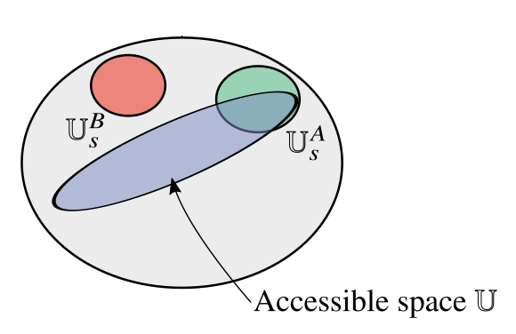
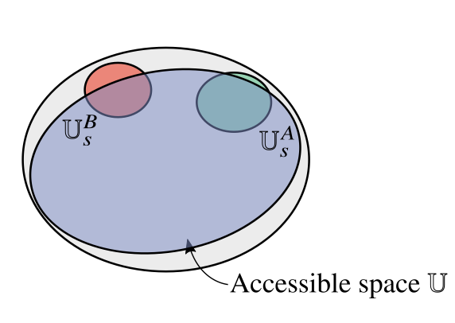
Ingredients for a successful VQA: Expressibility
In the absence of prior knowledge, best bet is to use an ansatz that explores the space of unitaries as fully and uniformally as possible.
Such ansatze are known as expressive ansatze
Inexpressive
Expressive

Slide 34
Ingredients for a successful VQA: Expressibility
Expressibility can be quantified by comparing to the maximally expressible uniform (Haar) distribution of unitaries
Inexpressive
Expressive

Slide 35
Ingredients for a successful VQA: Expressibility
Expressibility superoperator
Expressibility can be quantified by comparing to the maximally expressible uniform (Haar) distribution of unitaries
Inexpressive
Expressive

Slide 36
Ingredients for a successful VQA: Expressibility
Expressibility can be quantified by comparing to the maximally expressible uniform (Haar) distribution of unitaries
If then forms a t-design
More loosely, t-design = ensemble that looks random when considering functions of only t copies U

Slide 37
Ingredients for a successful VQA: Expressibility
Expressibility can be quantified by comparing to the maximally expressible uniform (Haar) distribution of unitaries
If then forms a t-design
More loosely, t-design = ensemble that looks random when considering functions of only t copies U
e.g. the average cost over an ensemble of unitaries that form a 1 design is equivalent to an average over a random distribution
Sim, S., Johnson, P. D., & Aspuru‐Guzik, A. (2019), Advanced Quantum Technologies, 2(12), 1900070.

Slide 38
Ingredients for a successful VQA: Expressibility
Expressibility can be quantified by comparing to the maximally expressible uniform (Haar) distribution of unitaries
If then forms a t-design
More loosely, t-design = ensemble that looks random when considering functions of only t copies U
e.g. but the average cost squared (and so the variance) over an ensemble of unitaries that form a 1 design is not equivalent to an average over a random distribution

Slide 39
Ingredients for a successful VQA: Expressibility
Expressibility can be quantified by comparing to the maximally expressible uniform (Haar) distribution of unitaries
If then forms a t-design
More loosely, t-design = ensemble that looks random when considering functions of only t copies U
e.g. but the average cost squared (and so the variance) over an ensemble of unitaries that form a 2 design IS equivalent to an average over a random distribution

Slide 40
Ingredients for a successful VQA: Expressibility
Expressibility can be quantified by comparing to the maximally expressible uniform (Haar) distribution of unitaries
If then forms a 2-design

Slide 41
Ingredients for a successful VQA: Expressibility
Expressibility can be quantified by comparing to the maximally expressible uniform (Haar) distribution of unitaries
Recall we are interested in minimizing
Cost function dependent measures of expressibility
Inexpressive: large
Expressive: small

Slide 42
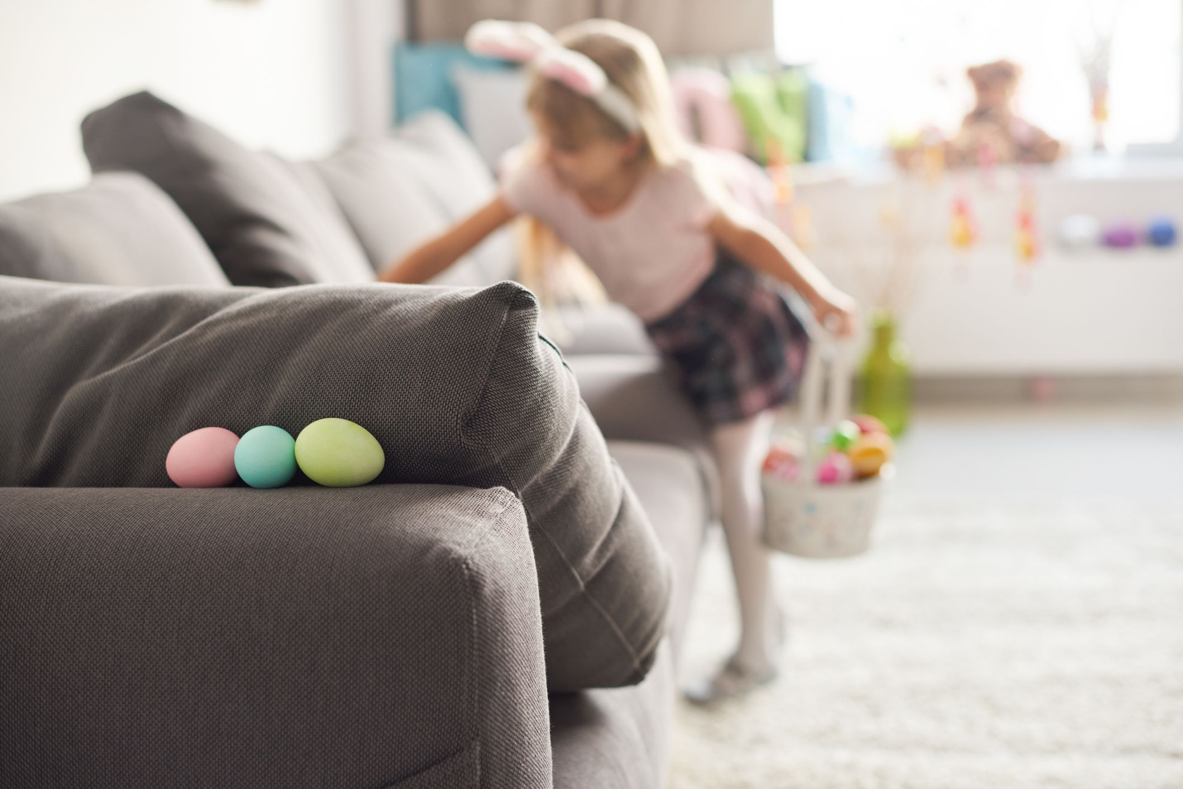
Ingredients for a successful VQA: Trainability
Just because the ansatz contains the solution…

Slide 43
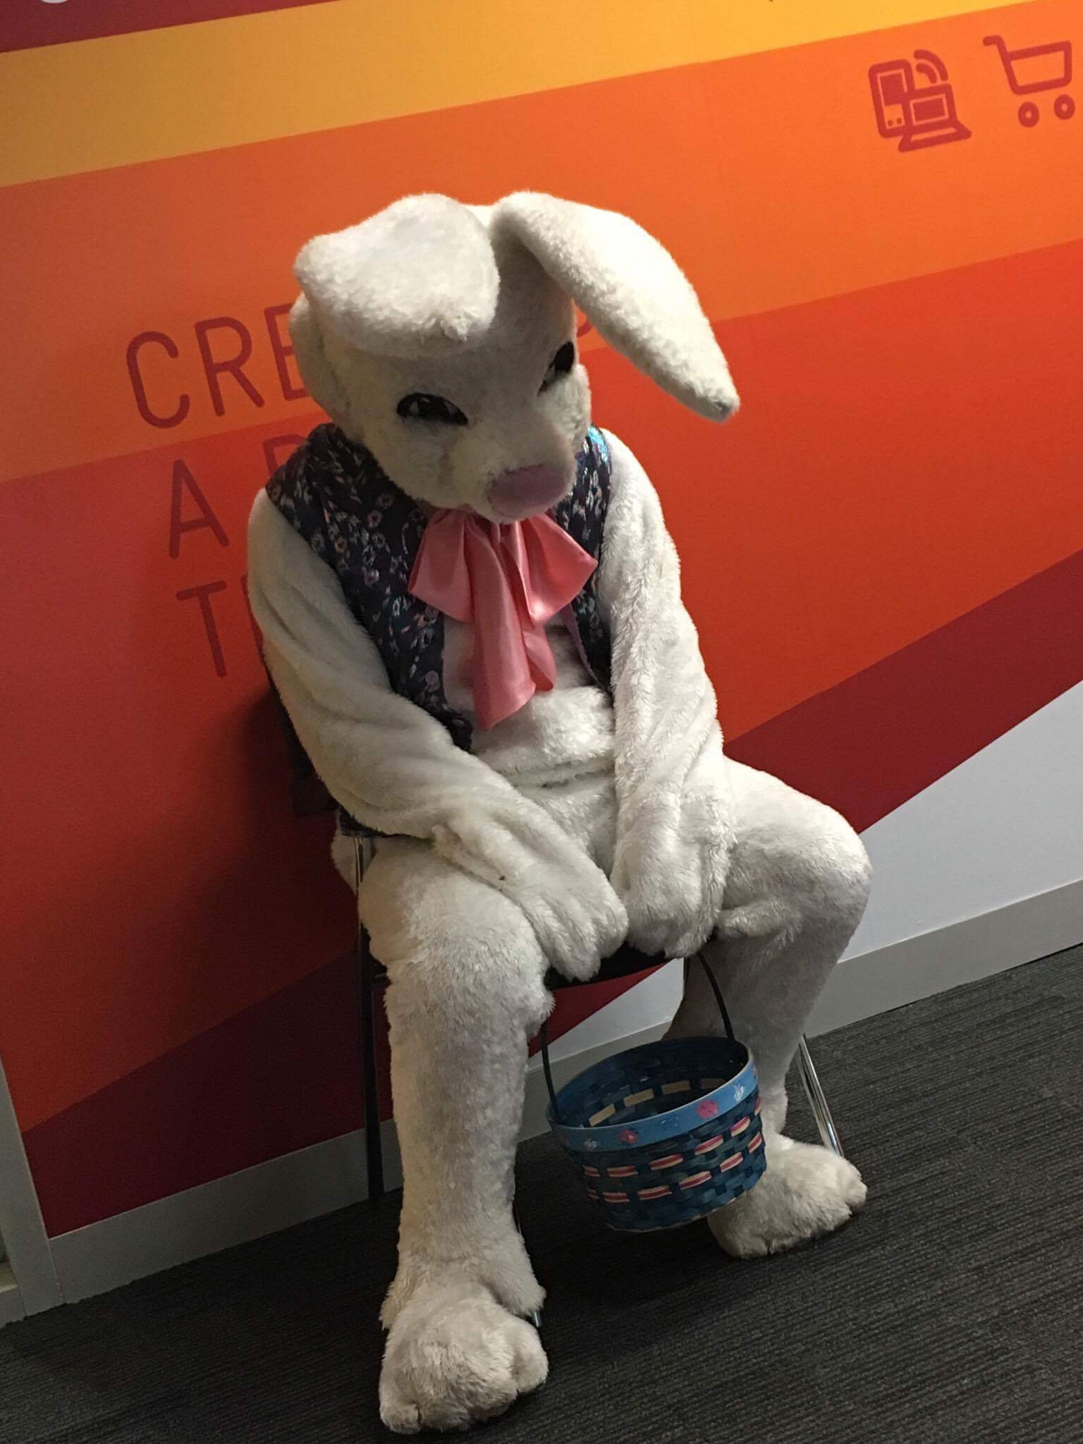
Ingredients for a successful VQA: Trainability
Just because the ansatz contains the solution… doesn’t mean you can find it…

Slide 44
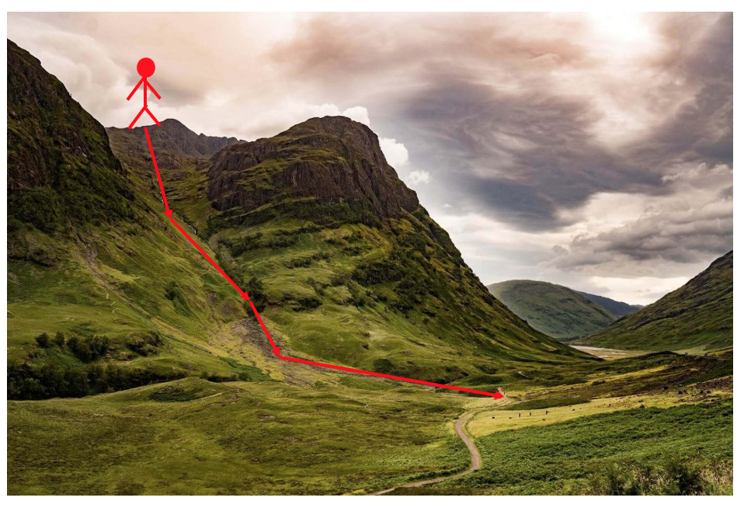
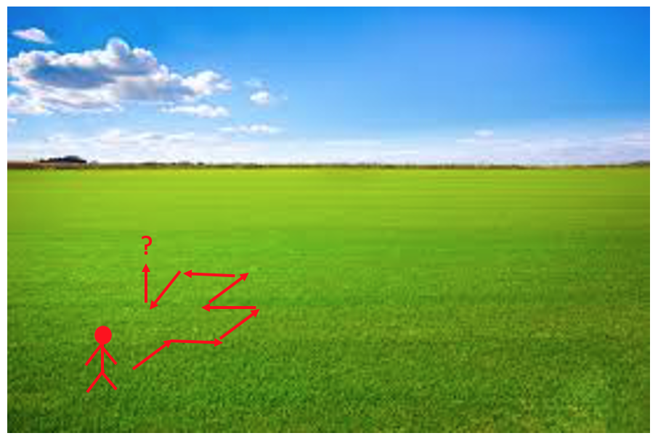
Barren Plateaus
The cost landscape needs to be sufficiently featured to enable training

Slide 45
Barren Plateaus
The cost landscape needs to be sufficiently featured to enable training
Small gradients high precision required to resource intensive
find cost minimizing direction
( shots are required
estimate a cost to precision )

Slide 46
Barren Plateaus
The cost landscape needs to be sufficiently featured to enable training
How do we know if our landscape is nice and textured or flat and untrainable?

Slide 47
Barren Plateaus
Assess trainability of a VQA by studying expected cost gradients
The average cost gradient vanishes
Chebyshev's inequality:
Small variance entails small cost gradients.

Slide 48
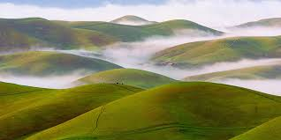
Barren Plateaus
Assess trainability of a VQA by studying expected cost gradients
The average cost gradient vanishes
Chebyshev's inequality:
Small variance entails small cost gradients.

Slide 49
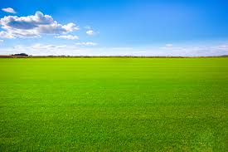
Barren Plateaus
Assess trainability of a VQA by studying expected cost gradients
The average cost gradient vanishes
Chebyshev's inequality:
Small variance entails small cost gradients.

Slide 50
Barren Plateaus
Assess trainability of a VQA by studying expected cost gradients
The average cost gradient vanishes
Chebyshev's inequality:
Small variance entails small cost gradients.

Slide 51
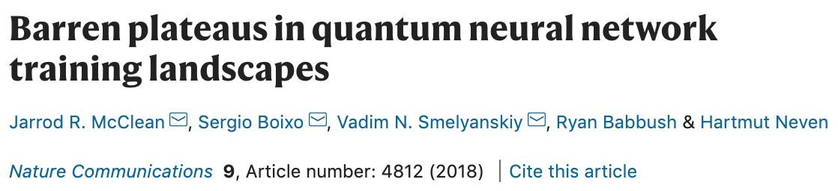
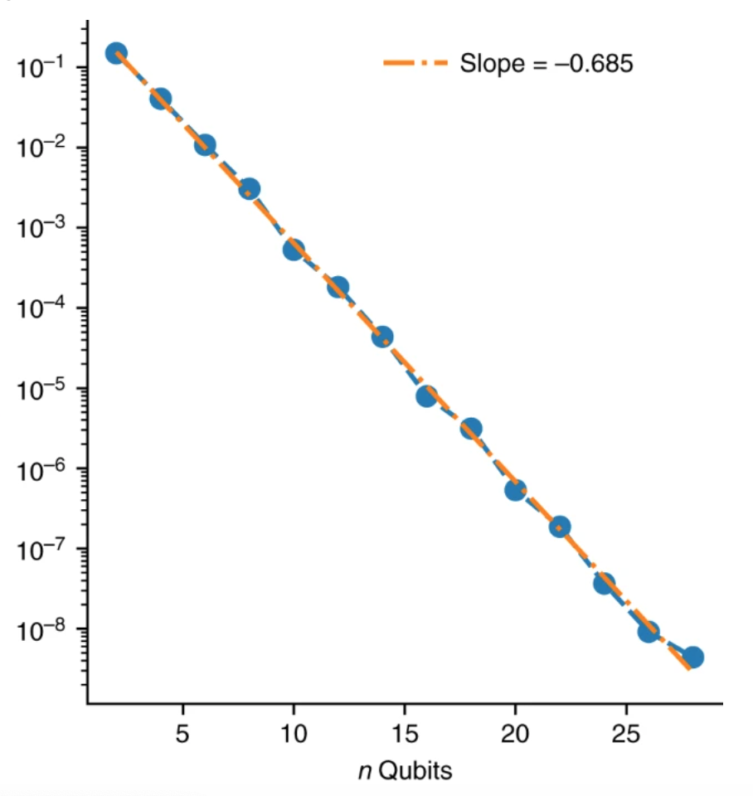
Barren Plateaus
If forms a 2-design then:
barren plateau phenomena
Probability of non-zero gradients vanishes exponentially with problem size.
Shot required for training grows exponentially with problem size.

Slide 52
Barren Plateaus
Perfectly expressible ansatze are untrainable
If is perfectly expressive
barren plateau phenomena
Probability of non-zero gradients vanishes exponentially with problem size.
Shot required for training grows exponentially with problem size.

Slide 53
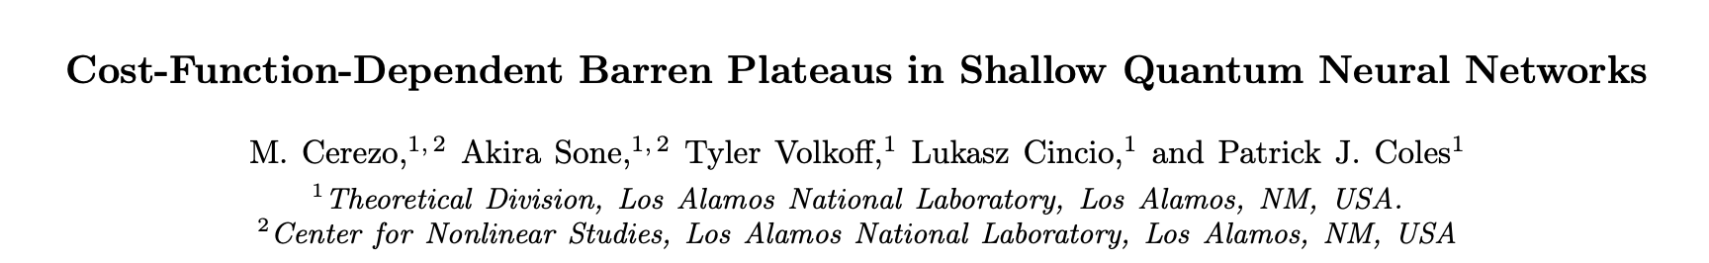
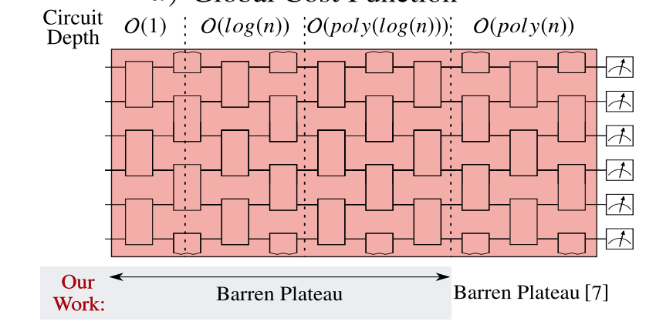
Barren Plateaus
But the converse isn’t true….
Global Cost:
H acts non-trivially on all qubits
Inexpressive ansatz can be untrainable
Single layer (highly inexpressive!) ansatz with global cost has barren plateau

Slide 54
Trade off between Trainability and Expressibility
Perfectly expressible ansatze are untrainable.
Inexpressive ansatze are not always trainable.
Can we formalize this trade off?

Slide 55
Trade off between Trainability and Expressibility
We derive an upper bound on the variance in cost gradients in terms of the expressibility
The higher the expressibility of the ansatz, that is the smaller , the smaller the upper bound on the variance of the cost partial derivative.
Highly expressive ansatze will have flatter landscapes and consequently be harder to train.
Variance of gradient of cost with arbitrary ansatz
Variance of gradient of cost for maximally expressive ansatz
Expressibility measures

Slide 56
Trade off between Trainability and Expressibility
Upper bound leaves wiggle room. Inexpressive ansatze may (but are not guaranteed) not exhibit large cost gradients.
Prompts question: when/how can reducing the expressibility of an ansatz increase expressibility?
We explore this numerically…

Slide 57
Trade off between Trainability and Expressibility

Slide 58
Trade off between Trainability and Expressibility
Restricting rotation angles

Slide 59
Conclusions 1
Take home message:
Use problem inspired, rather than maximally expressive, ansatze.
Trainability
Expressibility
And it’s Expressibility who’s gotta leave…
Job for future: come up with
good problem inspired ansatze

Slide 60
Conclusions 1
Take home message:
Use problem inspired, rather than maximally expressive, ansatze.
Trainability
Expressibility
And it’s Expressibility who’s gotta leave…
Job for future: come up with
good problem inspired ansatze
BUT some problems are untrainable no matter how clever your ansatz is…

Slide 61
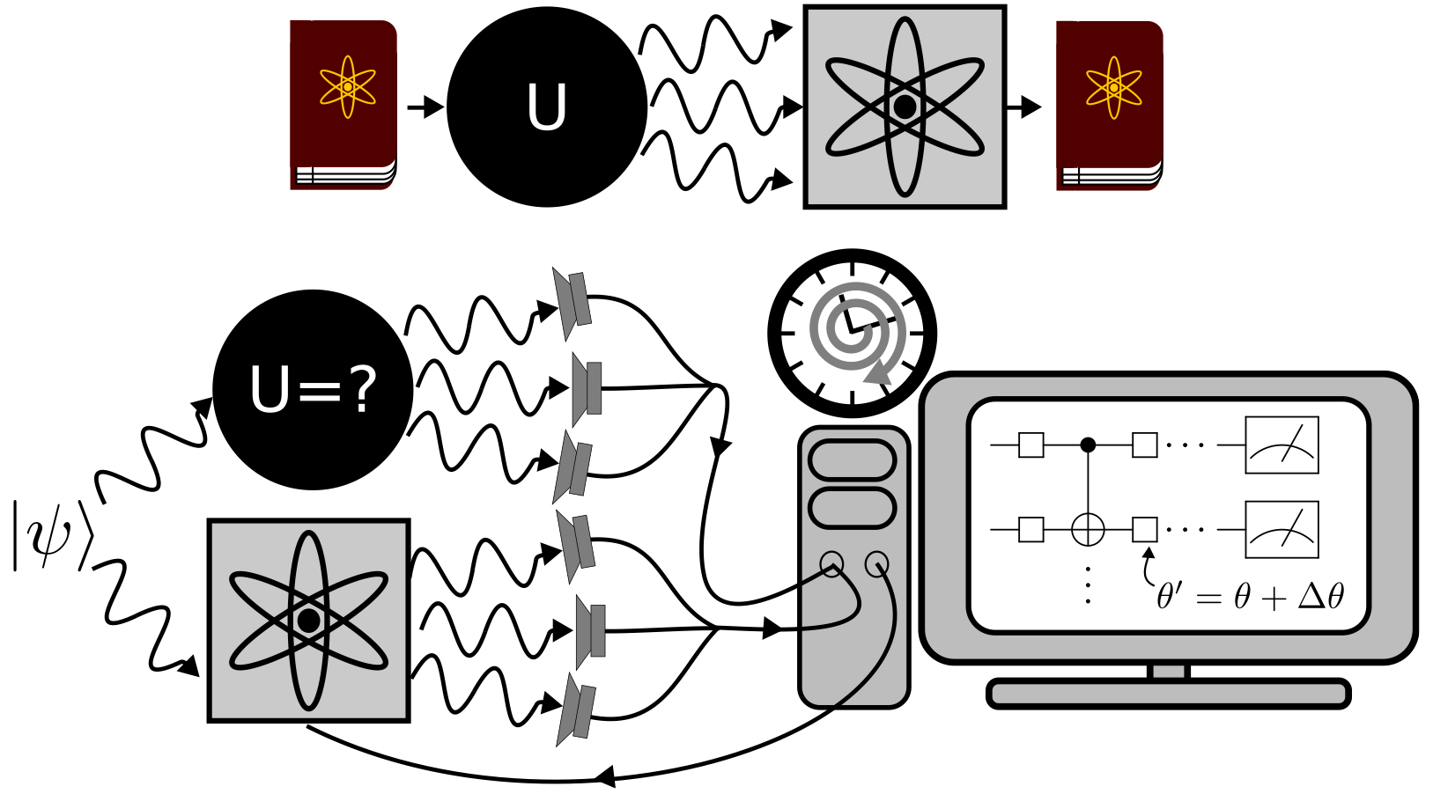
Hayden-Preskill Thought Experiment
Alice throws her diary into a black hole, can Bob recover it?

Slide 62
Hayden-Preskill Thought Experiment
Alice throws her diary into a black hole, can Bob recover it?
(Looks unlikely… ? )

Slide 63
Hayden-Preskill Thought Experiment
Alice throws her diary into a black hole, can Bob recover it?
But actually…. if he knows the scrambling unitary implemented by the black hole, then yes.

Slide 64
Hayden-Preskill Thought Experiment
Alice throws her diary into a black hole, can Bob recover it?
But actually…. if he knows the scrambling unitary implemented by the black hole, then yes.
But how could he learn that unitary?

Slide 65
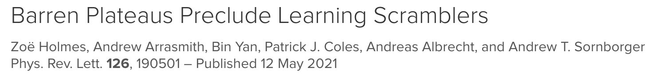
Hayden-Preskill Thought Experiment
Alice throws her diary into a black hole, can Bob recover it?
But actually…. if he knows the scrambling unitary implemented by the black hole, then yes.
But how could he learn that unitary?
Not using a variational quantum algorithm…

Slide 66
Quantum Scrambling

Slide 67
Quantum Scrambling
Scrambling = the rapid spread of entanglement and information through many-body quantum systems.

Slide 68
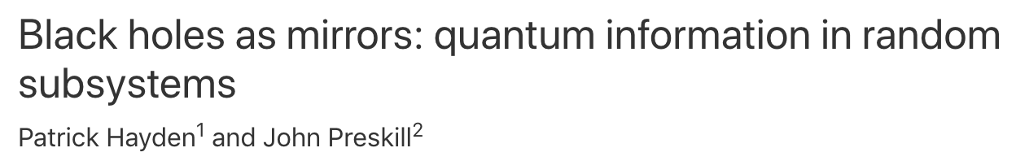
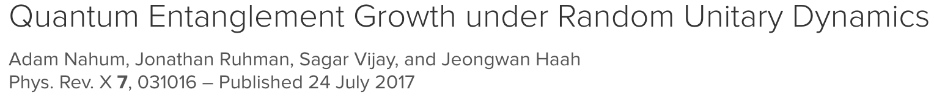
Quantum Scrambling
Scrambling = the rapid spread of entanglement and information through many-body quantum systems.
Central to understanding:
  black hole physics

Slide 69
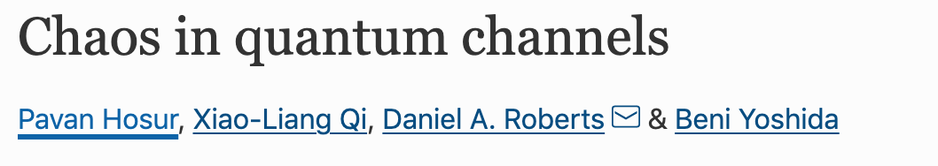
Quantum Scrambling
Scrambling = the rapid spread of entanglement and information through many-body quantum systems.
Central to understanding:
  black hole physics
  quantum information

Slide 70
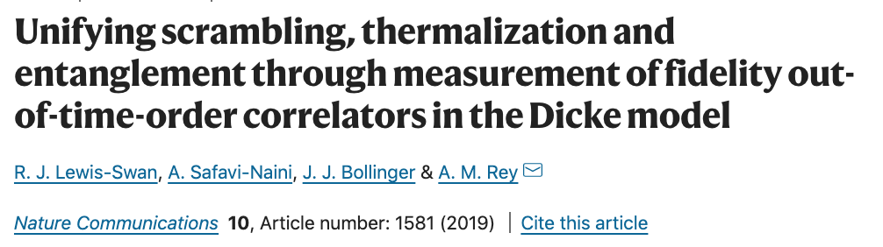
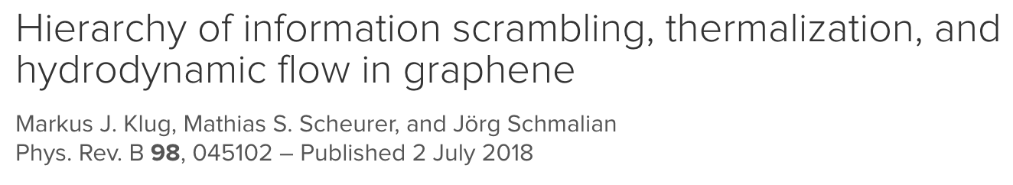
Quantum Scrambling
Scrambling = the rapid spread of entanglement and information through many-body quantum systems.
Central to understanding:
  black hole physics
  quantum information
  thermalization phenomena

Slide 71
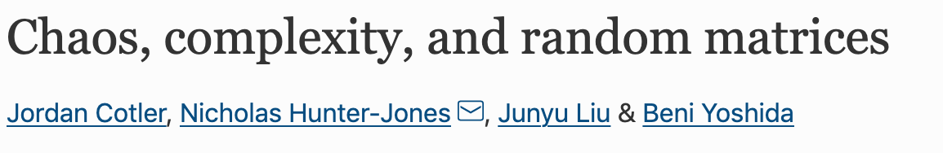
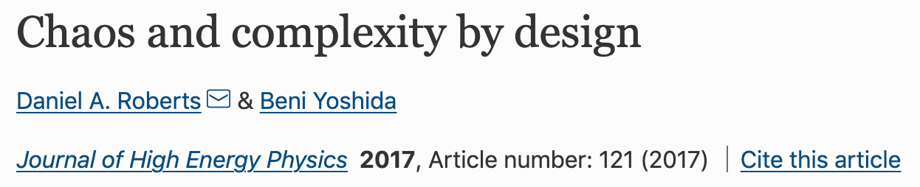
Quantum Scrambling
Scrambling = the rapid spread of entanglement and information through many-body quantum systems.
Central to understanding:
  black hole physics
  quantum information
  thermalization phenomena
  random circuits

Slide 72
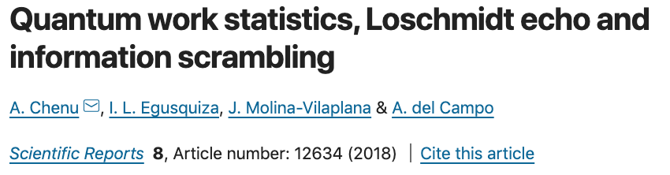

Quantum Scrambling
Scrambling = the rapid spread of entanglement and information through many-body quantum systems.
Central to understanding:
  black hole physics
  quantum information
  thermalization phenomena
  random circuits
  fluctuation relations

Slide 73
Quantum Scrambling
Scrambling = the rapid spread of entanglement and information through many-body quantum systems.
Central to understanding:
  black hole physics
  quantum information
  thermalization phenomena
  random circuits
  fluctuation relations
  And more (that I don’t have space on my slide for) ….

Slide 74
Quantum Scrambling
Scrambling = the rapid spread of entanglement and information through many-body quantum systems.
The Out-of-time-ordered correlator (OTOC) diagnoses scrambling

Slide 75
Quantum Scrambling
Scrambling = the rapid spread of entanglement and information through many-body quantum systems.
The Out-of-time-ordered correlator (OTOC) diagnoses scrambling
X and Y are local operators

Slide 76
Quantum Scrambling
Scrambling = the rapid spread of entanglement and information through many-body quantum systems.
The Out-of-time-ordered correlator (OTOC) diagnoses scrambling
X and Y are local operators
is the time evolved initial operator X = X(0)

Slide 77
Quantum Scrambling
Scrambling = the rapid spread of entanglement and information through many-body quantum systems.
The Out-of-time-ordered correlator (OTOC) diagnoses scrambling
X and Y are local operators
is the time evolved initial operator X = X(0)
The average is taken over an infinite temperature state

Slide 78
Quantum Scrambling
Scrambling = the rapid spread of entanglement and information through many-body quantum systems.
The Out-of-time-ordered correlator (OTOC) diagnoses scrambling
X and Y are local operators
is the time evolved initial operator X = X(0)
The average is taken over an infinite temperature state
The OTOC of a scrambled system rapidly decays

Slide 79
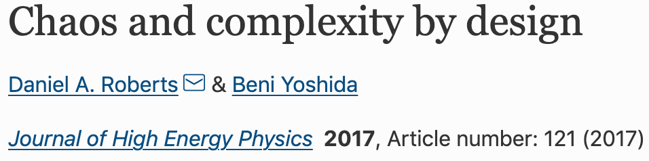
Quantum Scrambling
Scrambling = the rapid spread of entanglement and information through many-body quantum systems.
The Out-of-time-ordered correlator (OTOC) diagnoses scrambling
X and Y are local operators
is the time evolved initial operator X = X(0)
The average is taken over an infinite temperature state
The OTOC of a scrambled system rapidly tends to a minimal value that is equivalent to taking its average over a random distribution of unitaries.

Slide 80
Quantum Scrambling
Scrambling = the rapid spread of entanglement and information through many-body quantum systems.
The Out-of-time-ordered correlator (OTOC) diagnoses scrambling
X and Y are local operators
is the time evolved initial operator X = X(0)
The average is taken over an infinite temperature state
The OTOC of a scrambled system rapidly tends to a minimal value that is equivalent to taking its average over a random distribution of unitaries.
Can model a scrambling unitary as a typical random unitary

Slide 81
Quantum Scrambling
Scrambling = the rapid spread of entanglement and information through many-body quantum systems.
The Out-of-time-ordered correlator (OTOC) diagnoses scrambling
X and Y are local operators
is the time evolved initial operator X = X(0)
The average is taken over an infinite temperature state
The OTOC of a scrambled system rapidly tends to a minimal value that is equivalent to taking its average over a random distribution of unitaries.
Only involves 2 copies of
Can model a scrambling unitary as a typical random unitary

Slide 82
Quantum Scrambling
Scrambling = the rapid spread of entanglement and information through many-body quantum systems.
The Out-of-time-ordered correlator (OTOC) diagnoses scrambling
X and Y are local operators
is the time evolved initial operator X = X(0)
The average is taken over an infinite temperature state
The OTOC of a scrambled system rapidly tends to a minimal value that is equivalent to taking its average over a distribution of unitaries that agrees with random distribution up to the second moment (i.e. a 2-design)
Only involves 2 copies of
Can model a scrambling unitary as a typical (pseudo) random unitary
(a unitary drawn from a 2-design)

Slide 83
Quantum Scrambling
Scrambling = the rapid spread of entanglement and information through many-body quantum systems.
The Out-of-time-ordered correlator (OTOC) diagnoses scrambling
X and Y are local operators
is the time evolved initial operator X = X(0)
The average is taken over an infinite temperature state
The OTOC of a scrambled system rapidly tends to a minimal value that is equivalent to taking its average over a distribution of unitaries that agrees with random distribution up to the second moment (i.e. a 2-design)
Only involves 2 copies of
Can model a scrambling unitary as a typical (pseudo) random unitary
(a unitary drawn from a 2-design)
Can we use a variational quantum algorithm to learn/compile a target scrambling unitary?

Slide 84
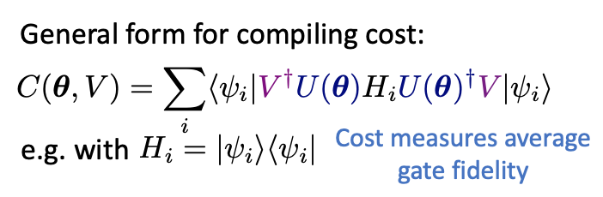
Quantum Scrambling
Scrambling = the rapid spread of entanglement and information through many-body quantum systems.
The Out-of-time-ordered correlator (OTOC) diagnoses scrambling
X and Y are local operators
is the time evolved initial operator X = X(0)
The average is taken over an infinite temperature state
The OTOC of a scrambled system rapidly tends to a minimal value that is equivalent to taking its average over a distribution of unitaries that agrees with random distribution up to the second moment (i.e. a 2-design)
Only involves 2 copies of
Can model a scrambling unitary as a typical (pseudo) random unitary
(a unitary drawn from a 2-design)
Can we use a variational quantum algorithm to learn/compile a target scrambling unitary?

Slide 85
Barren Plateaus preclude learning Scramblers
Average over ensemble of pseudo random unitaries/scramblers
We prove that for compiling costs to learn a scrambling unitary (i.e. a unitary drawn from a 2 design):
The average cost gradient vanishes
The variance in the gradient of the cost vanishes exponentially
the probability the gradient of the cost is non-zero vanishes exponentially with the size of the problem (n).

Slide 86
Barren Plateaus preclude learning Scramblers
Average over ensemble of random unitaries/scramblers
We prove that for compiling costs to learn a scrambling unitary (i.e. a unitary drawn from a 2 design):
The average cost gradient vanishes
The variance in the gradient of the cost vanishes exponentially
The probability the gradient of the cost is non-zero for a typical scrambler vanishes exponentially with the size of the problem (n).

Slide 87
Barren Plateaus preclude learning Scramblers
Average over ensemble of random unitaries/scramblers
Crucially, this holds for any choice in ansatz.
We prove that for compiling costs to learn a scrambling unitary (i.e. a unitary drawn from a 2 design):
The average cost gradient vanishes
The variance in the gradient of the cost vanishes exponentially
The probability the gradient of the cost is non-zero for a typical scrambler vanishes exponentially with the size of the problem (n).

Slide 88
Barren Plateaus preclude learning Scramblers
Average over ensemble of random unitaries/scramblers
Crucially, this holds for any choice in ansatz.
We prove that for compiling costs to learn a scrambling unitary (i.e. a unitary drawn from a 2 design):
The average cost gradient vanishes
The variance in the gradient of the cost vanishes exponentially
The probability the gradient of the cost is non-zero for a typical scrambler vanishes exponentially with the size of the problem (n).
No go theorem for learning of scramblers using VQAs/QML

Slide 89
Barren Plateaus preclude learning Scramblers
Strong scramblers: Landscape forms a barren plateau with only a narrow gorge where cost dips to minimum.
Weaker scramblers: Valley wider and plateau more featured allowing for training.
highly scrambling
Model of scrambler/ansatz:
non-scrambling
Belyansky, R., Bienias, P., Kharkov, Y. A., Gorshkov, A. V., & Swingle, B. (2020). Minimal Model for Fast Scrambling. Physical Review Letters, 125(13), 130601.

Slide 90
Barren Plateaus preclude learning Scramblers
Cost gradients decrease with increasing time and so increased scrambling
Exponentially vanishing cost gradients (i.e. a barren plateau) for strong scramblers

Slide 91
Barren Plateaus preclude learning Scramblers
Cost gradients decrease with increasing time and so increased scrambling
Exponentially vanishing cost gradients (i.e. a barren plateau) for strong scramblers

Slide 92
Conclusions 2
Barren plateau exhibited by scramblers

Slide 93
Conclusions 2
Barren plateau exhibited by scramblers and typical random unitaries

Slide 94
Conclusions 2
Barren plateau exhibited by scramblers and typical random unitaries
Randomness is a barrier to trainability

Slide 95
Conclusions 2
Barren plateau exhibited by scramblers and typical random unitaries
Randomness is a barrier to trainability
Take home message:
There are fundamental limits to QML.

Slide 96
Conclusions 2
Barren plateau exhibited by scramblers and typical random unitaries
Randomness is a barrier to trainability
Take home message:
There are fundamental limits to QML.
Further research needed into what systems can be learnt.

Slide 97
Overview
Requirements for a variational quantum algorithm to be effective:
Expressibility Trainability
1) Trade off. Can’t have both.
2) Pick your target problems carefully.
Trainability
Holmes, Z., Sharma, K., Cerezo, M., & Coles, P. J. (2021). Connecting ansatz expressibility to gradient magnitudes and barren plateaus. arXiv:2101.02138.
Holmes, Z., Arrasmith, A., Yan, B., Coles, P. J., Albrecht, A., & Sornborger, A. T. Barren plateaus preclude learning scramblers. Phys. Rev. Lett. 126, 190501, 2021.
Expressibility

Slide 99

Quantum Machine Learning (QML)
training data
Classical
Computation
Quantum Computation
Optimization Loop
“Any method that optimizes a parameterized quantum circuit by minimizing a quantum cost function (potentially using training data)”

Slide 100
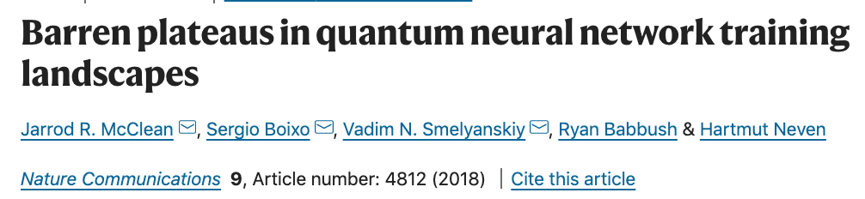


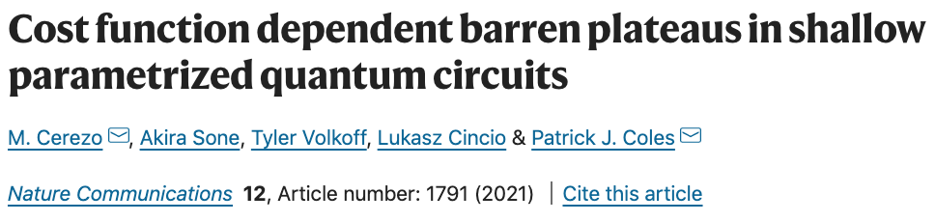
Barren Plateaus
Barren plateau phenomena can be induced by
Choice in circuit:
Too expressive
Too entangling
Choice in cost function (globality of measurement):
Choice in target learning problem

Slide 101
Example: Variational Quantum Algorithm to Learn a Unitary
Quantum Computation
Measured
Cost
Classical Computation
$$θ_{1}$$
$$θ_{4}$$
$$θ_{5}$$
$$θ_{3}$$
$$θ_{2}$$
Update
parameters
Parameterised
Quantum Circuit
Also consider more general compiling costs:
Task:
Optimised
quantum circuit
Target unitary
Allows for entangled training data
Allows for dissipative ansatzes

