Slide 1
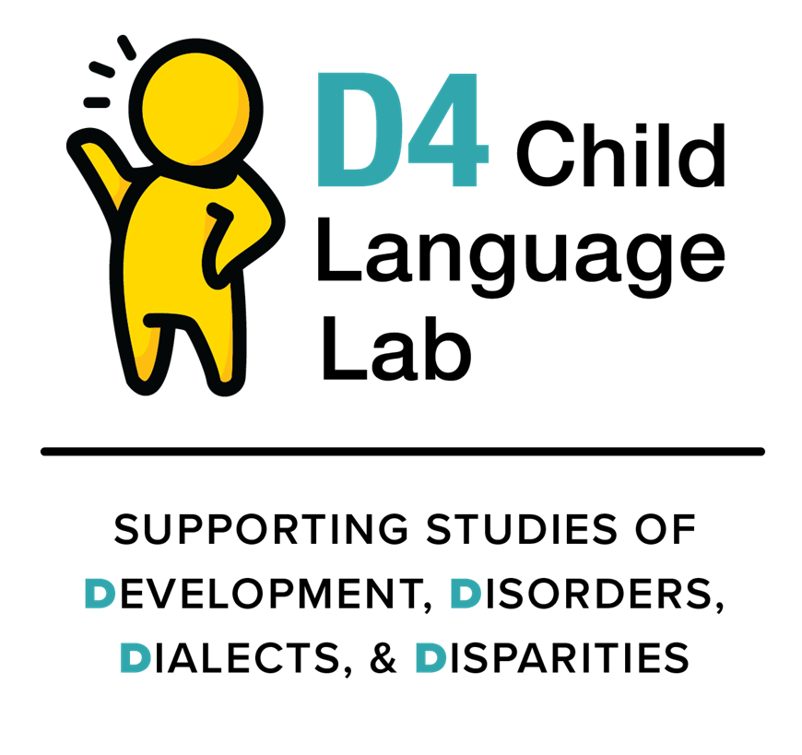
Messaging about DLD
Some Thoughts and Suggestions
Oetting, 2021, with special thanks to Erin Bonfanti and the students in COMD 7750, Spring, 2020

Slide 2
What are Linguistic Microaggressions?
Brief, everyday exchanges that send negative messages to individuals because of the way they talk.
Microaggression deals with a class of utterances or sentences that, given the context of their production, are ambiguous: they are potentially insulting or invalidating, but the insult is plausibly deniable.
Unambiguously Negative: Your outfit looks dumb.
Ambiguous: Your outfit looks [pause] so interesting.
Intent vs. Effect
Taylor Jones, https://www.languagejones.com/blog-1/2016/9/8/oi6379payz9mb4diadulndc244gq1s

Slide 3
Do we have ambiguous messaging about DLD?
If we do, we may be unintentionally engaging in linguistic microaggressions.
If we do, we should work to change our messaging.
The next two infographics were created as supplements to a recent article in the ASHA Leader. The infographics were cut for space. I’m offering these infographics to spark dialogue. I’d love to learn more about ways to improve my messaging. Please share tips!
https://leader.pubs.asha.org/do/10.1044/leader.FMP.25112020.12/full/

Slide 4
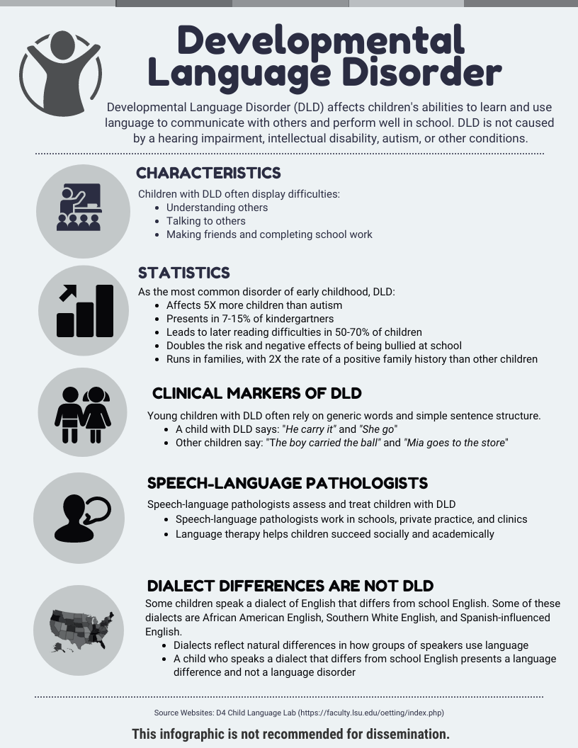
Let’s look at this first infographic.
It was created using a
Dialect vs. Disorder
Framework
Pretty standard content, eh?
Now let’s think about this content through a microaggression lens.

Slide 5
Look for ambiguity in the messaging.
If our messaging is ambiguous,
we may be engaging
in microaggressions.

Slide 6
Ambiguous
DLD affects children's abilities to learn and use language to communicate with others and perform well in school. DLD is not caused by a hearing impairment, intellectual disability, autism, or other conditions.
Young children with DLD often rely on generic words and simple sentence structure.
A child with DLD says: “He carry it” and “She go”.
Other children say: “The boy carried the ball” and “Mia goes to the store”.
Some nonmainstream dialect speakers may also struggle with language and school for different reasons. They are invisible in this paragraph.
OR
Dialects are treated as an “Other” condition, along with various childhood disorders. Neither interpretation is positive or affirming.
Examples may be relevant for mainstream dialects of English, but they are not relevant for all dialects of English when presented without more context.

Slide 7
Ambiguous
Dialect differences are not DLD. Some children speak a dialect that differs from school English. Some of these dialects are African American English, Southern White English, and Spanish-Influenced English.
Dialects are natural differences in how groups of speakers use language. A child who speaks a dialect that differs from school English presents a difference and not a disorder.
Well, that’s great to know but what does DLD look like in these other dialects?
Again, good to know but what does DLD look like in these other dialects?
Does our field care about DLD within dialects other than mainstream English?

Slide 8
From a
microaggression
lens,
there is ambiguity
in what seemed like a
pretty good
infographic.
AMBIGUOUS

Slide 9
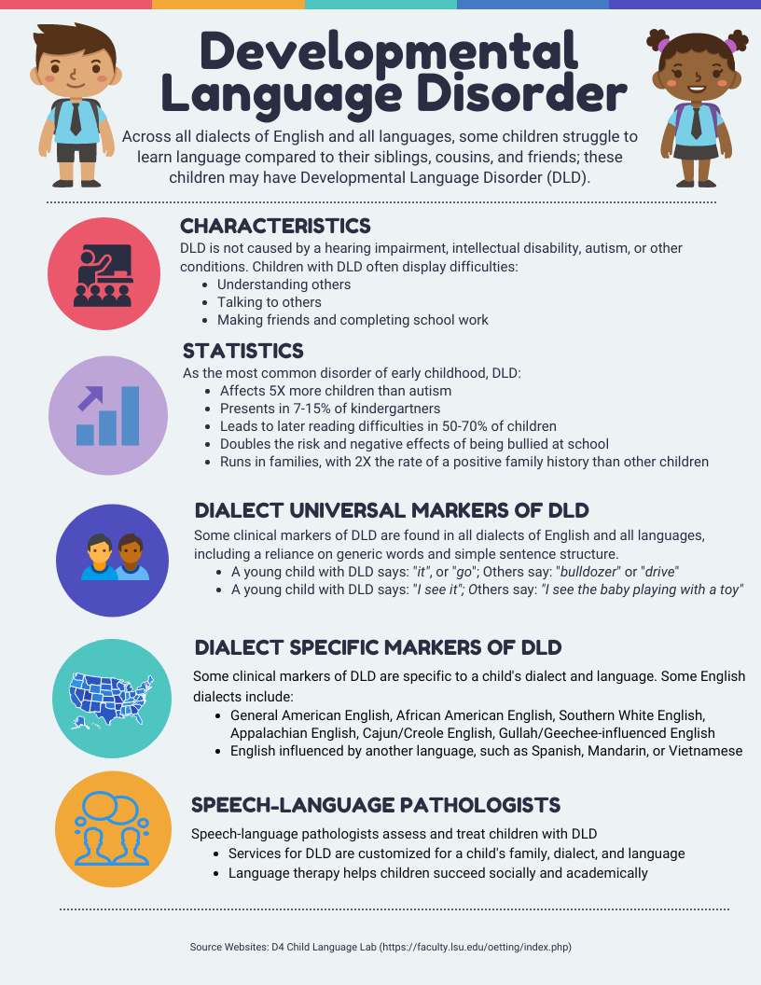
Let’s look at a second infographic.
Same content, but it is much more inclusive and unambiguous. It was written from a
Disorder within Dialects Framework

Slide 10
Unambiguous
Across all dialects of English and all languages, some children struggle to learn language and perform well in school compared to their siblings, cousins, and friends; these children may have DLD. DLD is not caused by a hearing impairment, intellectual disability, autism, or other conditions.
Dialect Universal Markers: Some clinical markers of DLD are found in all dialects of English and all languages, including a reliance on generic words and simple sentence structure.
Dialect Specific Markers: Some clinical markers of DLD are specific to a child’s dialect and language.
SLP services are customized for a child’s family, dialect, and language.
All dialects and languages are included. Reference is to children in the same dialect/language community.
Sends a message that SLPs work with children who present with DLD within ALL dialects and ALL languages.

Slide 11
Small Changes = Big Impact

Slide 12
Final Product!
Where else
might we revise
our messaging about
Childhood DLD?

