Slide 1
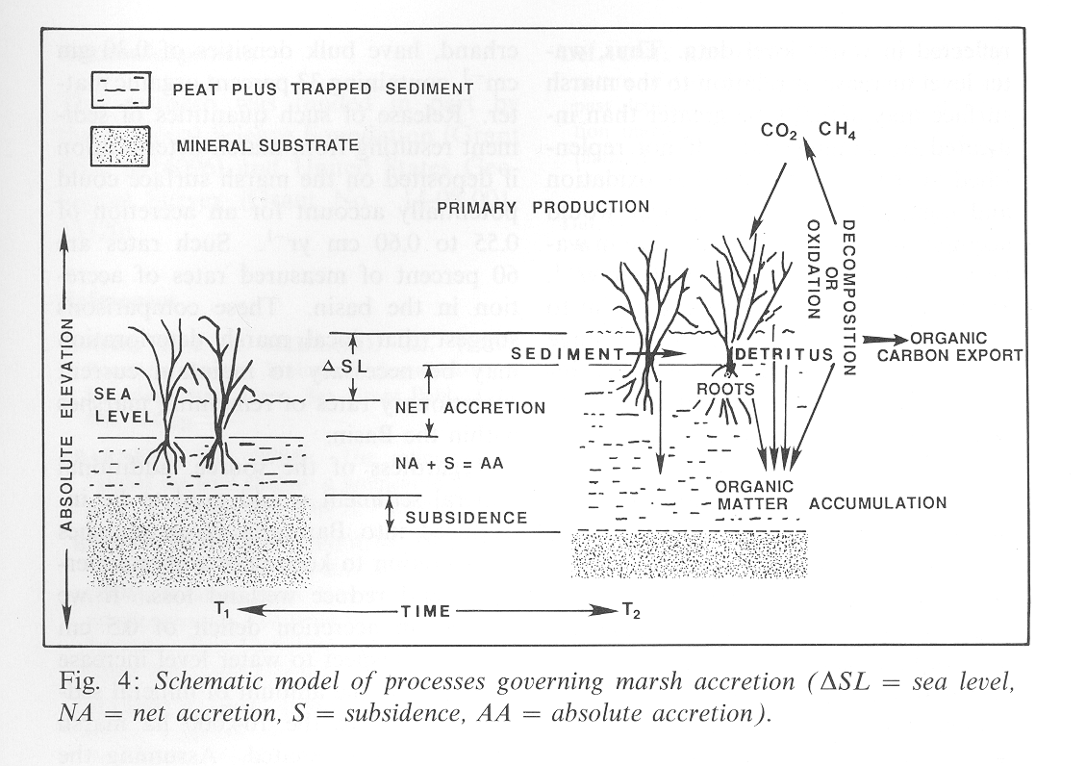
Workshop for Coastal Wetland Wildlife Managers
21 – 25 May 2018,
Rockefeller Refuge, Grand Chenier, Louisiana
pond
pond
modified from DeLaune et al. 1990. Catena 17:277-288

Slide 2
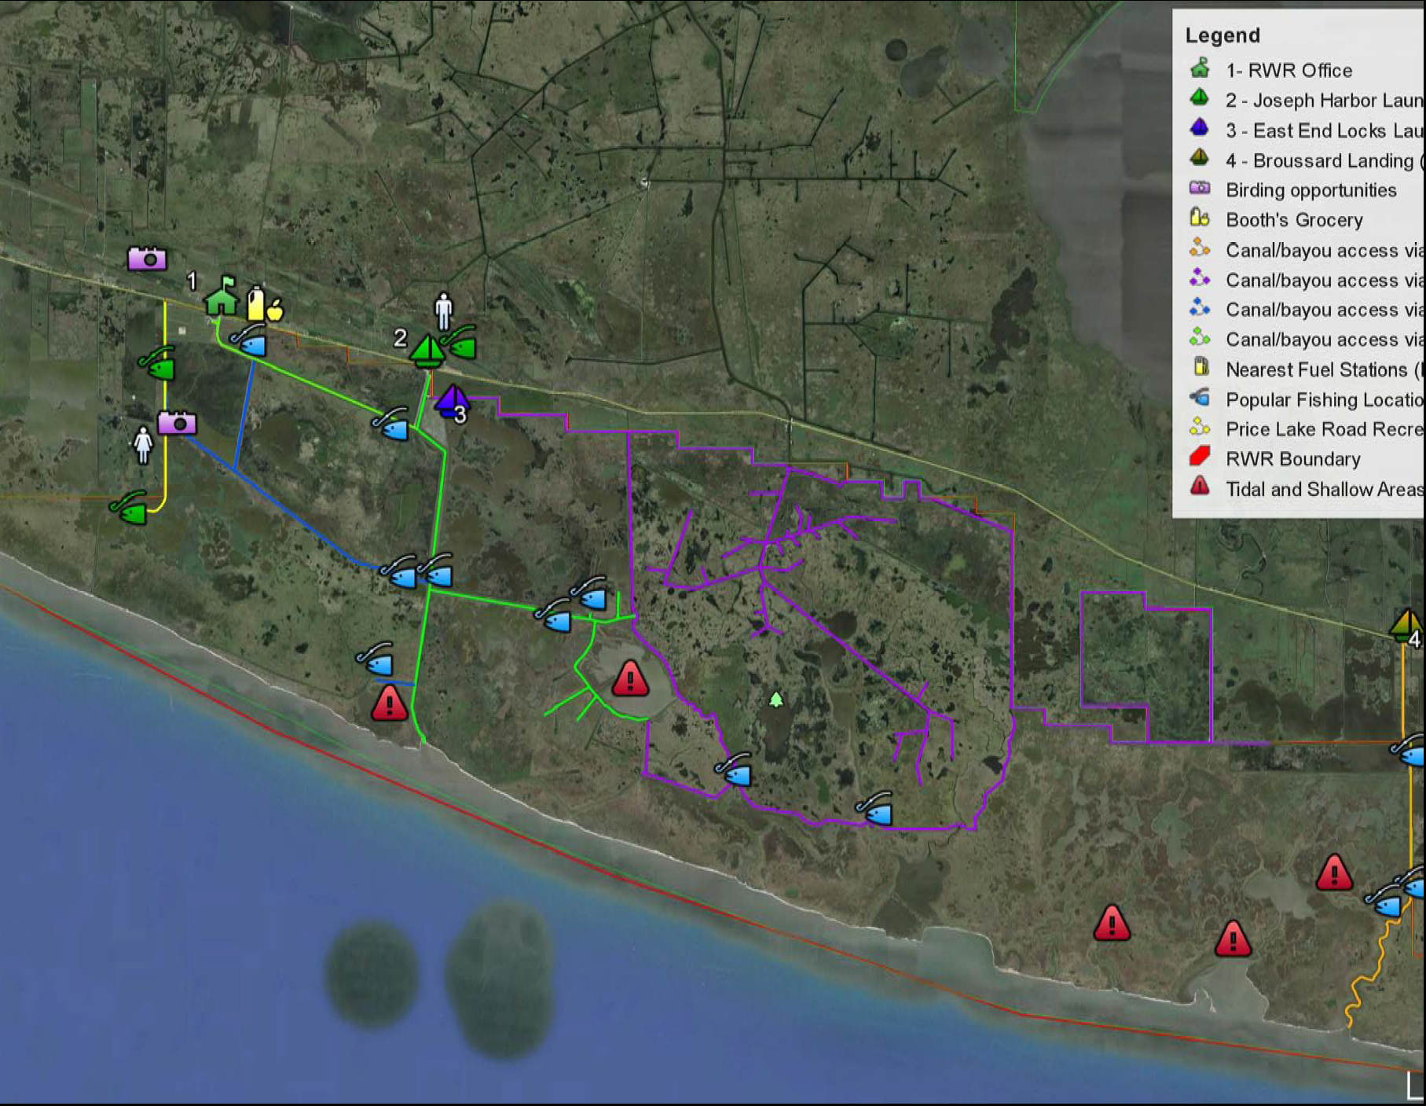

Slide 5
Notes:
5

Slide 6
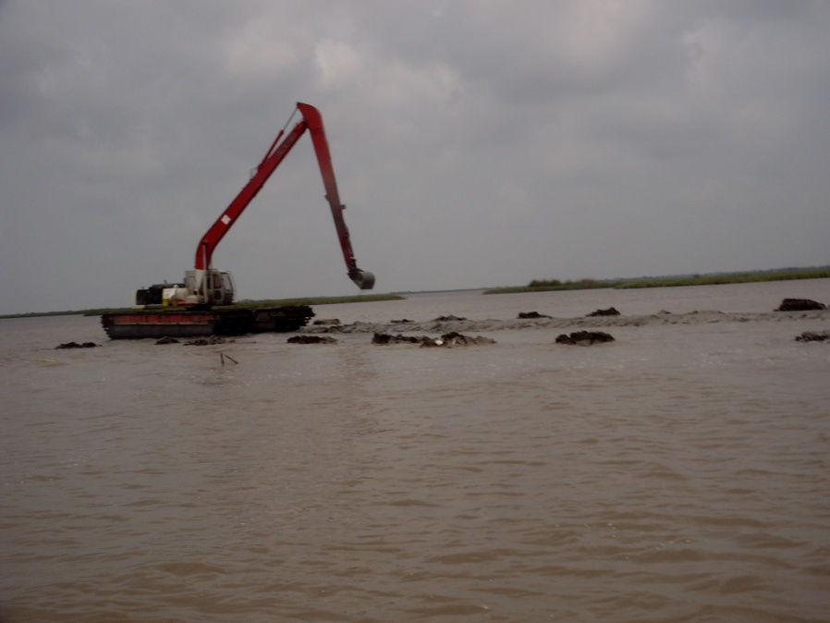
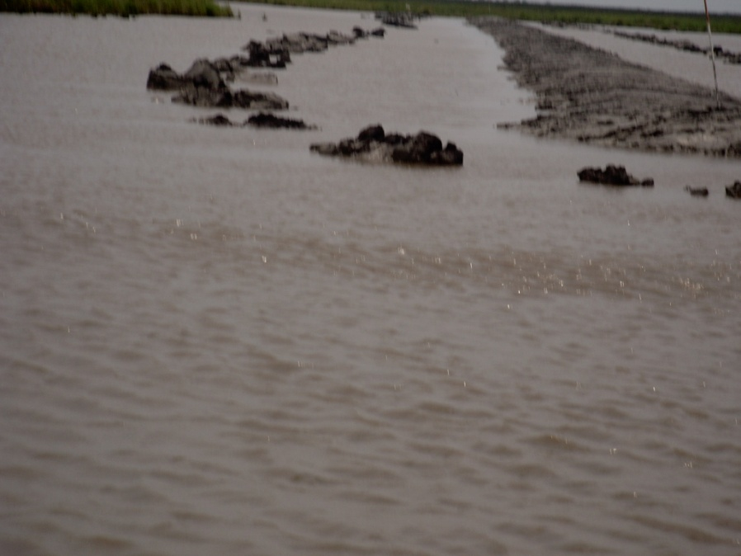
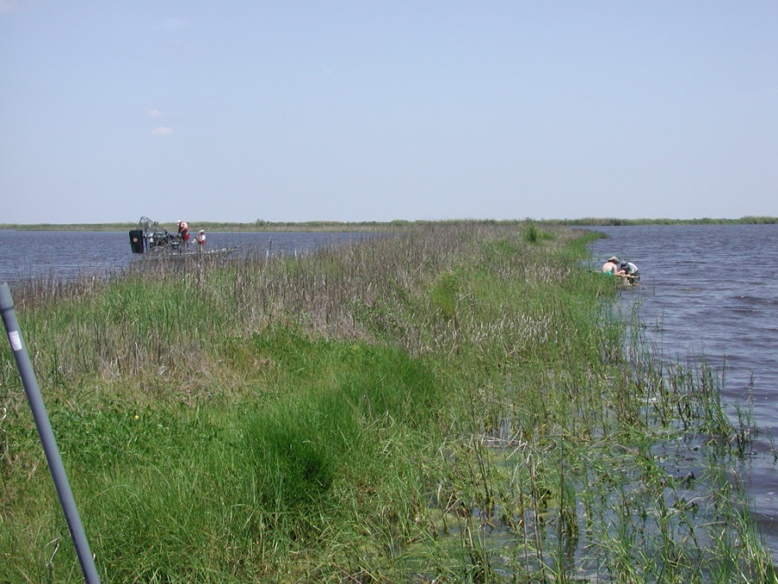

Slide 7
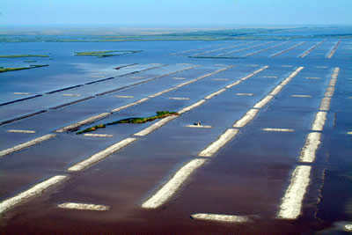
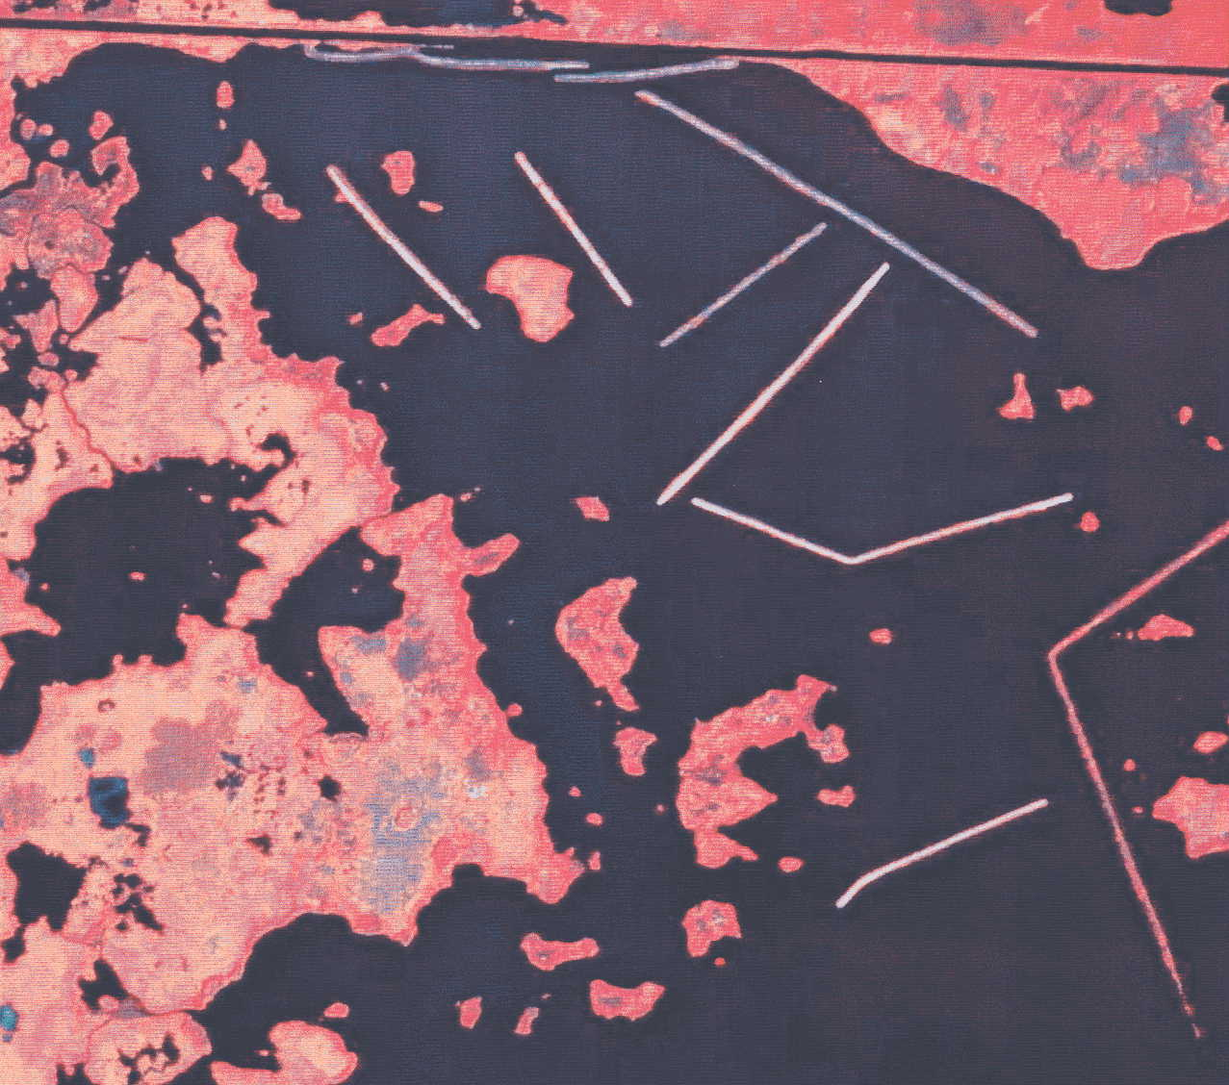
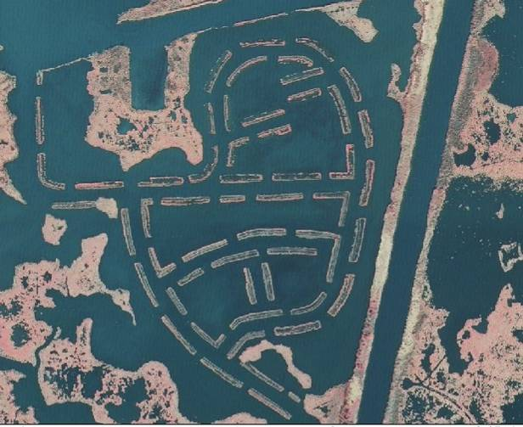
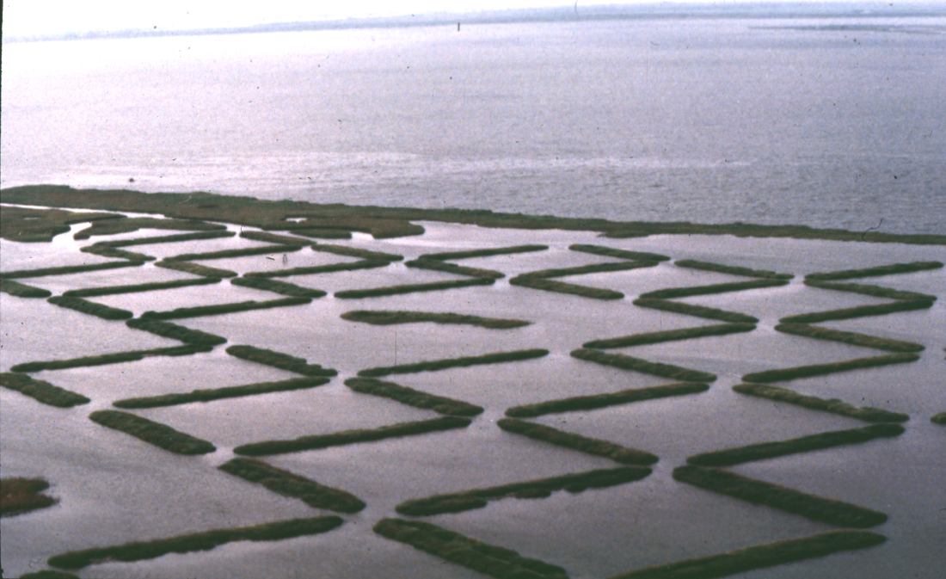

Slide 8
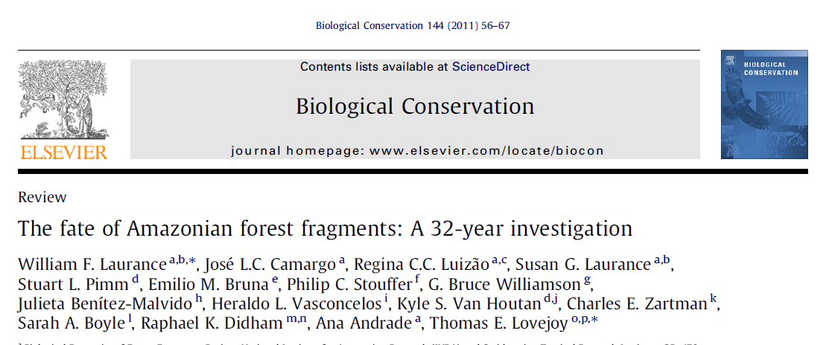
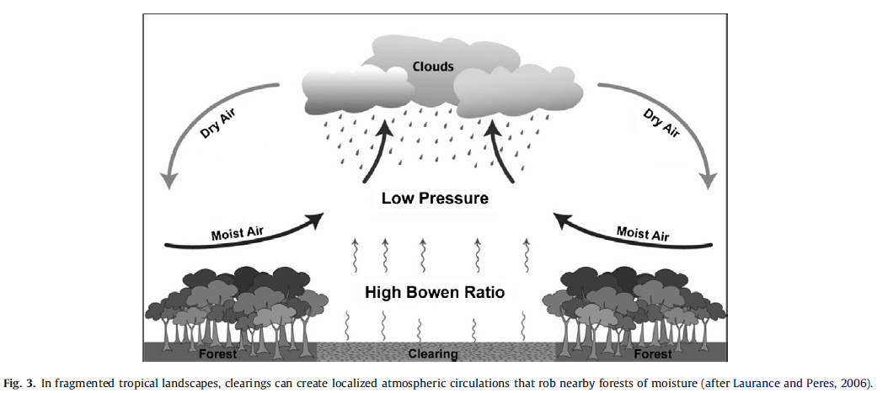

Slide 9
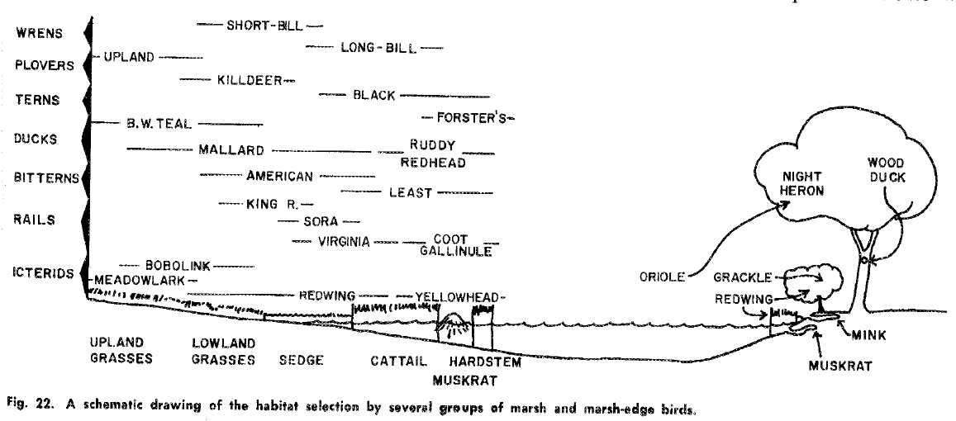
Weller and Spatcher 1965. Role of habitat distribution in the distribution and abundance of marsh birds. Special report No. 43. Iowa State University of Science and Technology

Slide 10
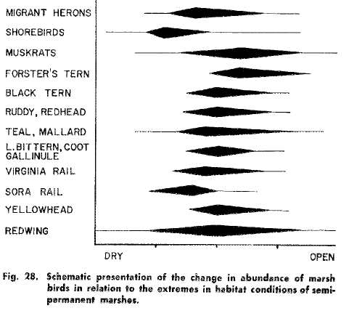
Weller and Spatcher (1965): It is apparent from fig. 28 that half vegetation and half open water produced the most suitable conditions for most species and that the habitat extremes were tolerated by a few forms but were not ideal for any marsh species.

Slide 11
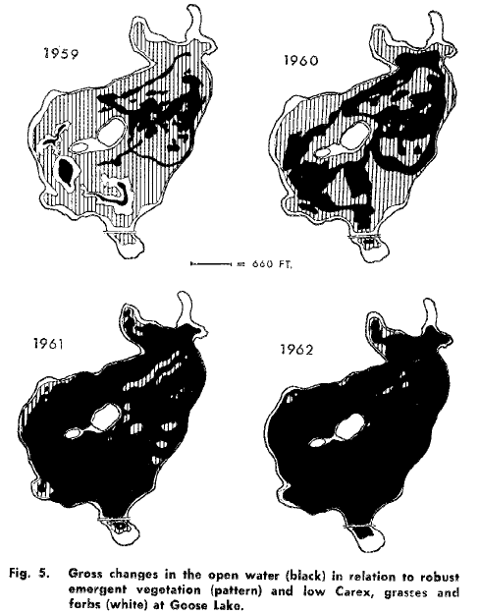
prairie pothole wetlands
Weller and Spatcher 1965. Role of habitat distribution in the distribution and abundance of marsh birds. Special report No. 43. Iowa State University of Science and Technology

Slide 12
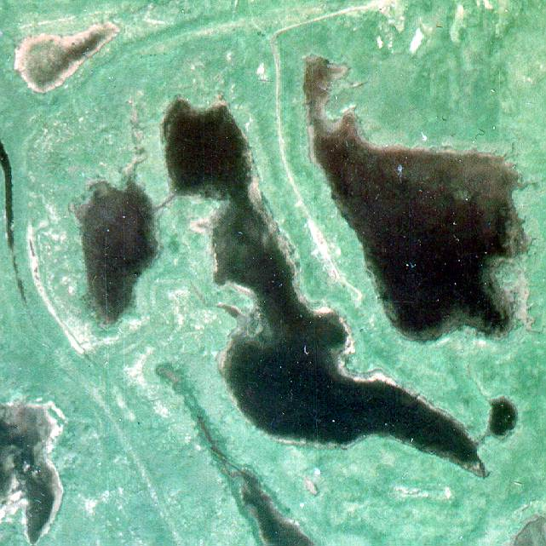
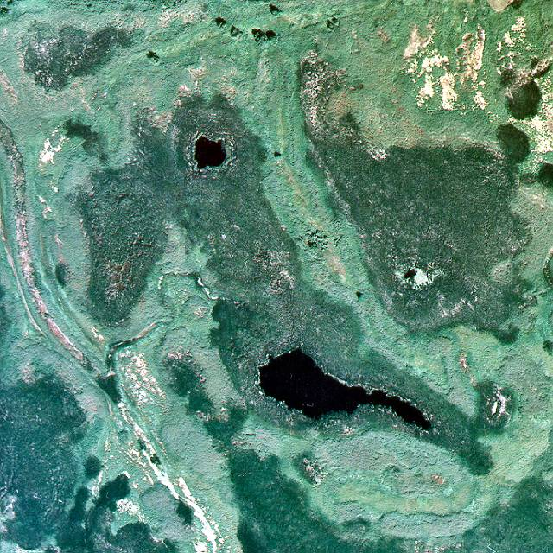
prairie pothole wetlands
Hutchinson’s Pothole, Delta Marsh, Manitoba, Canada
1965
Hutchinson’s Pothole, Delta Marsh, Manitoba, Canada
1997

Slide 13
prairie pothole wetlands
van der Valk 1981. Ecology 62:688-696

Slide 14
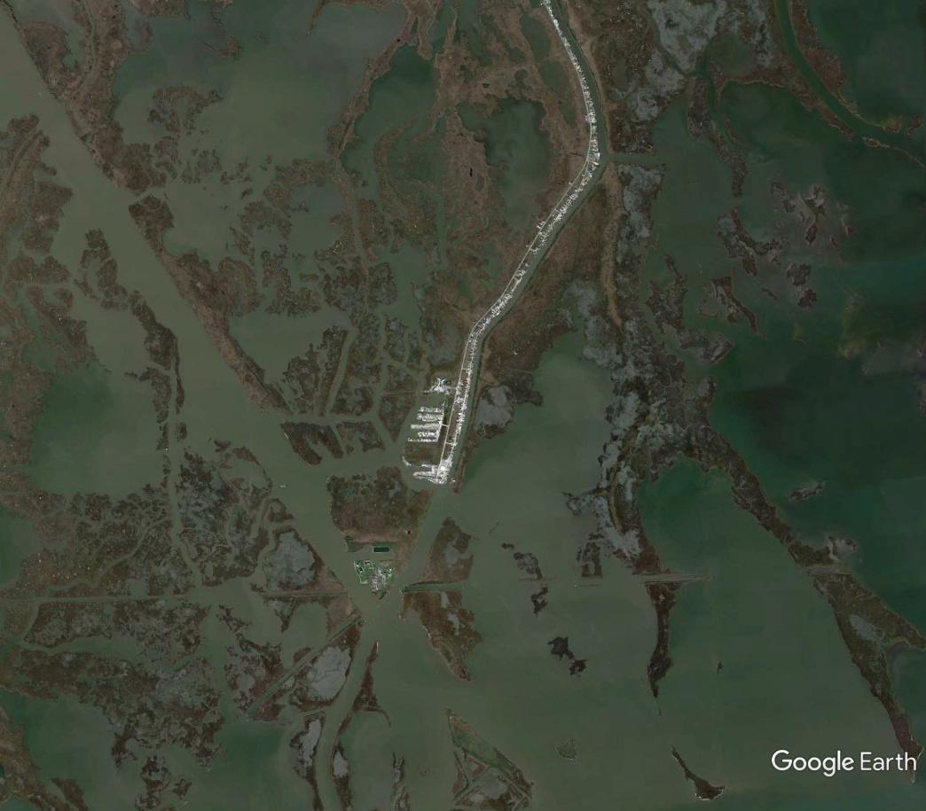

Slide 15
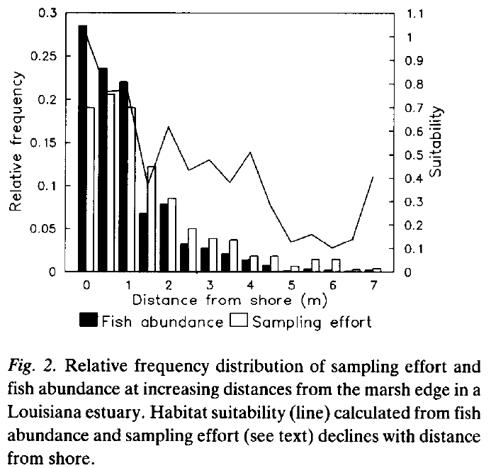
Baltz et al. 1993. Environmental Biology of Fishes 36:109-126

Slide 18
submersed aquatic vegetation
no effect
Steyer. 1993. LDNR report.
Caldwell. 2003. LSU Thesis.
increase
Cannaday. 2006 LSU Thesis
La Peyre et al. 2007. Estuaries and Coasts 30:526-536
nekton: terraces increase abundance and alter composition
Rozas and Minello 2001. Wetlands 21:327-341.
Bush Thom et al. 2004. Ecological Engineering 23:63-75.
Rozas et al. 2005. Journal of Coastal Research 40:37-50.
La Peyre et al. 2007. Estuaries and Coasts 30:526-536.

Slide 19
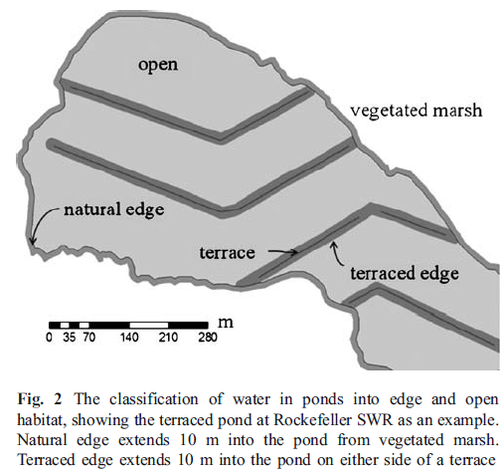
whole pond scale
O’Connell and Nyman 2010 Wetlands 30:125-135.

Slide 20
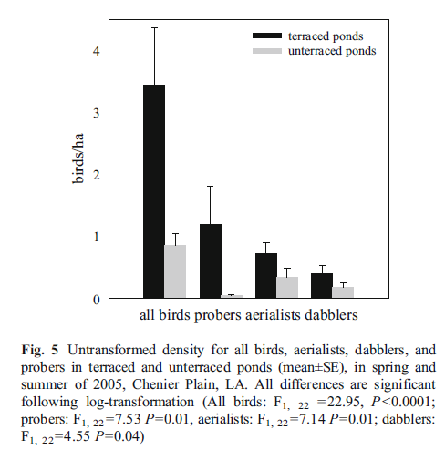
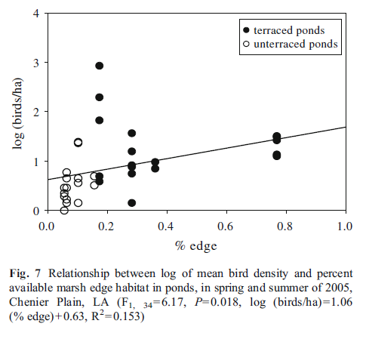
whole pond scale
O’Connell and Nyman 2010 Wetlands 30:125-135.

Slide 21
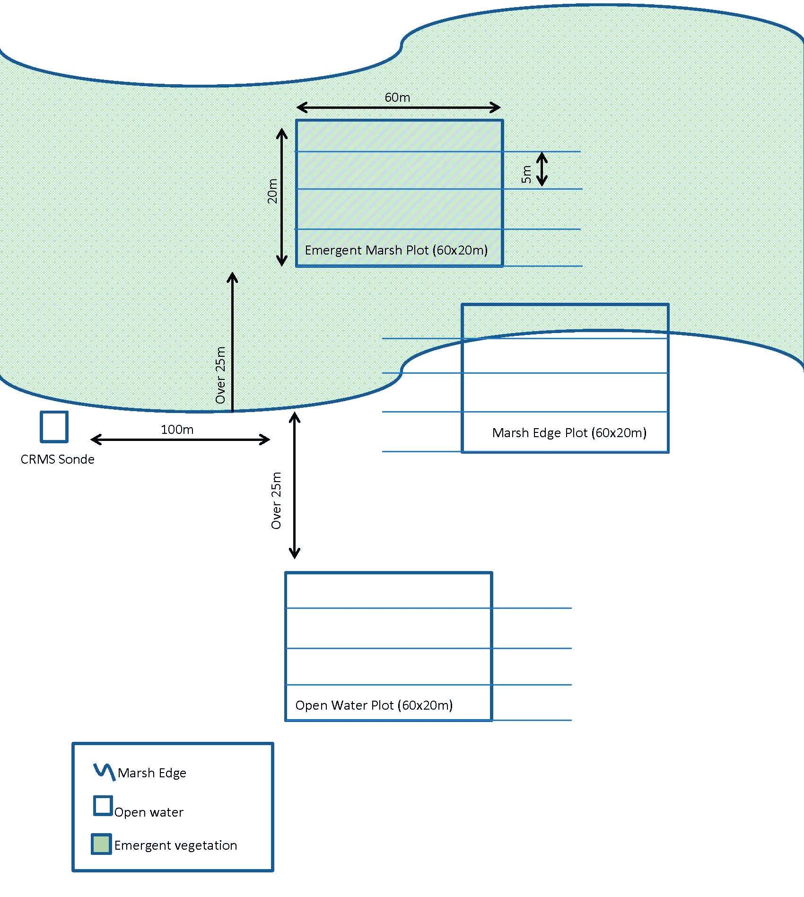
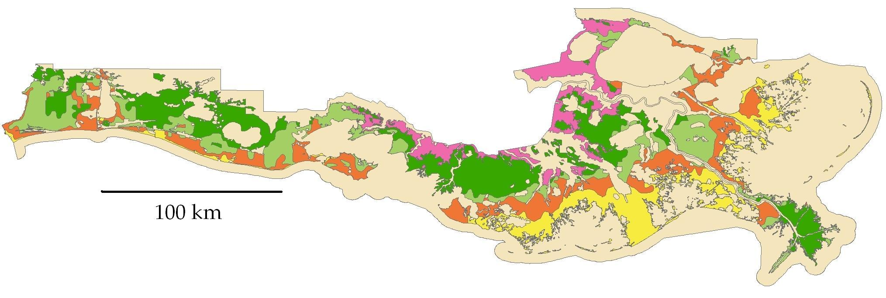
Edge and salinity stress
Patton 2016 LSU Thesis, Patton et al. in preparation.

Slide 22
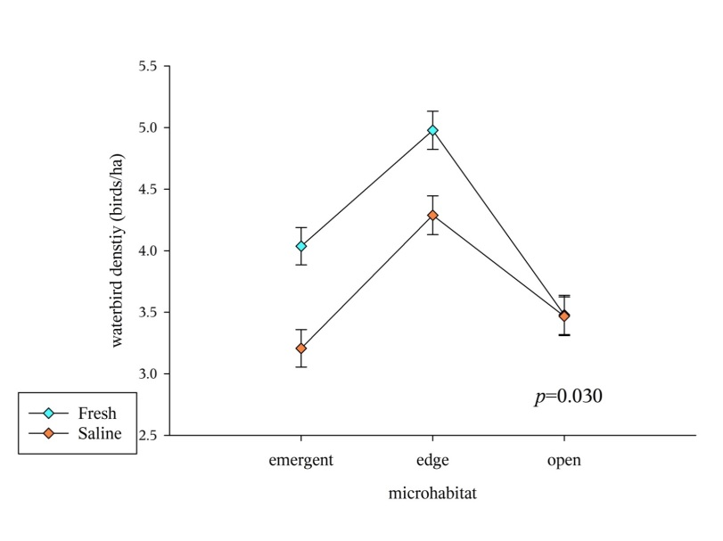
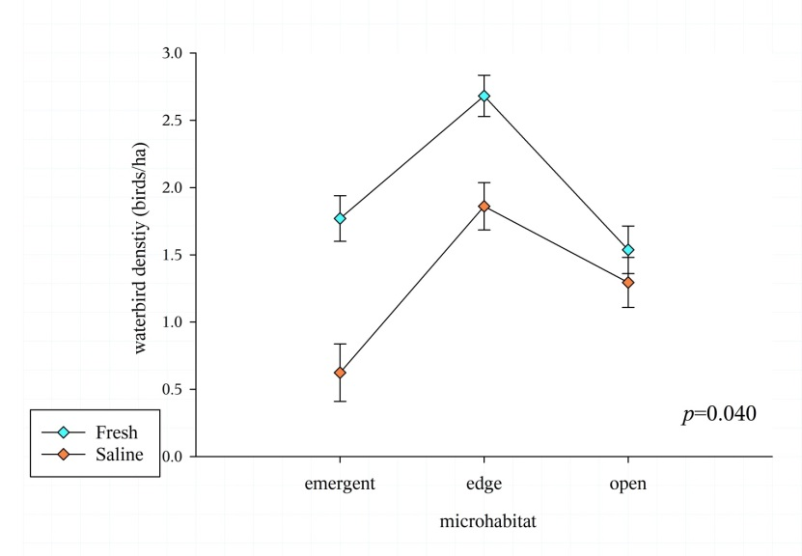
Edge and salinity stress
Patton 2016 LSU Thesis, Patton et al. in preparation.

Slide 23
stress & edges conclusions
Coastal wetland edges are associated with increased fish and bird abundance relative to emergent vegetation and open water.
The magnitude of the edge effect decreases as salinity increases.
Cycles of disturbance/succession appear more complicated/diverse in lower salinity marshes than higher salinity marshes.

Slide 24
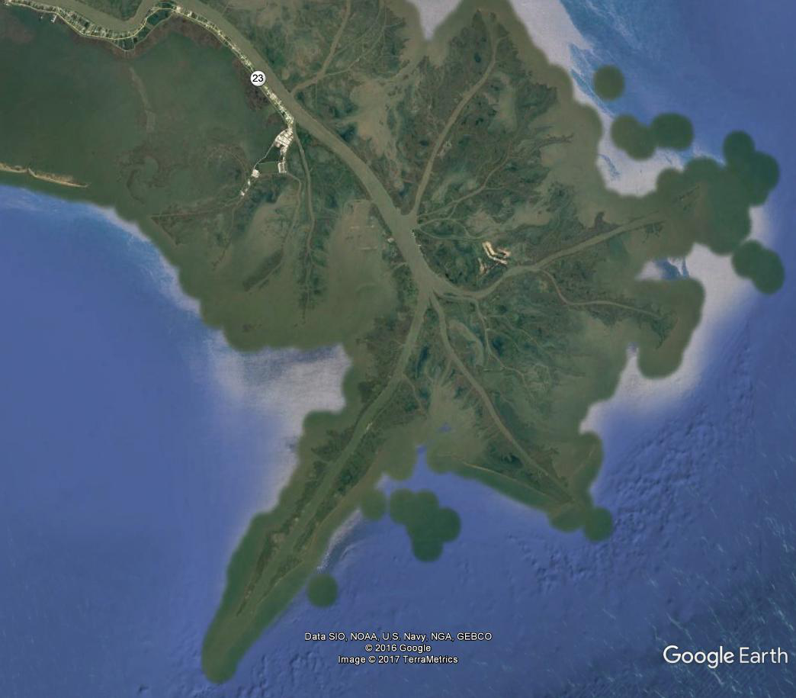
Update on Roseau Cane Die-Back in Coastal Louisiana: more questions than answers in May 2017
Andy Nyman, Ph.D.
School of Renewable Natural Resources
LSU and LSU Agricultural Center
jnyman@lsu.edu

Slide 25
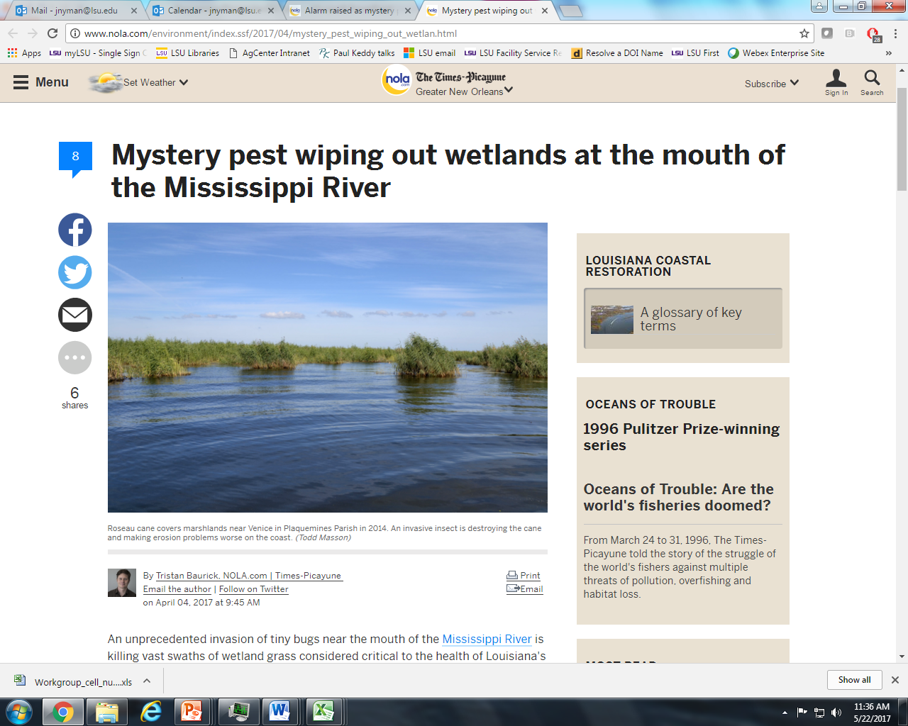
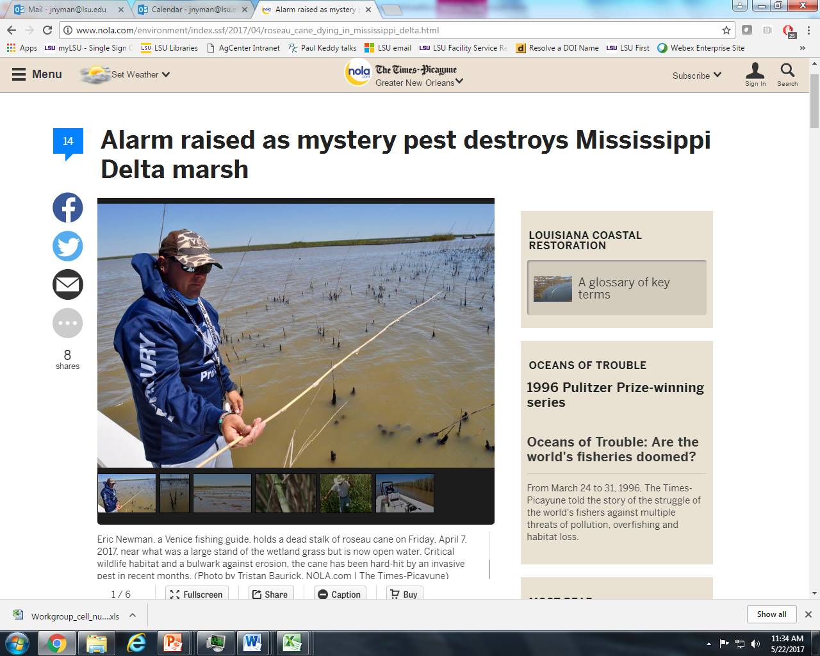
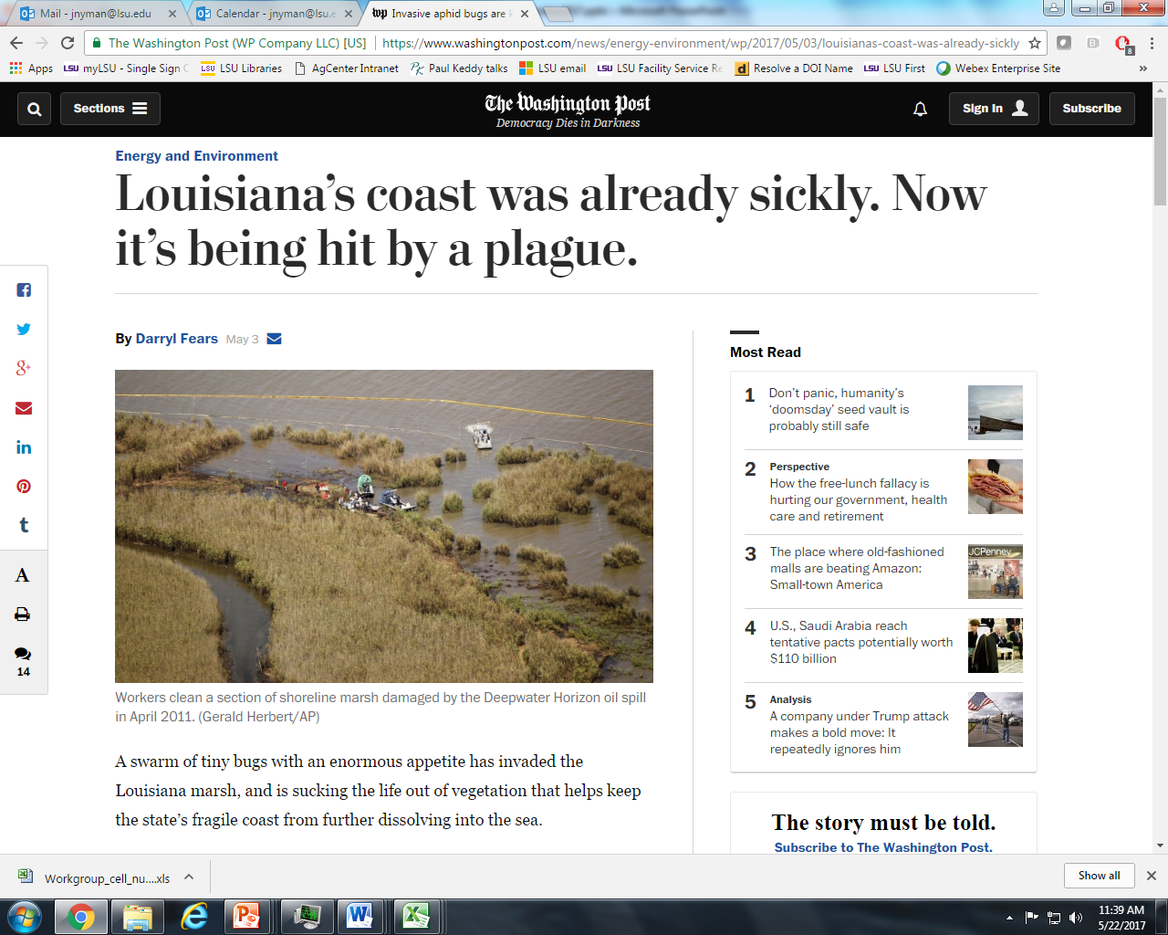

Slide 26
terminology
Common names
Scientific names
cane, Roseau cane, reed beds
insect, bug, scale-bug, or scale (bad bugs)
parasite or parasitoid (good bugs)
Phragmites australis or Phragmites or P. australis
Nipponaclerda biwakoensis or Nipponaclerda or N. biwakoensis
(i) Neastymachus japonicus, (ii) Boucekiella depressa, (iii) Astymachus japonicus
insect information provided by Rodrigo Diaz, LSU Entomology

Slide 27
My current thinking…
Roseau Cane (Phragmites australis) die-back appears
relatively new in coastal Louisiana
caused by a scale bug (but maybe not)
In most of North America, wildlife biologists and duck hunters either wouldn’t care or would celebrate if their Roseau Cane died
If Roseau Cane declines in the Bird’s Foot Delta
I am pretty sure that
fish and wildlife abundance will decline there
storm damage to infrastructure will increase there
I suspect that navigation dredging in the Mississippi River may need to be increased to maintain the existing channel
I’m hoping that future generations of the organism that is killing Roseau Cane are less fatal than the present generation

Slide 28
10 miles

Slide 29
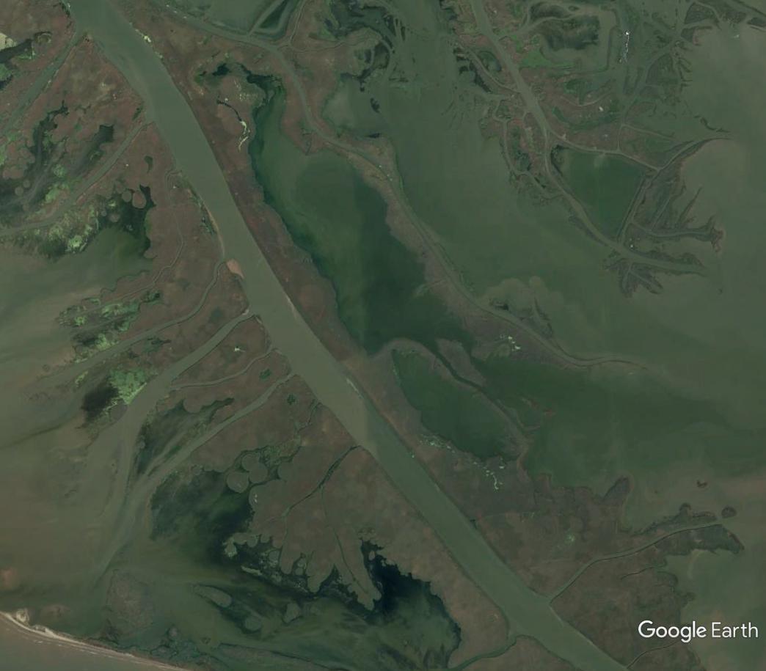
1 mile

Slide 30
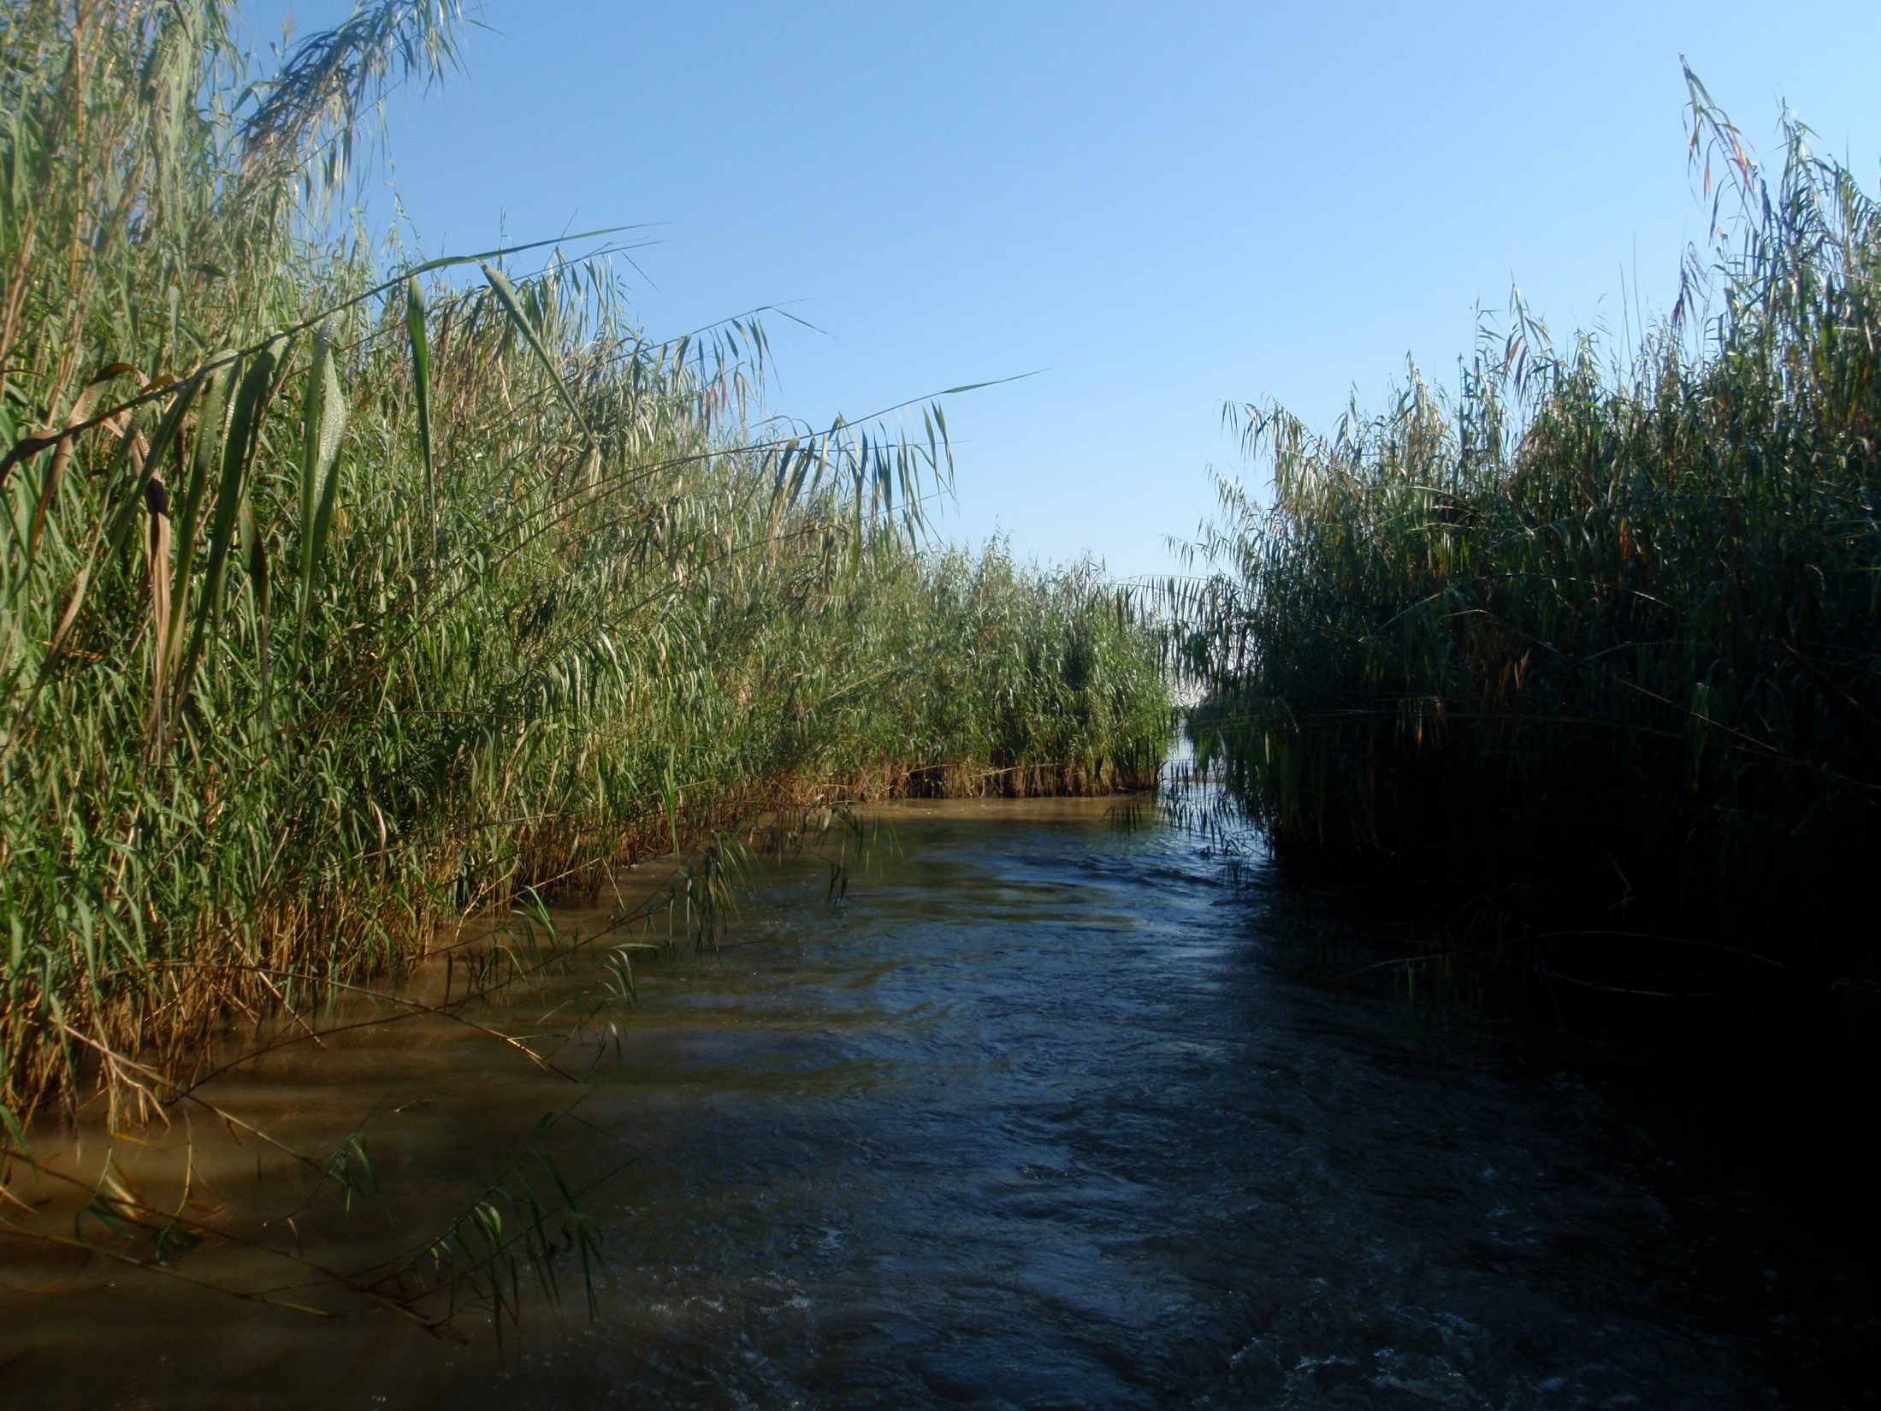
Healthy Roseau Cane
Roseau Cane is a robust plant that
appears to channelize water.

Slide 31
Roseau Cane that dominates the distributary channels in the Bird's Foot Delta appears unique in its extent, dominance, and desirability.

Slide 32
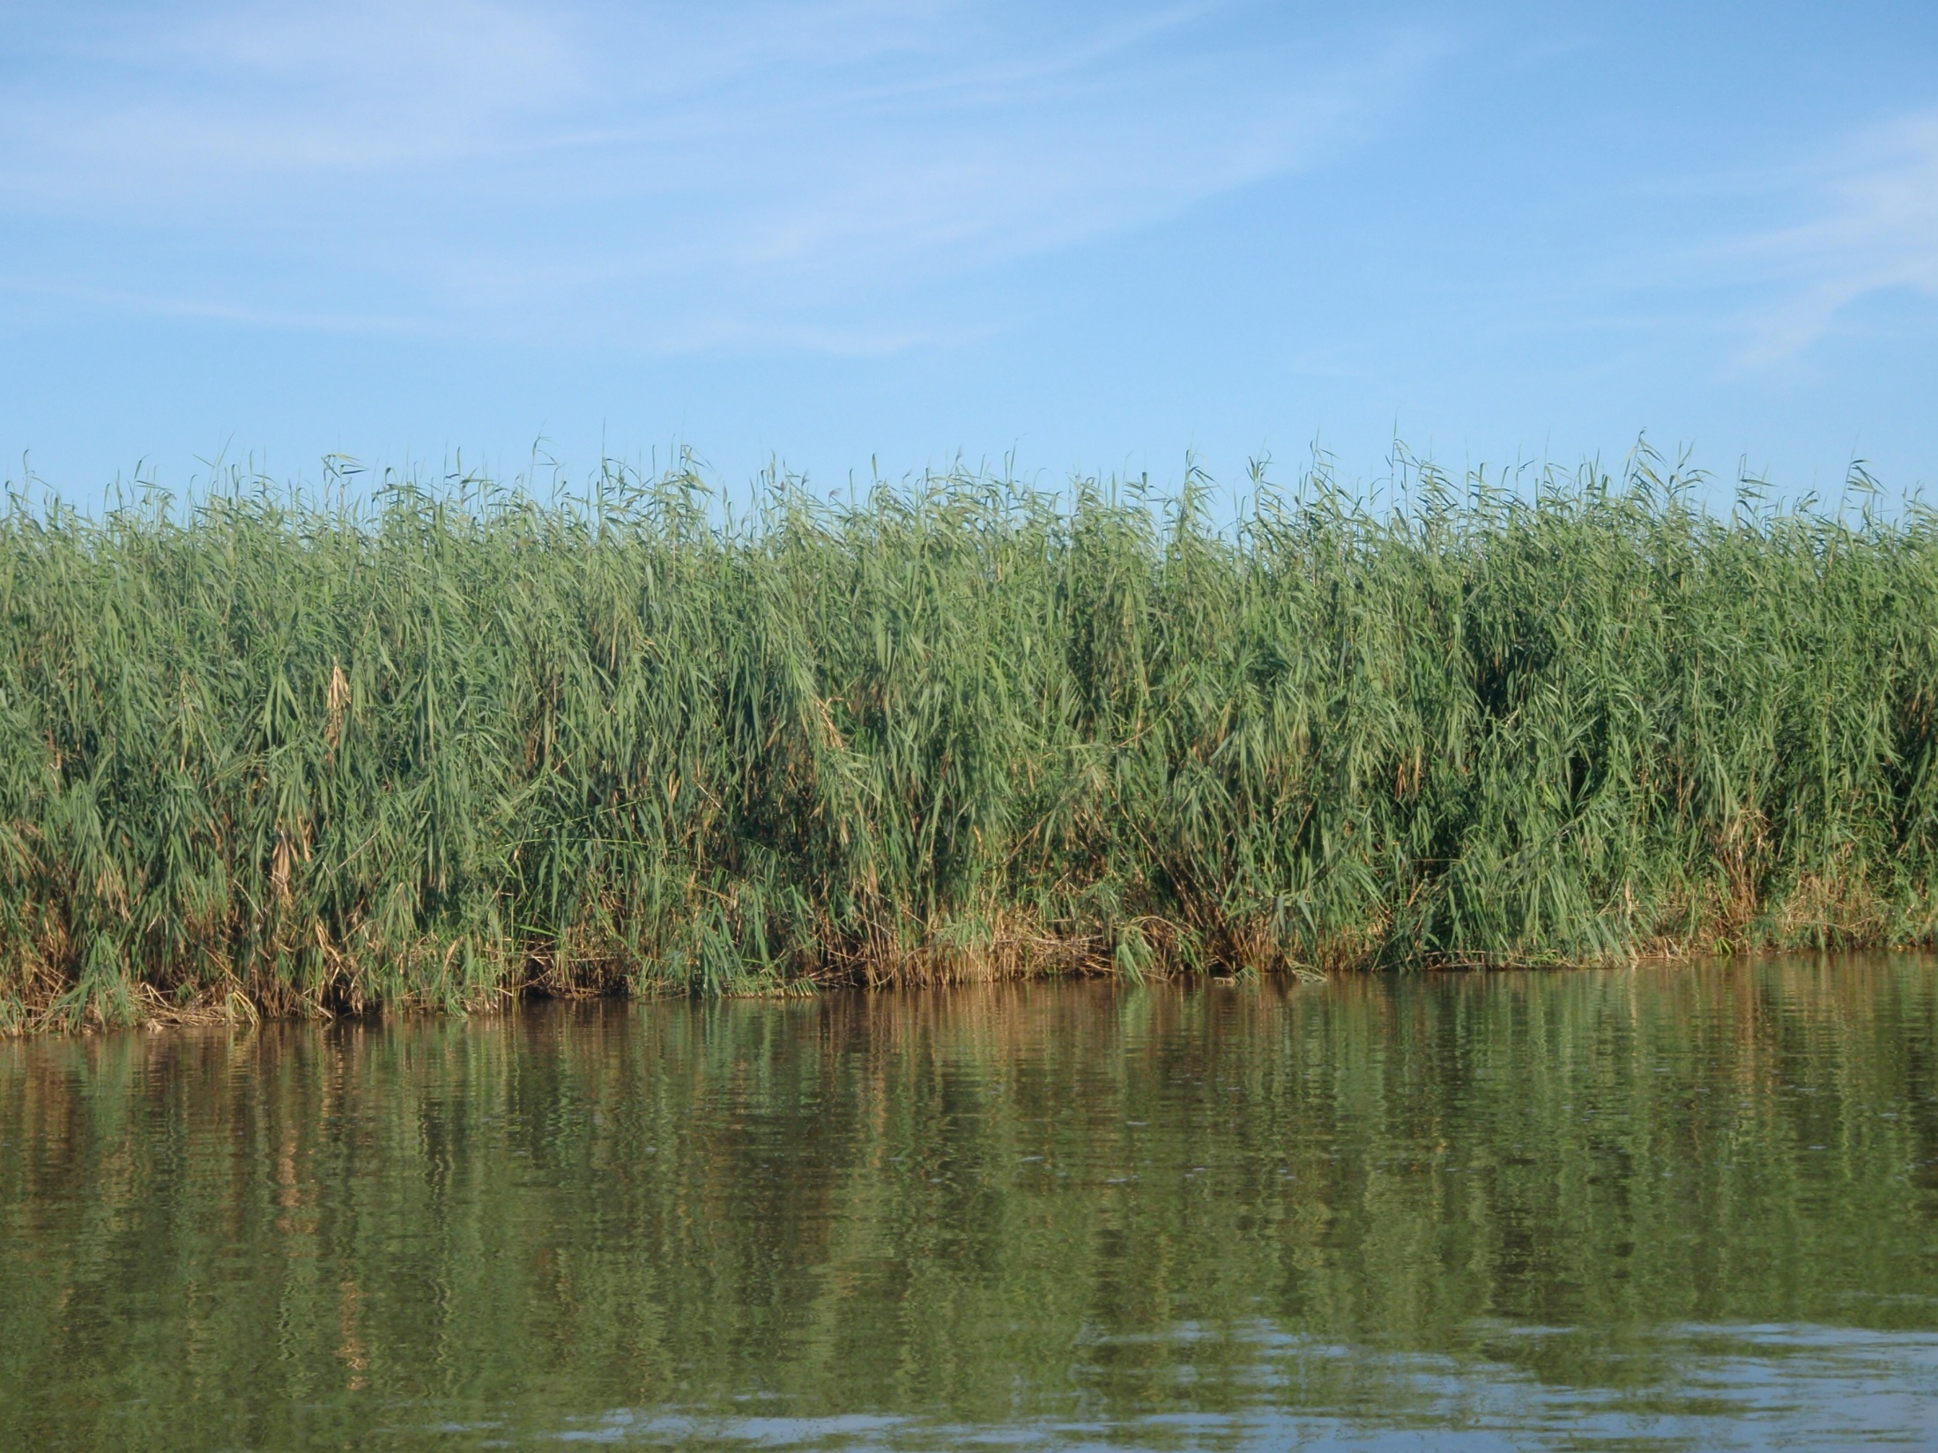
Healthy Roseau Cane
Roseau Cane is a robust plant that
can grow in deeper water than almost any other plant.

Slide 33
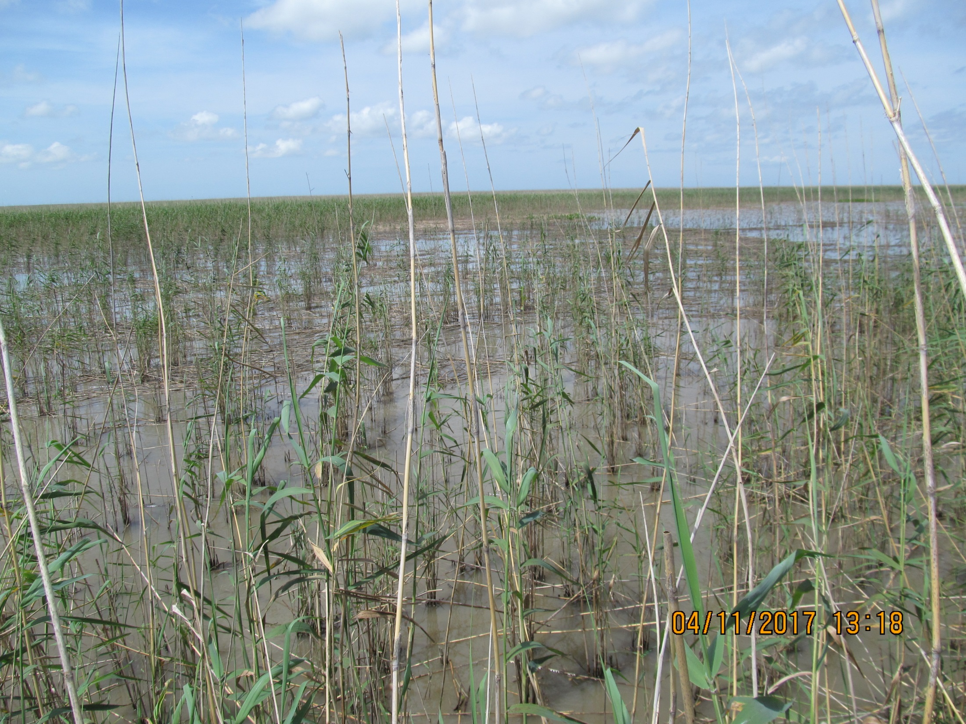
Die-back Roseau Cane
In thousands of acres of deep water (~18 inches deep)
nothing is replacing Roseau Cane that dies.

Slide 34
Die-back Roseau Cane
Roseau Cane growing in shallower water is being replaced by less robust species.

Slide 35
Pass A Loutre WMA, 12 Apr 2017

Slide 36
Bayou Cutler, 17 May 2017

Slide 37
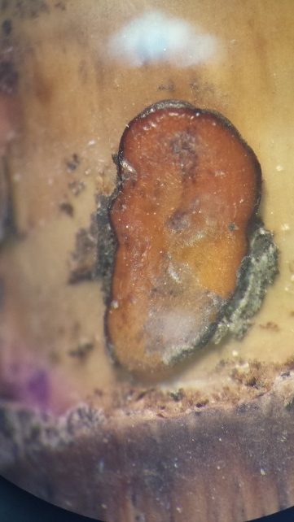
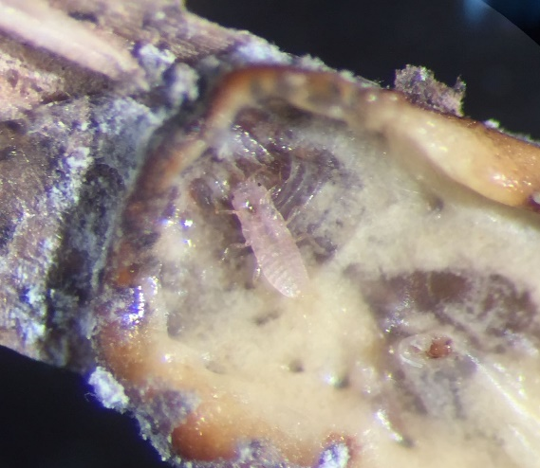
Scale Bug Life cycle (bad guys)
Eggs inside a dead female
Young female
Eggs
extracted
Crawlers or first nymphs
Crawlers settled
Second and third nymphs
images provided Rodrigo Diaz, LSU Entomology

Slide 38
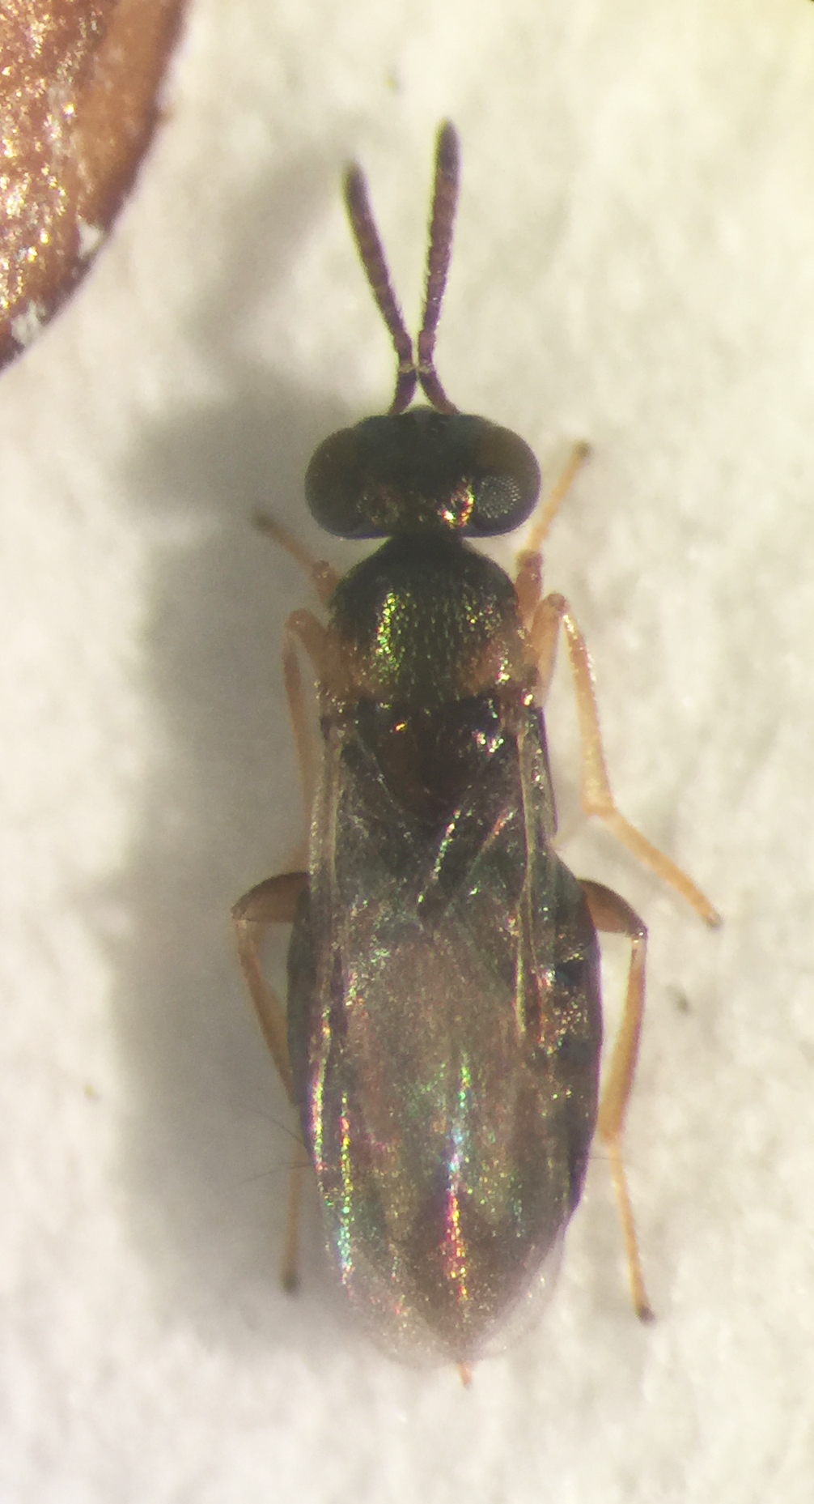
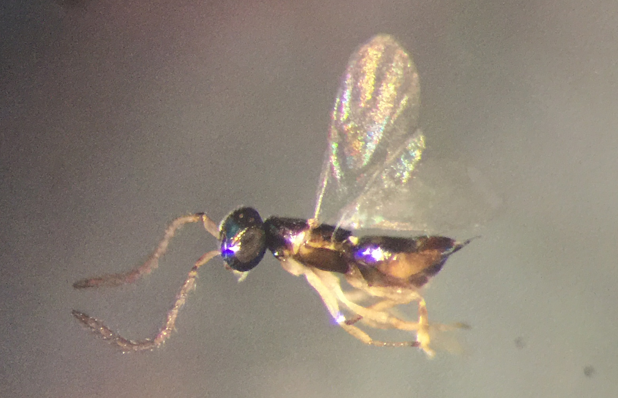
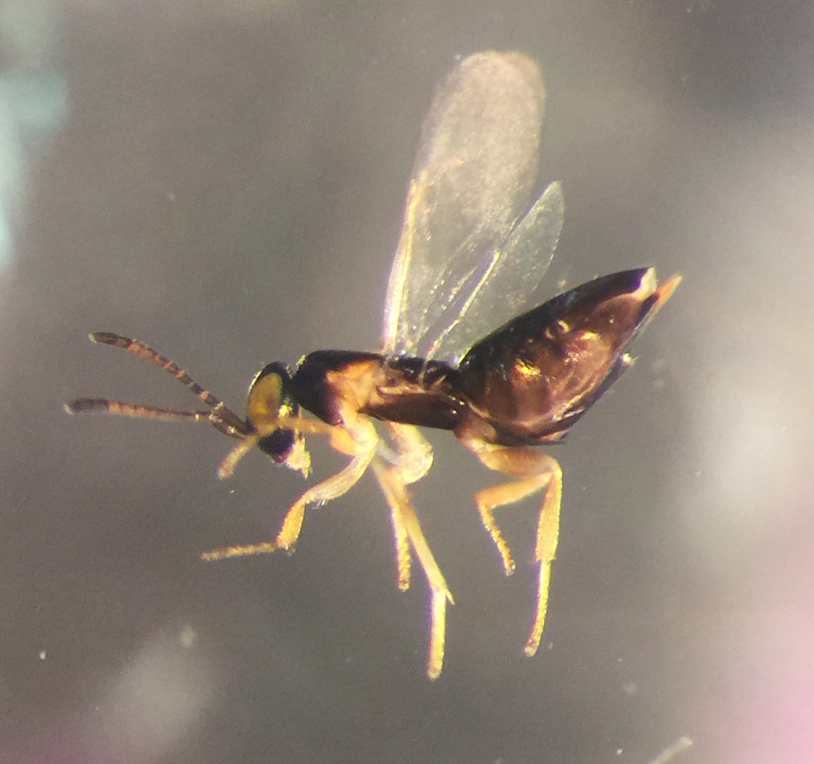
Parasitoids (good guys)
images provided Rodrigo Diaz, LSU
Tentative ID: Neastymachus japonicus (Encyrtidae)
Tentative ID: Astymachus japonicus (Encyrtidae) (Encyrtidae)
Tentative ID: Boucekiella depressa (Encyrtidae)

Slide 39
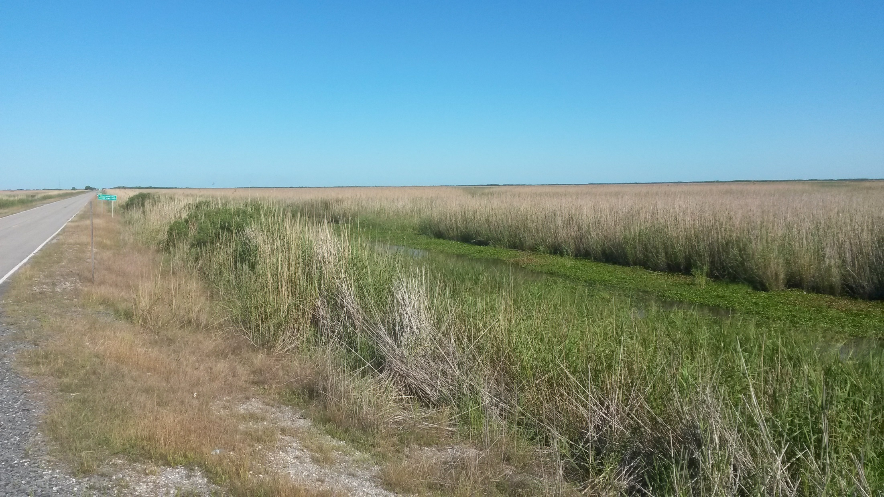
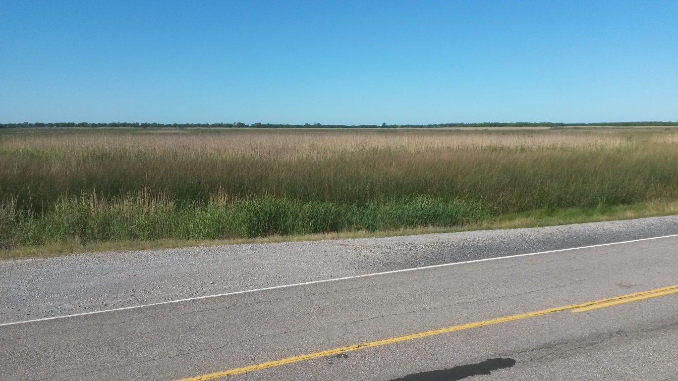
2 May 2017
Hwy 82, West of Rockefeller Refuge

Slide 40
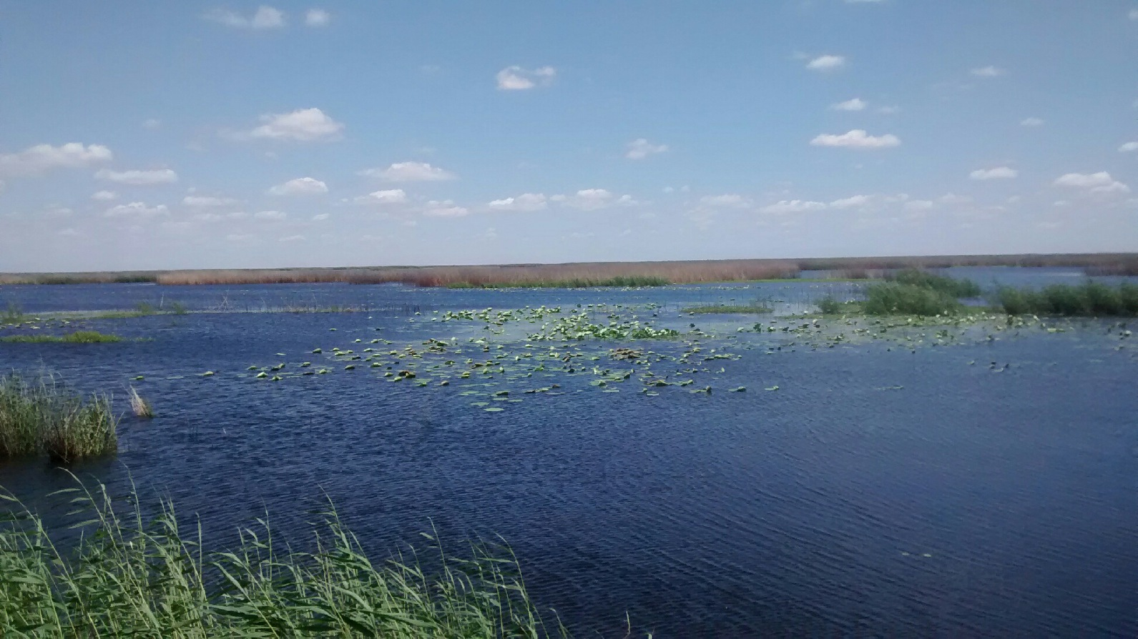
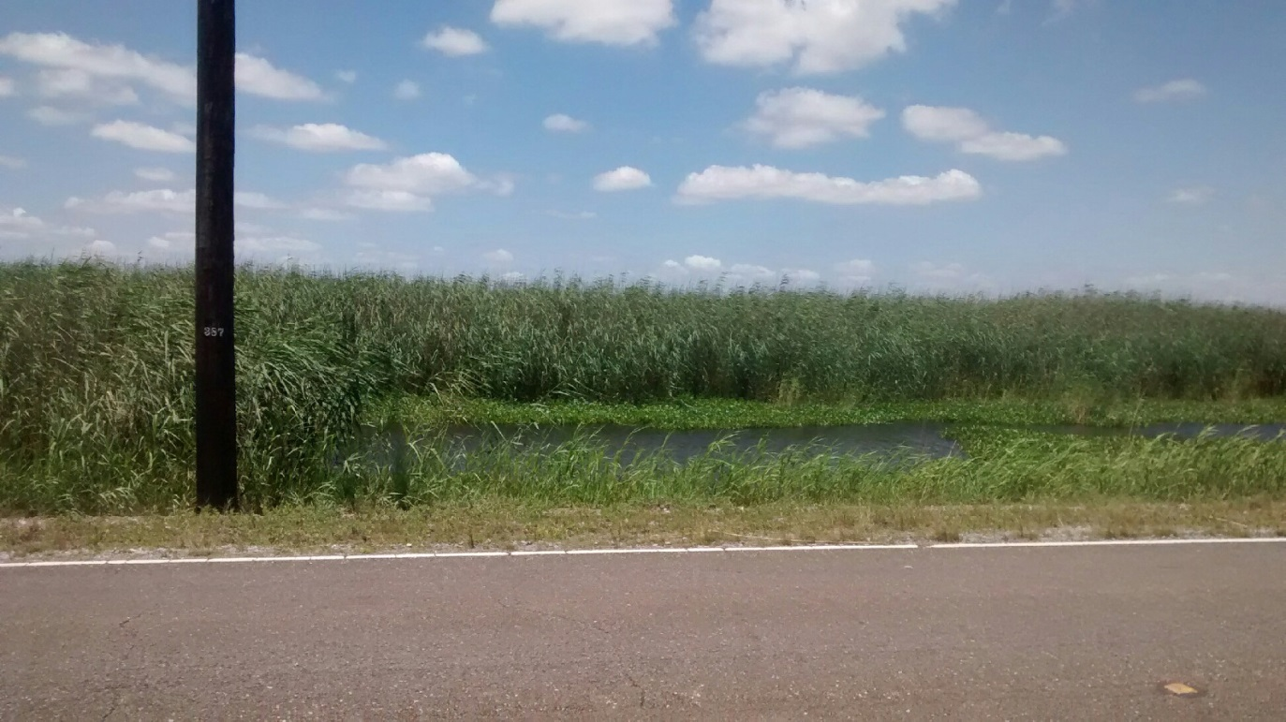
25 May 2017
Hwy 82, West of Rockefeller Refuge

Slide 41
My current thinking…
Roseau Cane (Phragmites australis) die-back appears
relatively new in coastal Louisiana
caused by a scale bug (but maybe not)
In most of North America, wildlife biologists and duck hunters either wouldn’t care or would celebrate if their Roseau Cane died
If Roseau Cane declines in the Bird’s Foot Delta
I am pretty sure that
fish and wildlife abundance will decline there
storm damage to infrastructure will increase there
I suspect that navigation dredging in the Mississippi River may need to be increased to maintain the existing channel
I’m hoping that future generations of the organism that is killing Roseau Cane are less fatal than the present generation

Slide 42
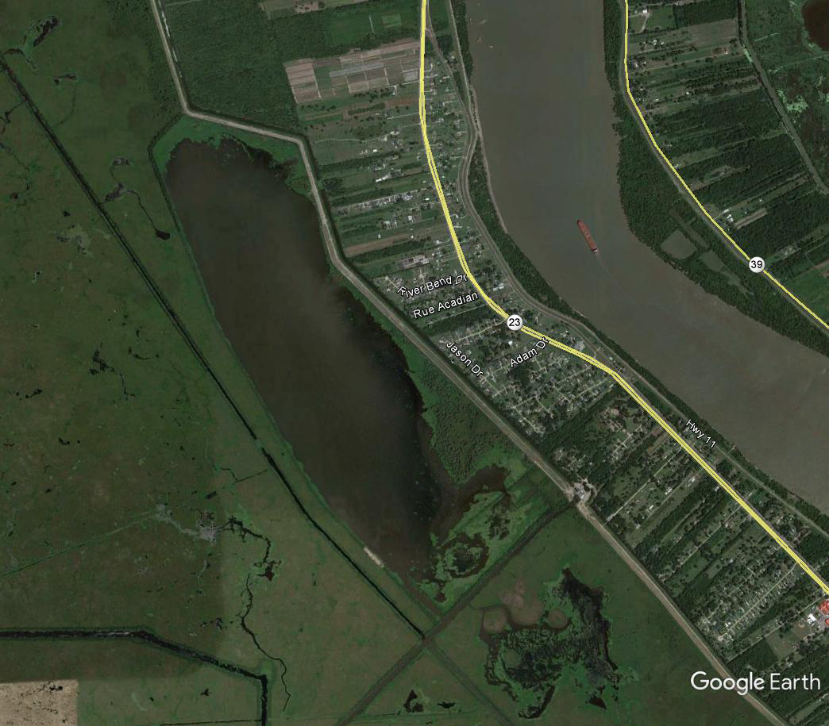

Slide 43
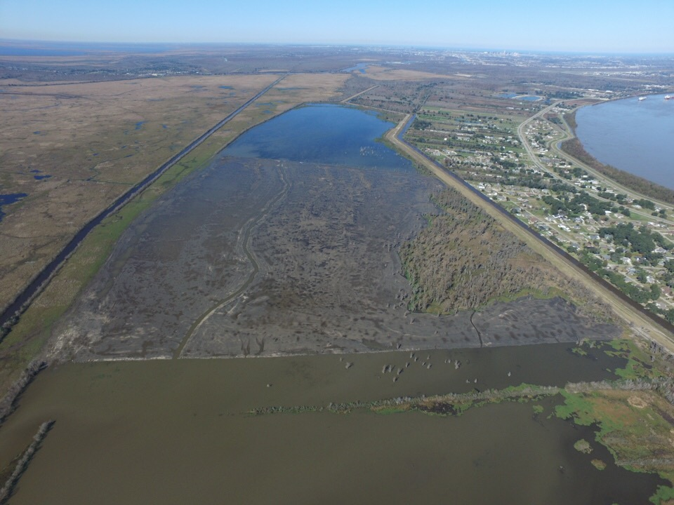
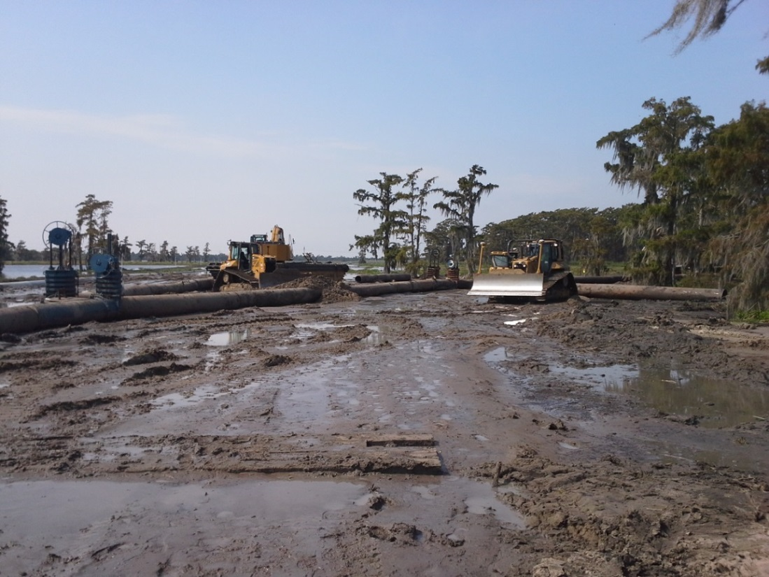
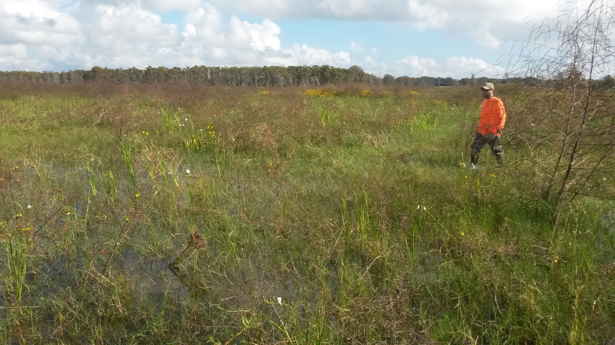

Slide 44
We Measure Emergent Vegetation to Measure Restoration Success
Why vegetation?
reduces storm surge speed
reduces wave height
creates fish and wildlife food and habitat
creates elevation (marsh vertical accretion via vegetative growth)
Notes:
ACCRETION

Slide 45
Emergent Vegetation as a Measure of Performance
Routinely monitored:
area of emergent vegetation (acres)
cover (%) within emergent vegetation
species richness within emergent vegetation
Vegetative monitoring data show that marsh creation projects succeed.

Slide 46
Fish and Wildlife as Measures of Performance
For over 50 years, almost every presentation and document addressing Louisiana’s wetland loss problem mentions fish and wildlife.
Public Law creating the Coastal Wetland Planning, Protection and Restoration Act (101st Congress, 1989-1990) has 5 references to wetlands and “the fish wildlife dependent thereon” or similar wording.
Almost all restoration controversy involves fish and/or wildlife.
Notes:
WHY COMPLICATED ASSESSMENT WITH FISH & WILDLIFE?

Slide 47
Fish and Wildlife as Measures of Performance
I’m unaware of routine monitoring of fish and wildlife use of created wetlands
A few studies of fish and wildlife in created wetlands
Creating Emergent Wetlands
Fish: Llewellyn and La Peyre (2011) Estuaries and Coasts 34:172-184, Harlamert in progress. M.S. Thesis.
Wildlife: Sullivan 2015. M.S. Thesis
Creating Barrier Islands and Back Barrier Marshes
Fish: Bilodeau and Bourgeois (2004) Journal of Coastal Research 20:931-936.
Wildlife: Raynor et al. (2012) Auk 129:763-772
Notes:
FISH & WILDLIFE ARE NOT MONITORED IN ANY RESTORATION PROGRAM THAT I KNOW
BARRIER ISLANDS/BACK BARRIER MARSHES; BAD NEWS:
FISH: PROBABLY CREATE SOME HABITAT FOR SOME FISH BUT ONLY STUDY FOCUSED ON LOSS OF HABITAT FOR BURROWING SHRIMP
WILDLIFE: BARRIER ISLANDS AND BACK BARRIER MARSHES ARE SO LARGE AND HIGH THAT THEY HOLD FRESHWATER PONDS AND CREATE HABITAT FOR RACOONS, COYOTES , AND/OR HOGS.
NONE OF THESE PROBLEMS ARE APPARENT IF ONLY VEGETATION IS USED AS PERFORMANCE MEASURE; PROBLEMS ARE GREATEST WITH THE MOST COMMON RESTORATION TYPE BEING CONSTRUCTED FOR THE PAST 10 YEARS.

Slide 48
Casual observations and ongoing research suggest that many created wetlands are too high to support wetland fish and wildlife typical of coastal Louisiana
Bayou Labranche Wetland Creation, St. Charles
Goose Point/Point Platte Marsh Creation, Big Branch NWR, St. Tammany
West Belle Pass Headland Restoration, Lafourche
Bayou Dupont Sediment Delivery System, Jefferson and Plaquemines
Near No-Name-Bayou Marsh Creation
These problems are not apparent if vegetation is the only performance measure.

Slide 49
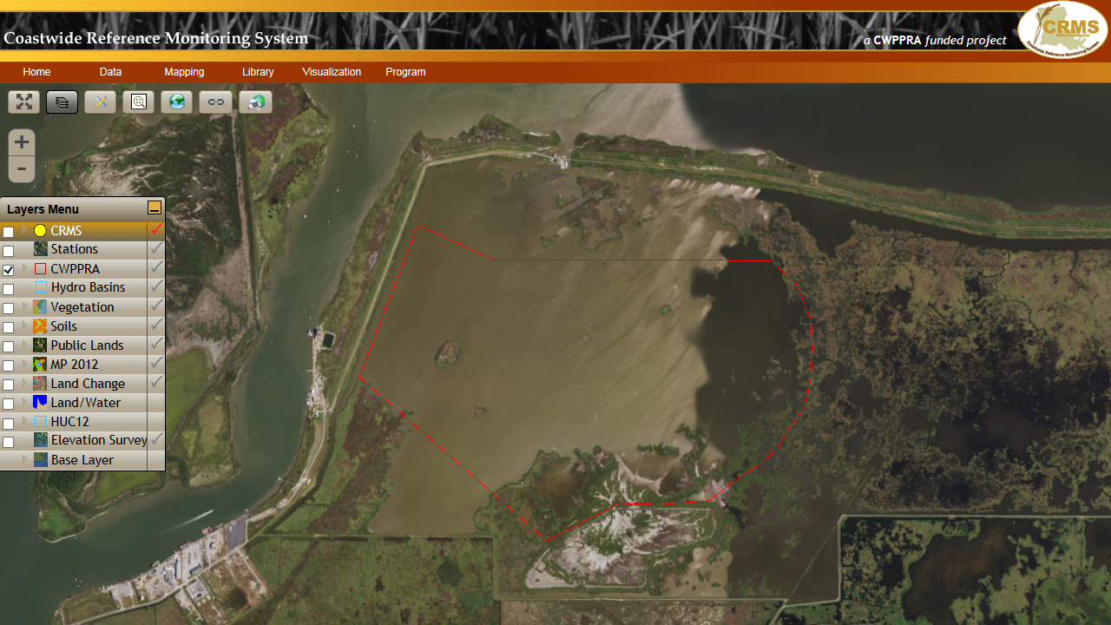

Slide 50
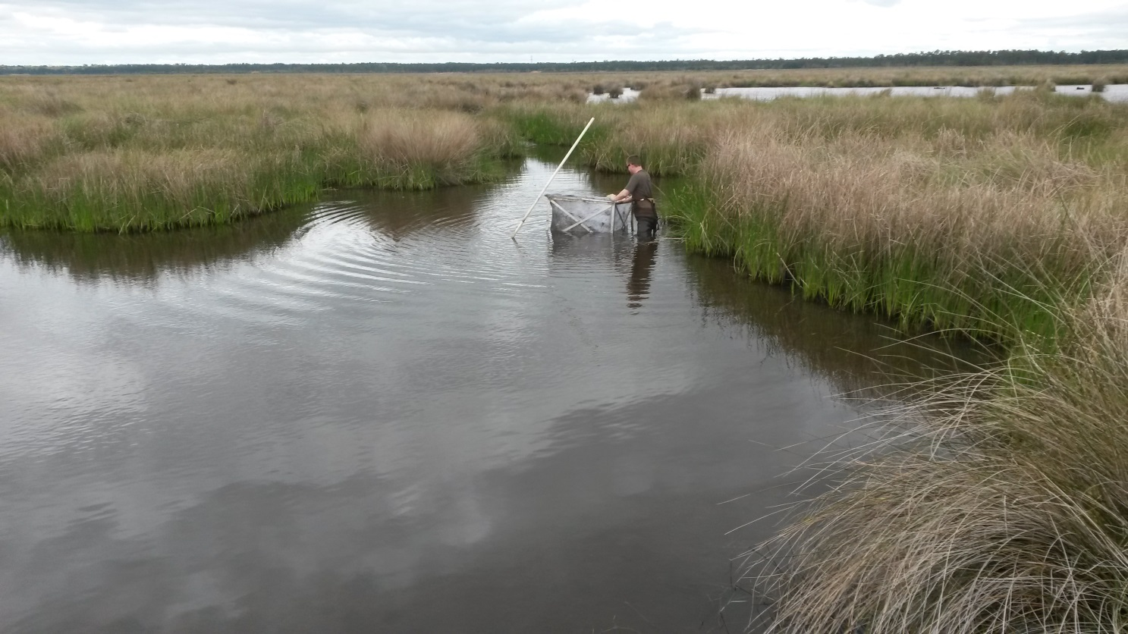
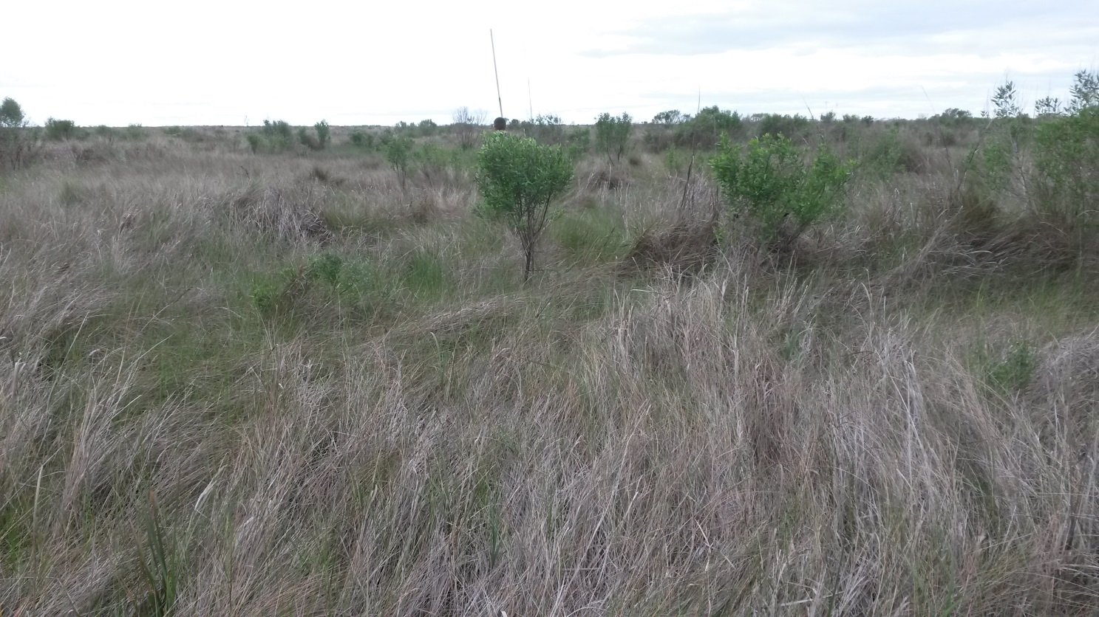
Pre-existing marsh
Marsh created with dredged material
Goose Point/Point Platte Marsh Creation, Big Branch NWR, St. Tammany

Slide 51
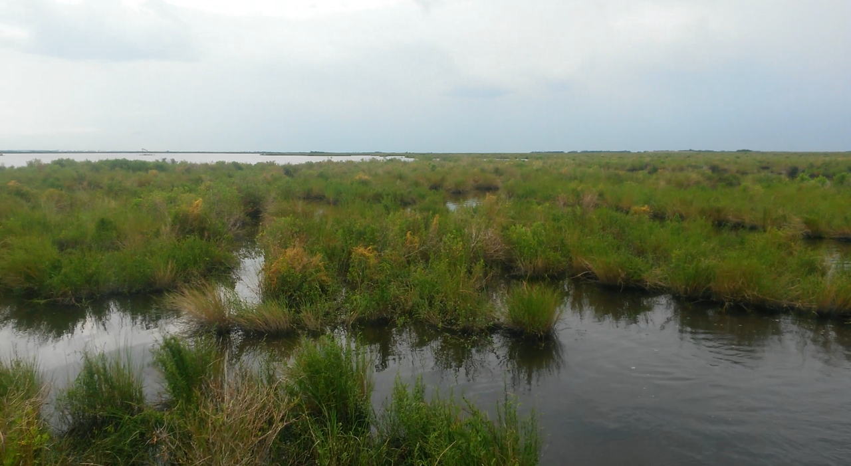
Pre-existing marsh
Marsh created with dredged material
Bayou Dupont Sediment Delivery System, Jefferson and Plaquimines

Slide 52
Notes:
PROBLEMS RELATE TO ELEVATION OF DREDGED MATERIAL WETLANDS, BARRIER ISLANDS, AND BACK BARRIER MARSHES.
HARDER TO CREATE COASTAL MARSHES ON THE GULF COAST THAN ON ATLANTIC OR PACIFIC COAST BECAUSE TIDAL RANGE IS SMALLER.
FURTHERMORE, GULF COAST MARSHES OCCURR WITHIN A NARROW RANGE WITHIN THE TIDAL RANGE THAN ATLANTIC COAST MARSHES.

Slide 53
1. Begin with most appropriate natural flooding
Snedden and Steyer (2013) Estuarine, Coastal & Shelf Science 118:11-123
Notes:
3. HOW TO SELECT ELEVATION
PICK MOST APPROPRIATE SALINITY TO EXPECT AT YOUR SITE; THEN SELECT PLANT COMMUNITY, WHICH DICTATES A FLOODING %
BUT REDUCE FLOODING TO ACCOUNT FOR LACK OF PLANT ROOTS IN NEW WETLAND; FIRST REASON TO BUILD HIGH; THIS IS A LEGETIMATE REASON TO BUILD HIGHER THAN ADJACENT MARSHES

Slide 54
2. reduce target flooding using best professional judgement
The initial (1-2 years after construction) elevation of created wetlands must be higher than natural wetlands because created wetlands begin without the mature root system of natural marshes.

Slide 55
3. Construct an exceedance curve with most appropriate data.
Notes:
ALSO TOO HIGH BECAUSE MARSH VERTICAL ACCRETION IS IGNORED
1. OBTAIN WATER LEVEL DATA FROM CRMS SITE NEAREST RESTORATION SITE

Slide 56
3. Construct an exceedance curve with most appropriate data.
Notes:
2. CREATE EXCEEDENC CURVE; PICK A FLOODING DURATION, WHICH DICTATES YOUR ELEVATION.

Slide 57
4. Select target elevation from target flooding.
Notes:
2. CREATE EXCEEDENC CURVE; PICK A FLOODING DURATION, WHICH DICTATES YOUR ELEVATION.

Slide 58
5. do NOT account for subsidence and sea-level rise without also accounting for accretion (current standard practice)
Notes:
PROJECT 20 YEARS OF SUBSIDENCE AND SEA-LEVEL RISE; 2ND REASON TO BUILD HIGH
BUT MARSHES VERTICALLY ACCRETE

Slide 59
5. do NOT account for subsidence and sea-level rise without also accounting for accretion (current standard practice)
5. account for accretion
Notes:
ACKNOWLEDGING THAT ALL COASTAL MARSHES THAT EXPERIENCE SUBSIDENCE AND SEA-LEVEL RISE AND THAT HAVE BEEN STUDIED, ACCRETE.

Slide 60
too high to perform for many years as a natural wetland with regards to fish and wildlife habitat.
quickly performs as a natural wetland with regards to fish and wildlife habitat.
Notes:
ACKNOWLEDGING THAT ALL COASTAL MARSHES THAT EXPERIENCE SUBSIDENCE AND SEA-LEVEL RISE AND THAT HAVE BEEN STUDIED, ACCRETE.

Slide 61
Marsh Vertical Accretion then will create this
Marsh Creation Projects only need to create this
DeLaune et al. 1990. Catena 17:277-288
Notes:
delta lobe cycle creates subsidence, so subsidence as well as gslr; travel a few km and subsidence differs
delta lobe cycle also creates wetland loss (18 ha/day from 1930-1990; 44.5 ac/day from 1930-1990)

Slide 62
Marsh Vertical Accretion then will create this
Marsh Creation Projects only need to create this
DeLaune et al. 1990. Catena 17:277-288
Notes:
delta lobe cycle creates subsidence, so subsidence as well as gslr; travel a few km and subsidence differs
delta lobe cycle also creates wetland loss (18 ha/day from 1930-1990; 44.5 ac/day from 1930-1990)

Slide 63
Conclusions
Whether restoration seeks to slow the loss of existing wetlands or to create new wetlands
emergent vegetation is an excellent but incomplete measure of performance for restored Gulf Coast Wetlands
limited data and much observation suggests that many created wetlands are too elevated to support the types and/or amounts of fish and wildlife found in natural wetlands

Slide 64
Conclusions
Valid reasons to create wetlands higher than natural wetlands:
Young plants lack extensive roots systems common in natural wetlands
Invalid reasons to create wetlands higher than natural wetlands:
extend wetland benefits; delay fish & wildlife benefits
wetlands to not accrete; wetlands do accrete
Advantages of creating marshes at lower elevations than currently used:
fish & wildlife benefits happen much sooner
costs are slightly reduced

