Slide 1
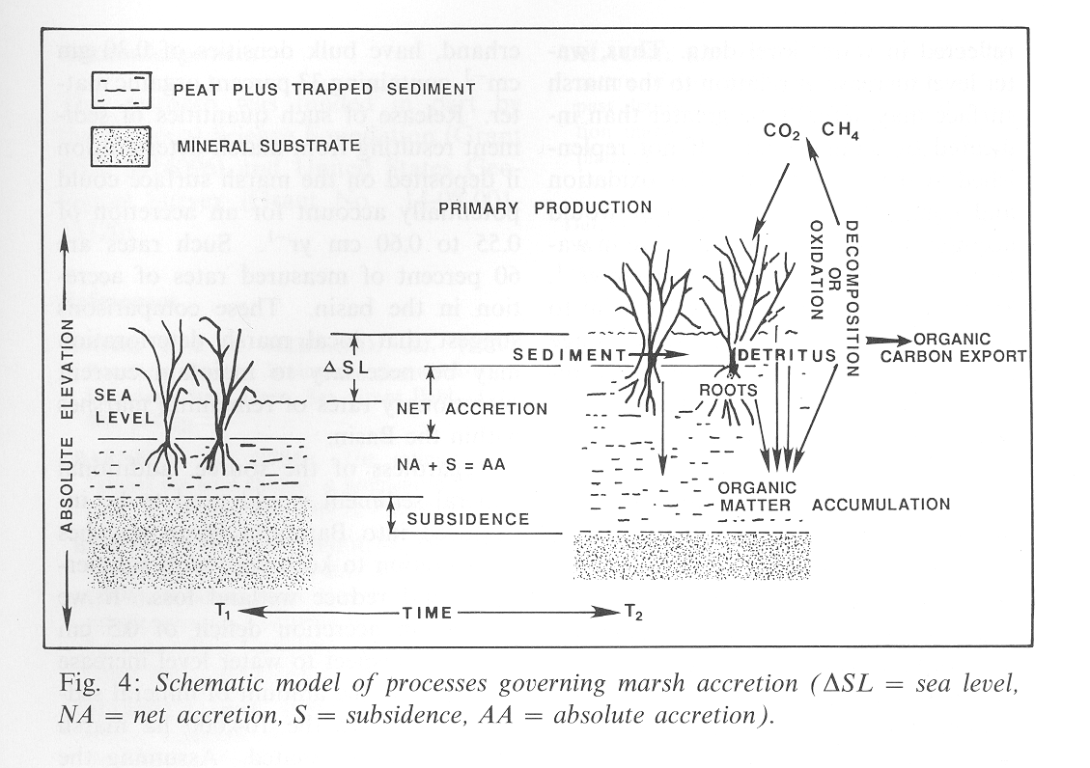
Workshop for Coastal Wetland Wildlife Managers
21 – 25 May 2018,
Rockefeller Refuge, Grand Chenier, Louisiana
pond
pond
modified from DeLaune et al. 1990. Catena 17:277-288

Slide 2
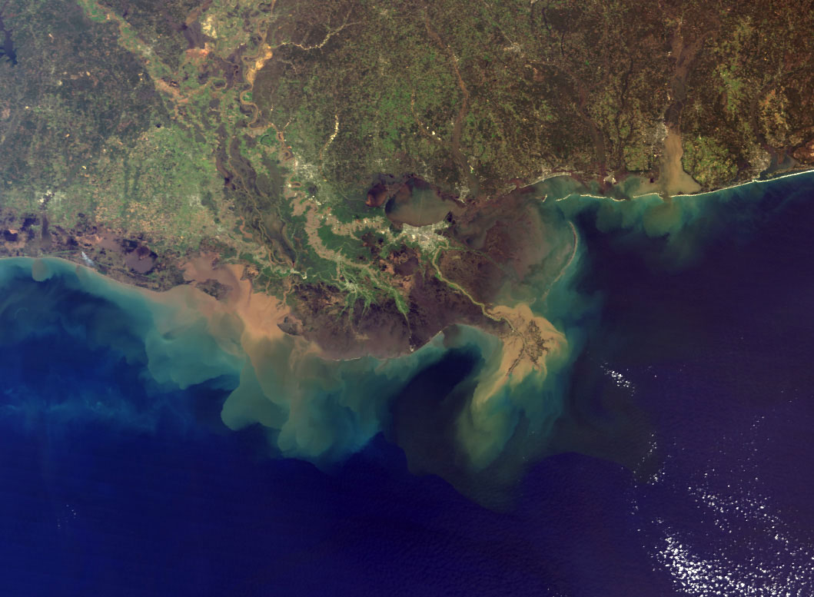
Mississippi River Deltaic Plain
Previous generations believed that the levees, the old river control structure, and wetland drainage that they desired would leave future generations living below sea level and without the benefits of adjacent wetlands.

Slide 3
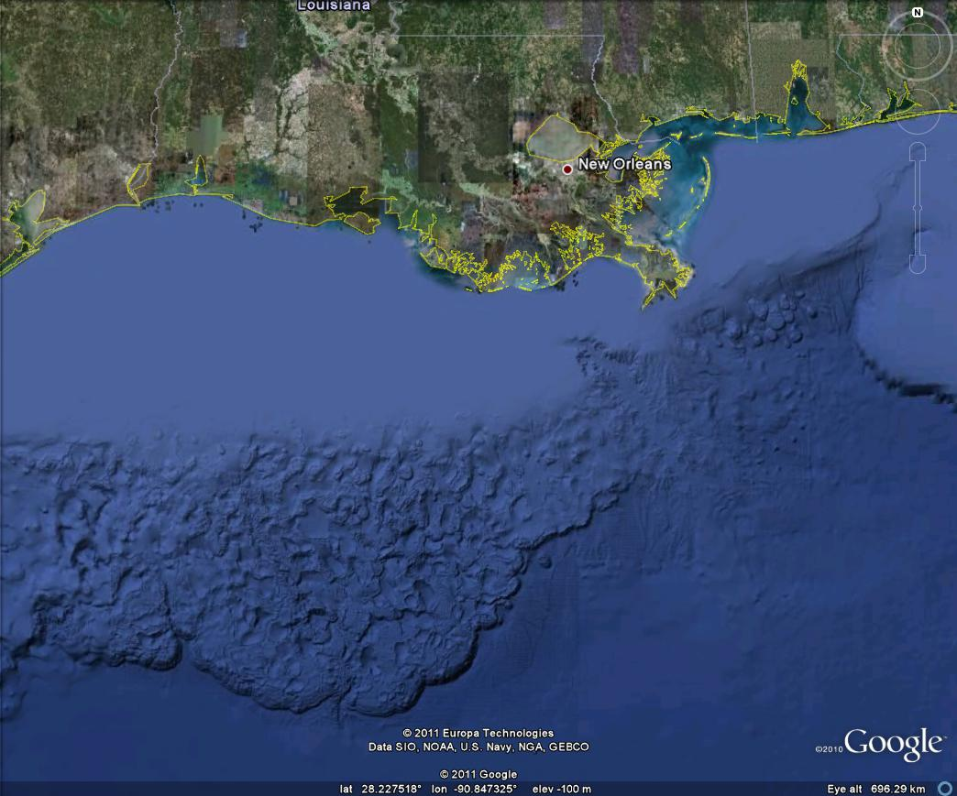

Slide 4
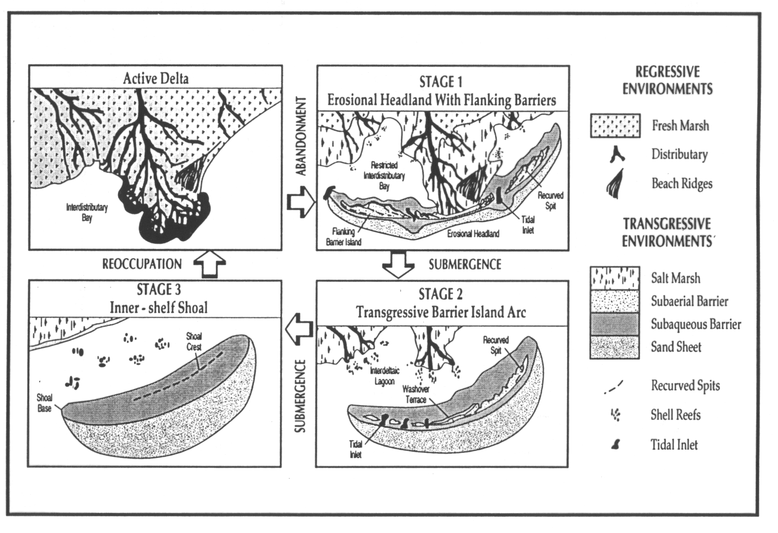

Slide 5
Inactive Delta

Slide 6
Inactive Delta
Inactive Delta

Slide 7
Inactive Delta
Inactive Delta
Inactive Delta

Slide 8
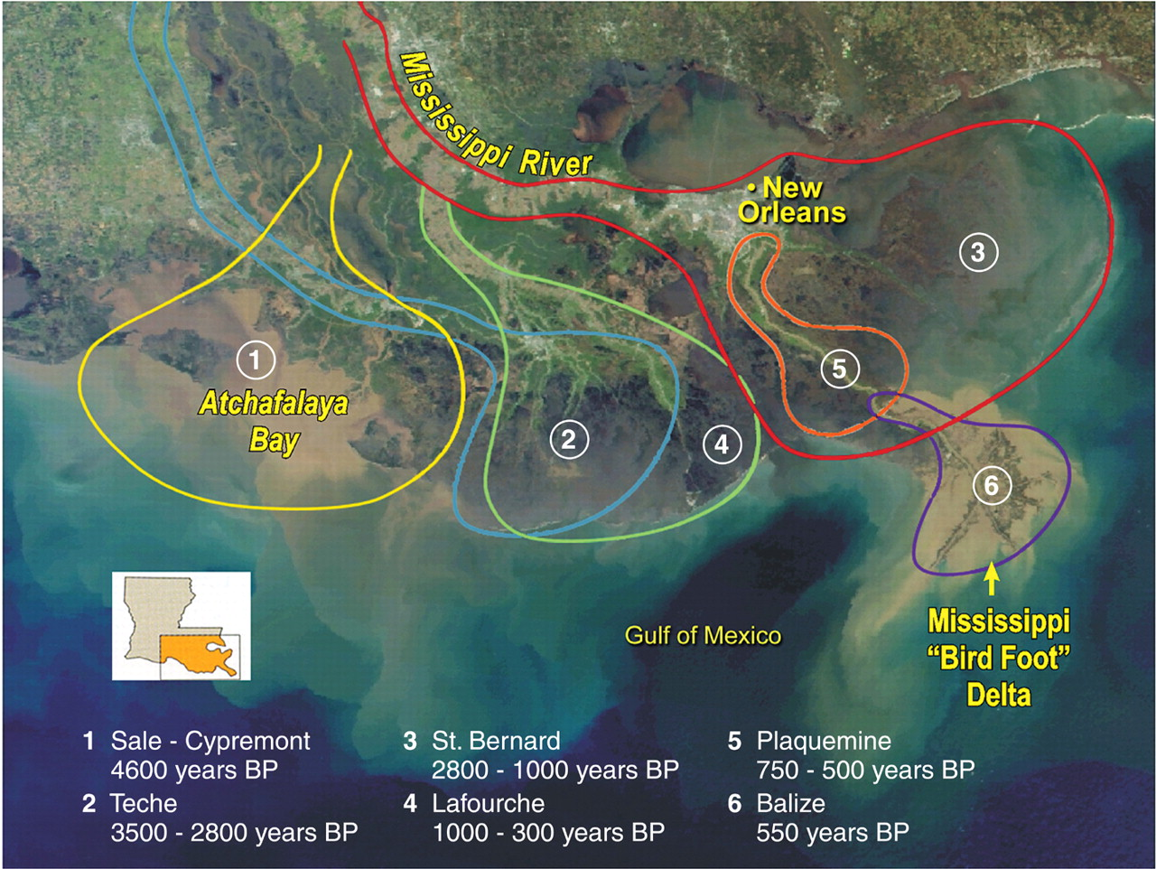
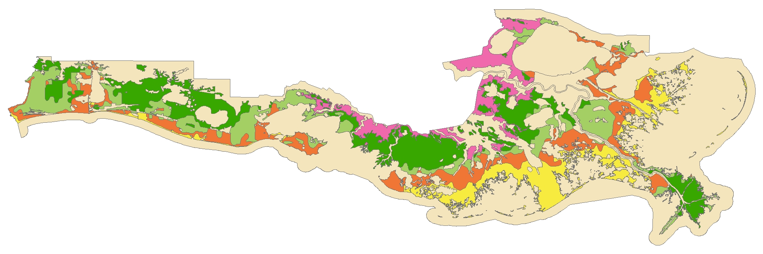

Slide 9
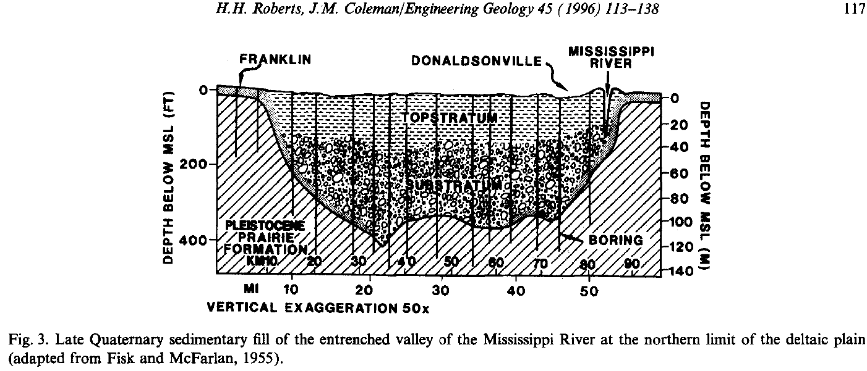
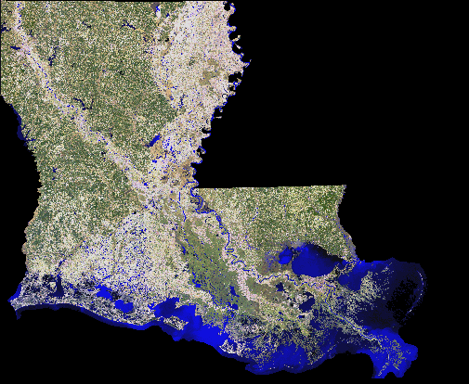

Slide 10
Inactive Delta
X
Inactive Delta
Inactive Delta

Slide 11
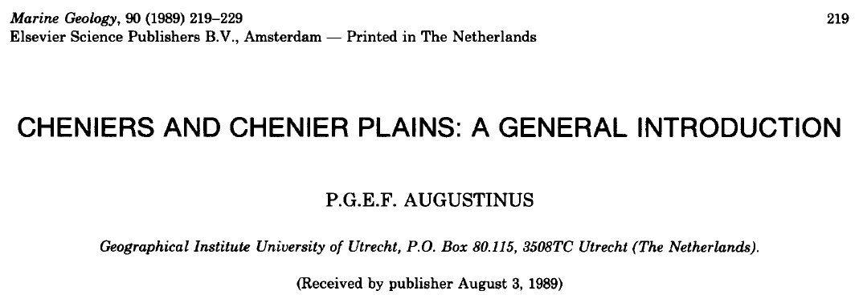

Slide 12
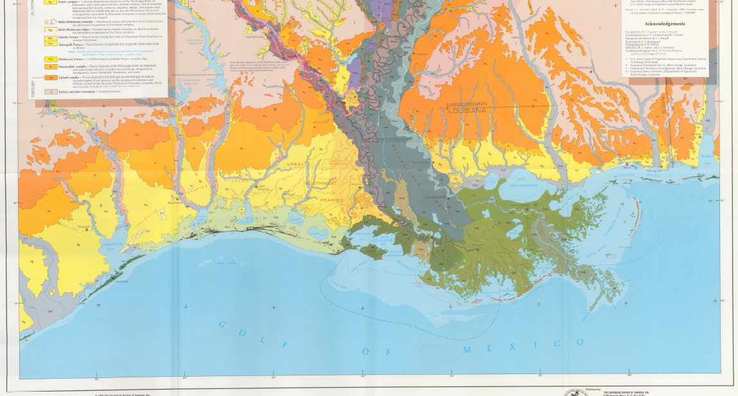
Mississippi River Chenier Plain
Saucier and Snead 1989. Quaternary Geology of the Lower Mississippi Valley. Geological Society of America

Slide 13
Miss. River never flowed through Chenier Plain
When Miss. River at western end of MRDP, then mud accumulates on shoreline. Saline marshes develop on mud
When Miss. River at eastern end of MRDP, then shoreline eroded and shell beach developed

Slide 14
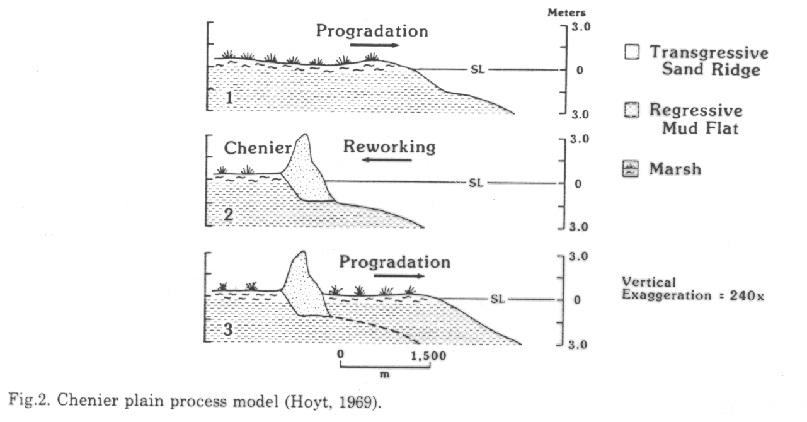
Marshes begin as saline marshes, then become fresh.
Erosion may be faster since 1900s because oyster and clam populations greatly reduced

Slide 16
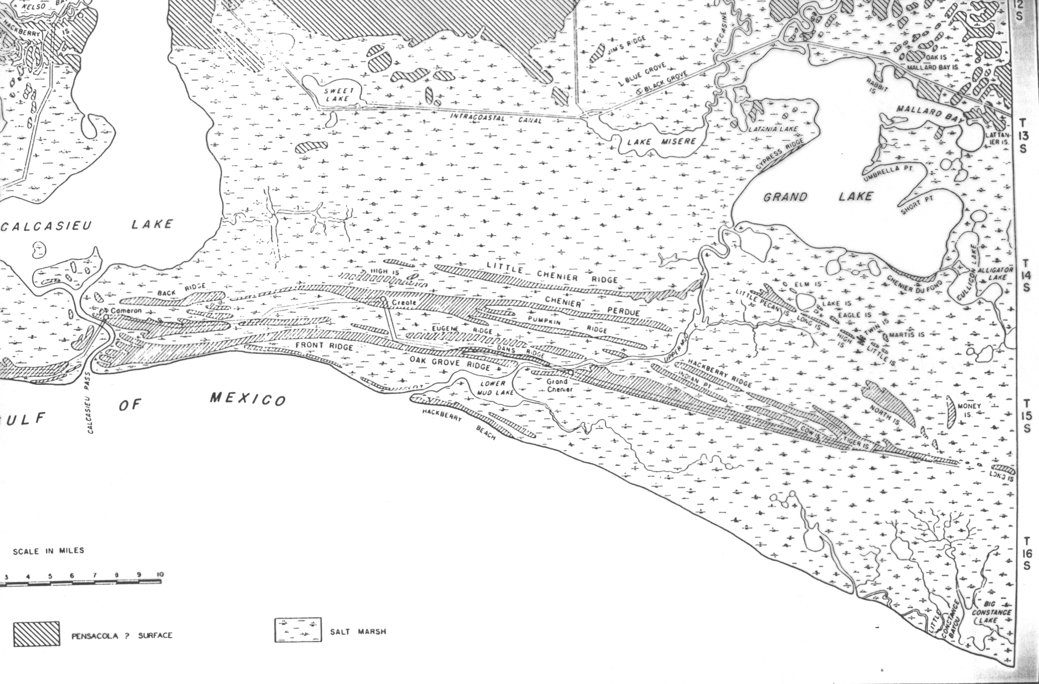
Chenier Plain interior marshes lack a natural loss process

Slide 17
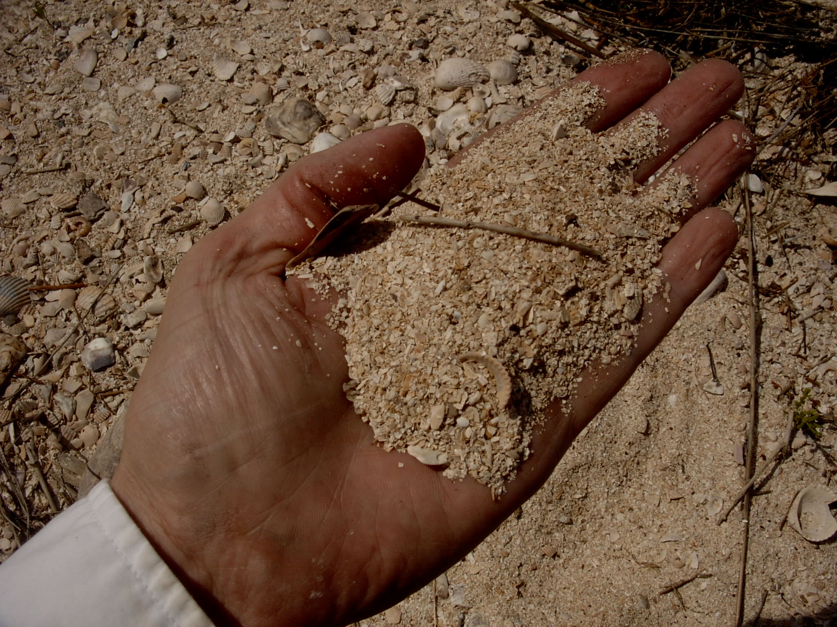
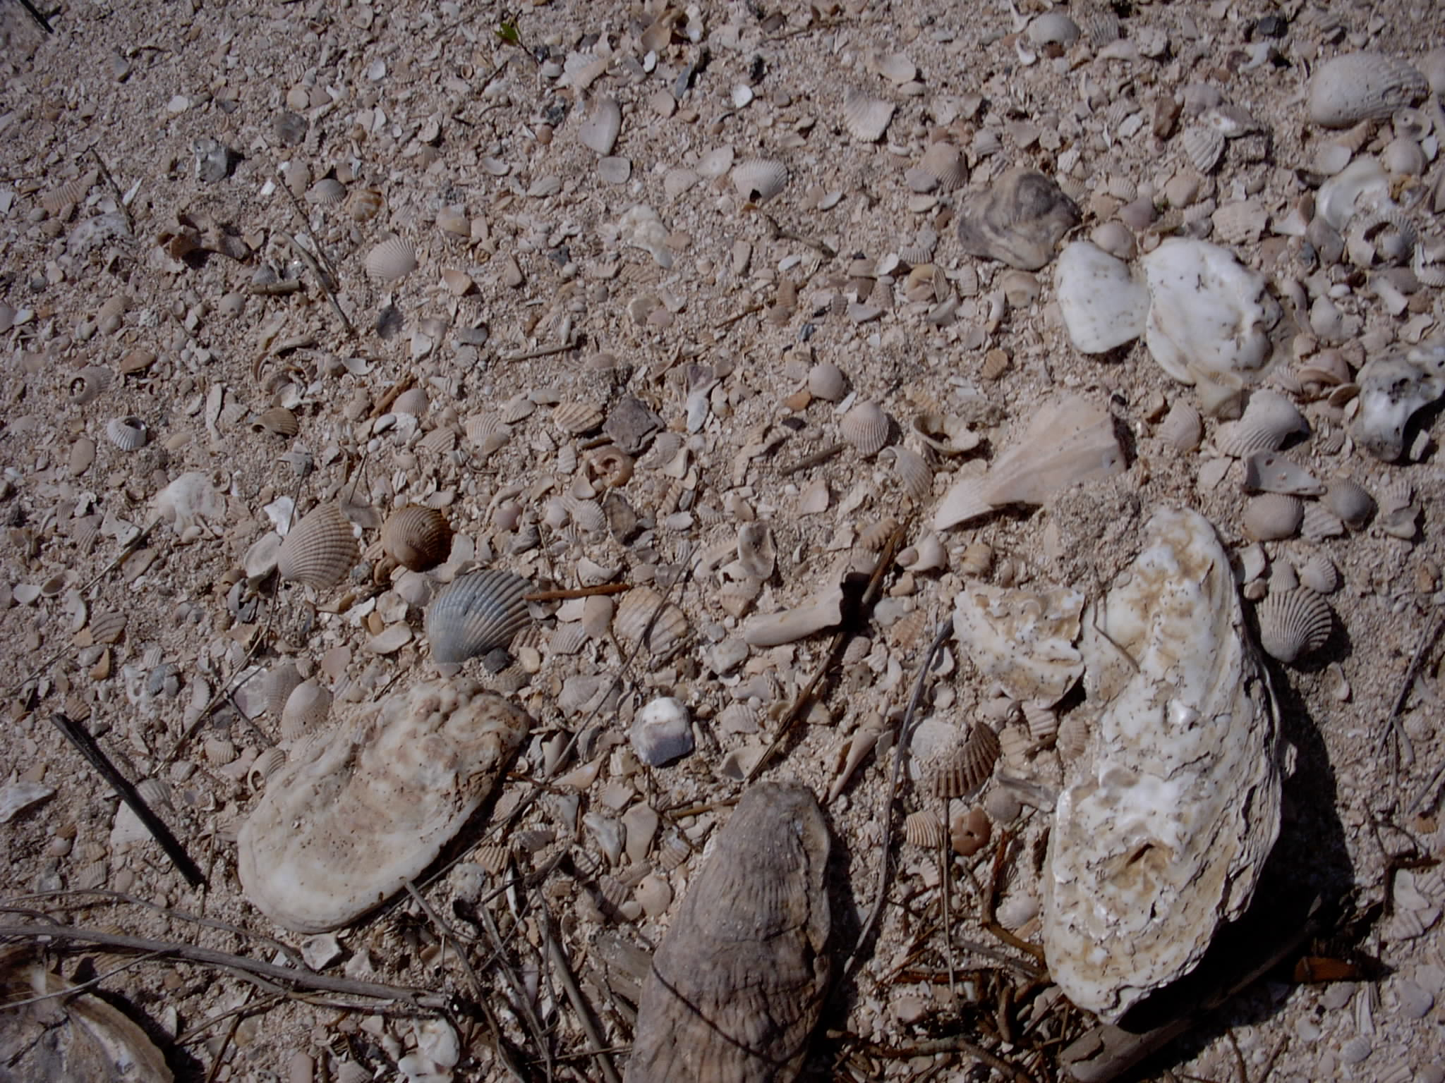
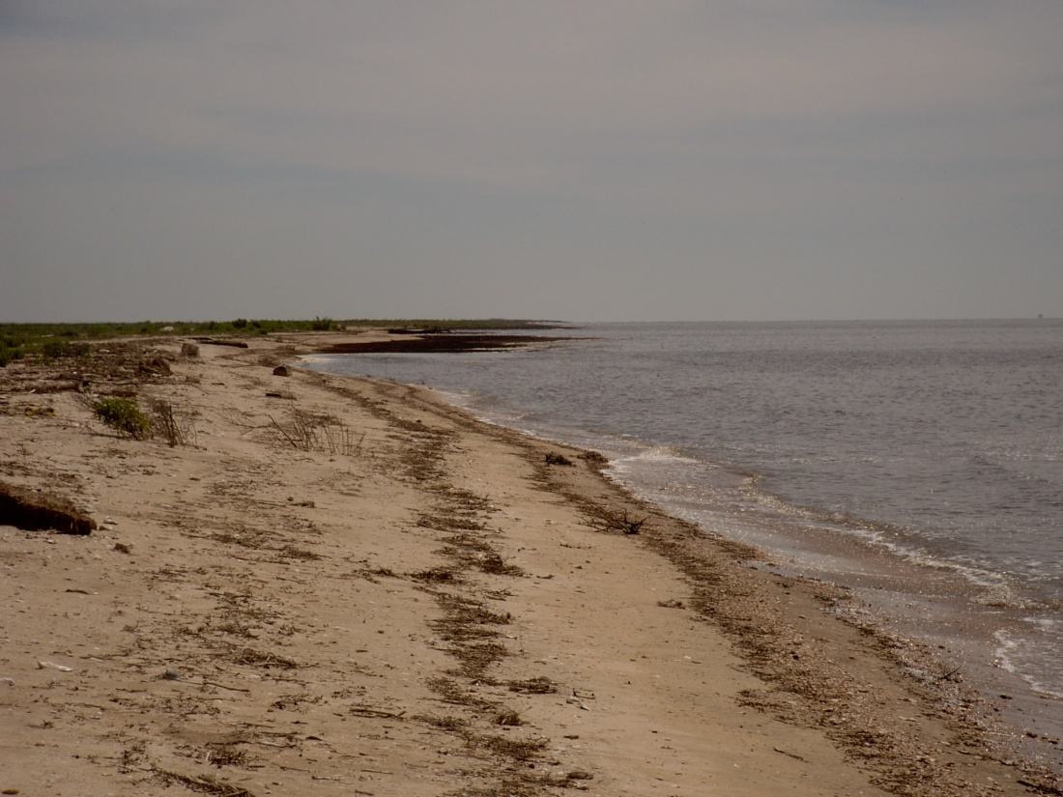

Slide 18
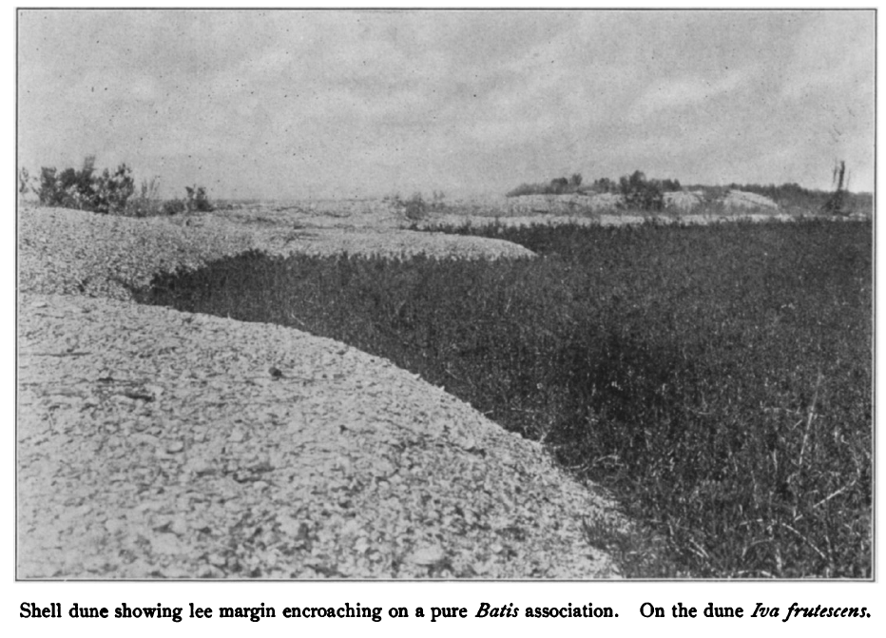
Lloyd and Tracy 1901 Bulletin Torrey Botanical Club 28:61-101.

Slide 19
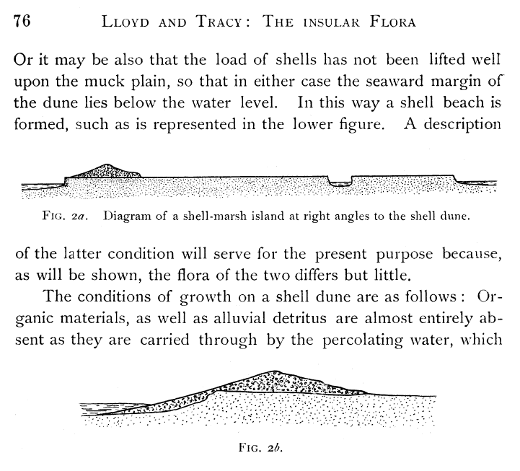
Faster-eroding shell dunes and slower-eroding shell beaches on islands of SE Louisiana and SW Mississippi; presumably applicable to erosion of Chenier Plain
Lloyd and Tracy 1901 Bulletin Torrey Botanical Club 28:61-101.

Slide 24
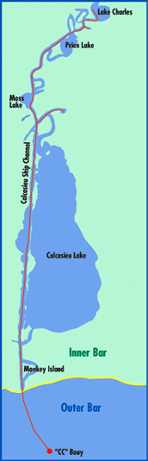
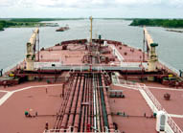
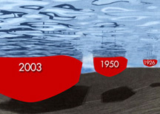
Calcasieu Ship Channel is just one of many in coastal Louisiana. Many navigation channels have been deepened over time; they erode over time.

Slide 25


Slide 27
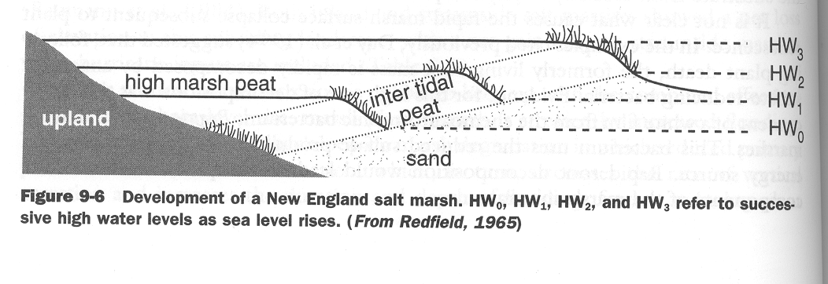
MARSH VERTICAL ACCRETION
Global Sea-Level Rise
1 mm/yr in 1950’s to 2 mm/yr today

Slide 28
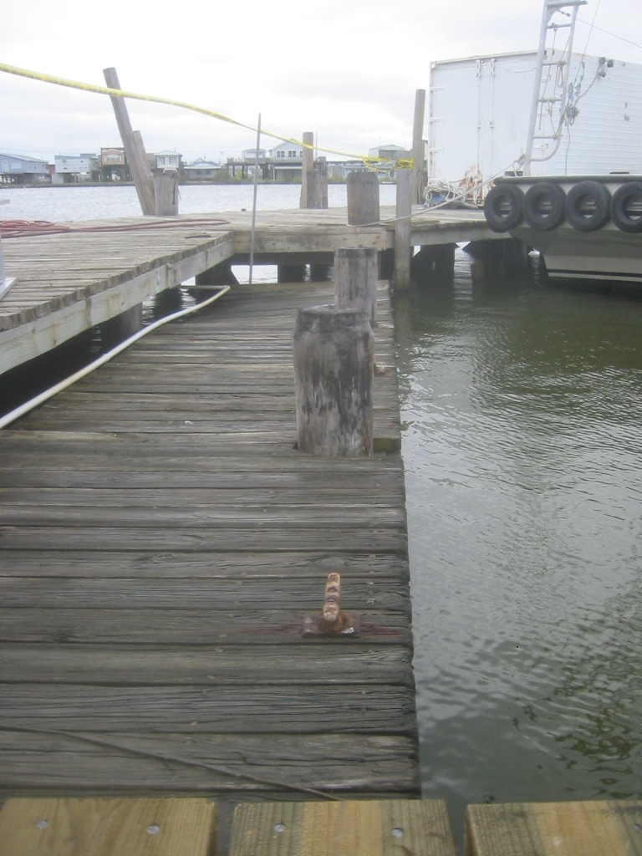
subsidence: spatially variable; the region in this photograph is subsiding fast enough that structures such as docks, roads, and houses become too low to use before they wear out.

Slide 30
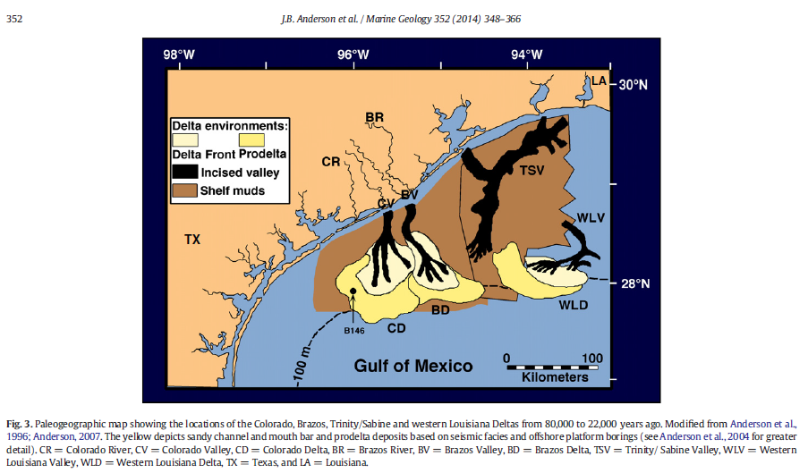
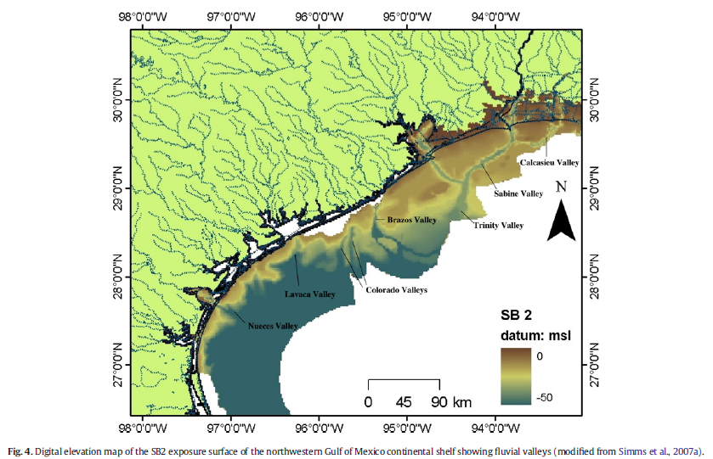
Anderson et al. 2014. Marine Geology 352:348-356.

Slide 31
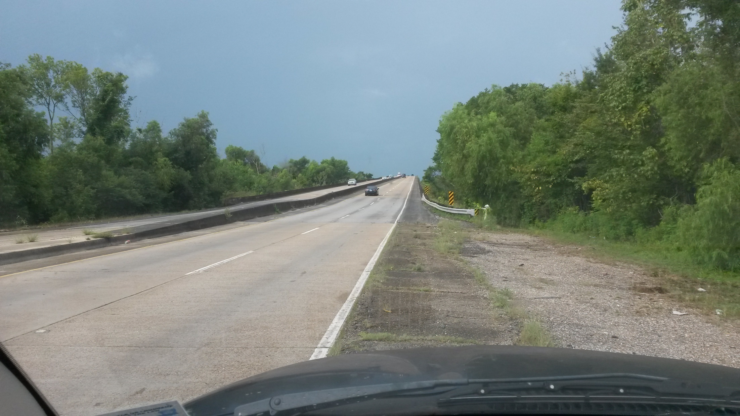

Slide 32
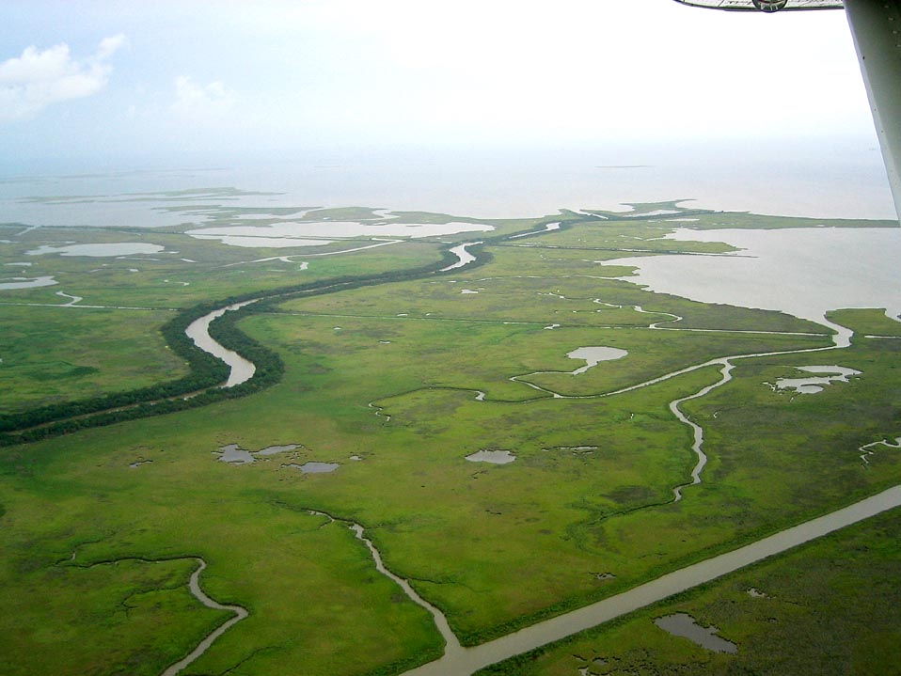
this marsh is vertically accreting fast enough to offset global sea-level rise and regional subsidence

Slide 33
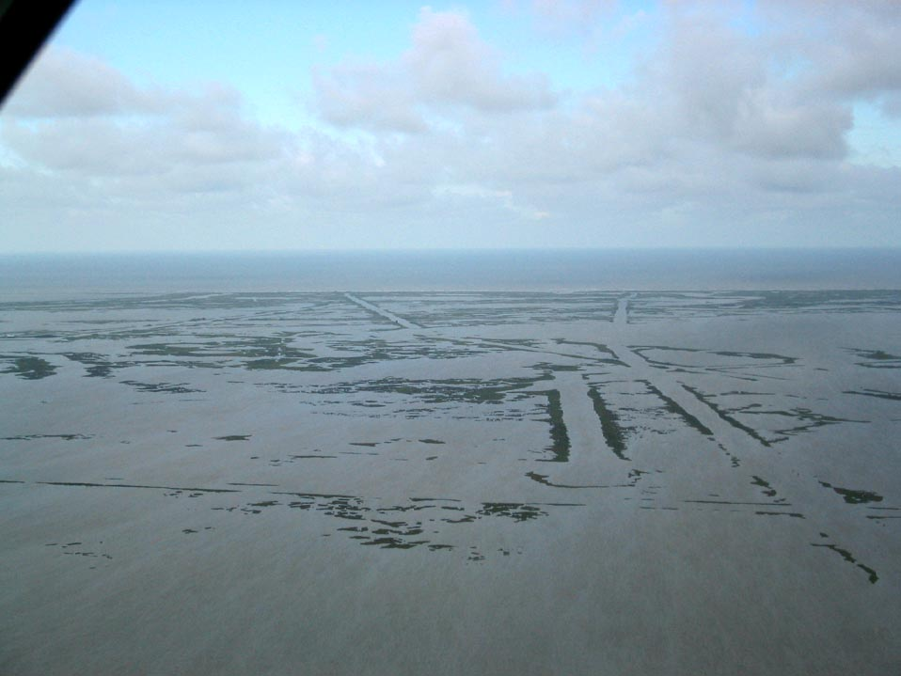
this marsh is not vertically accreting fast enough to offset global sea-level rise and regional subsidence; it may be accreting faster than the marsh in the previous picture but subsiding even faster

Slide 34
marsh vertical accretion
Notes:
delta lobe cycle creates subsidence, so subsidence as well as gslr; travel a few km and subsidence differs
delta lobe cycle also creates wetland loss (18 ha/day from 1930-1990; 44.5 ac/day from 1930-1990)

Slide 35
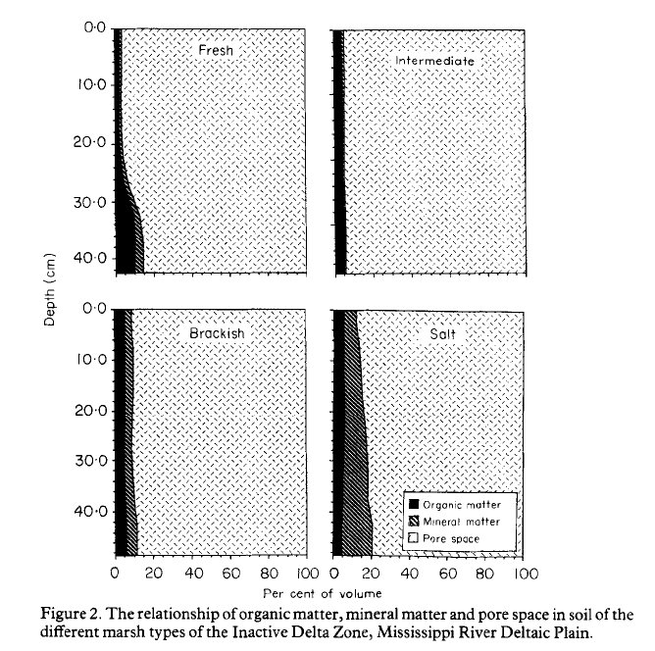

Slide 36
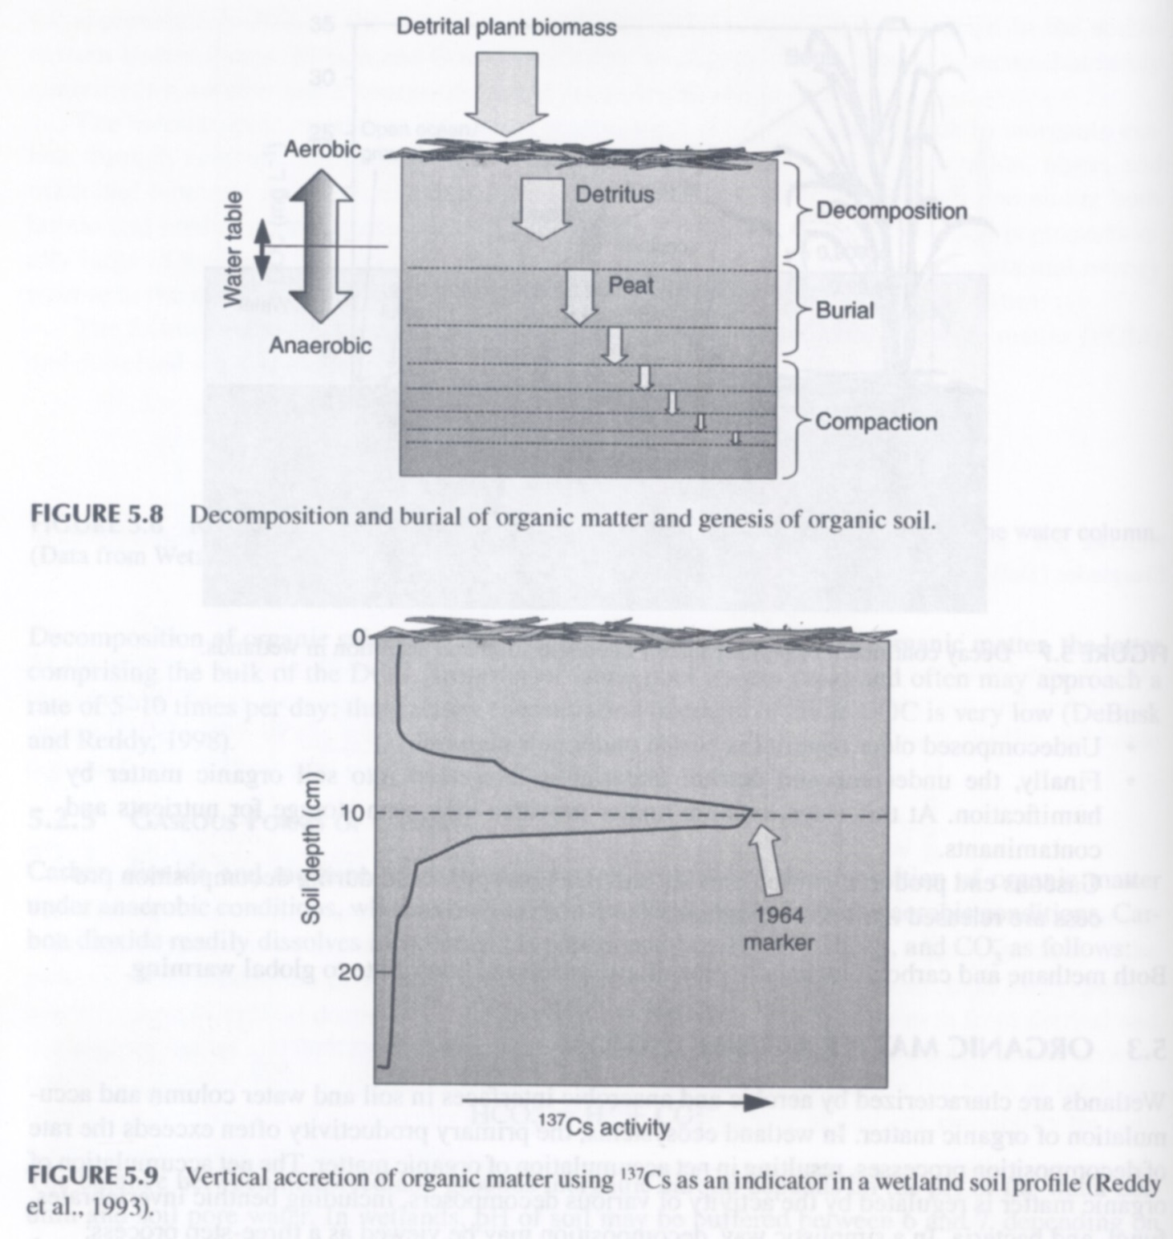

Slide 40
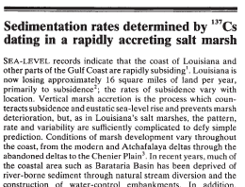
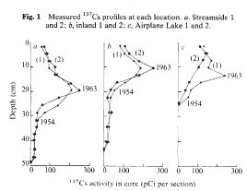
DeLaune et al. 1978. Nature. 275:532-533

Slide 41
6
DeLaune et al. 1978. Nature. 275:532-533

Slide 42
2
4
1
2
1
7
2
20
18
7
1
4
1
2
7
1
1
1
1
1
8
1
1
12
1
22
7
12
6
at least another 55 cores from Louisiana and Texas

Slide 43
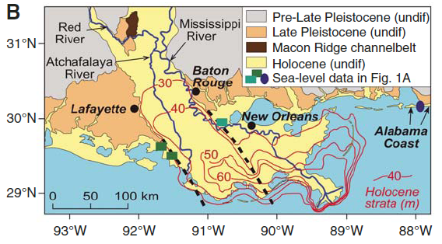
Blum et al. 2008. Geology 36:675-678

Slide 44
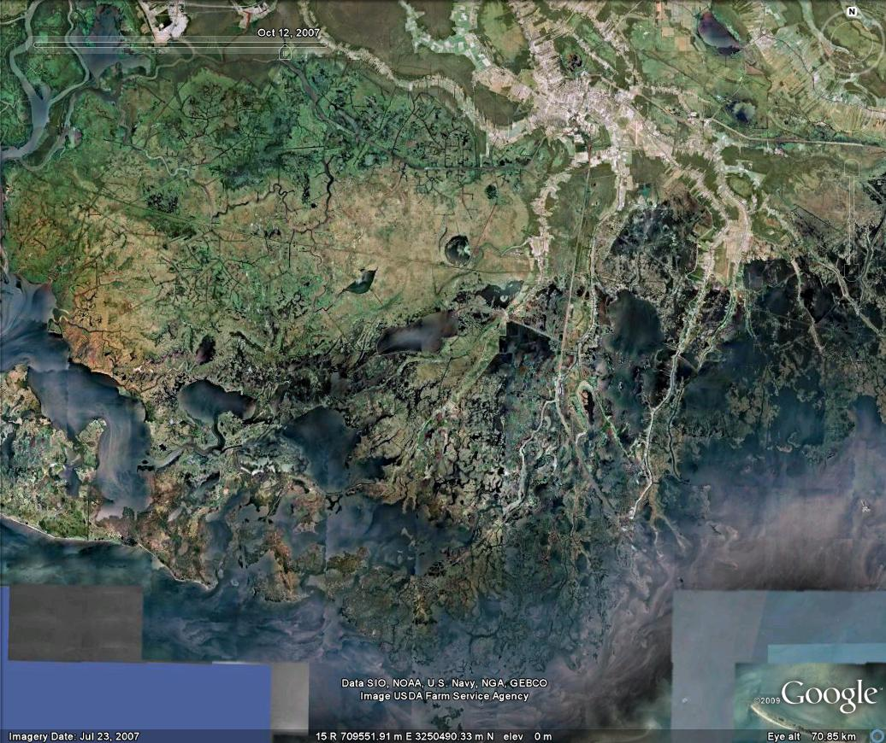
9.8 mm/yr
7.4 mm/yr
Nyman et al. 2006 Estuarine Coastal and Shelf Sci 69:370-380

Slide 45
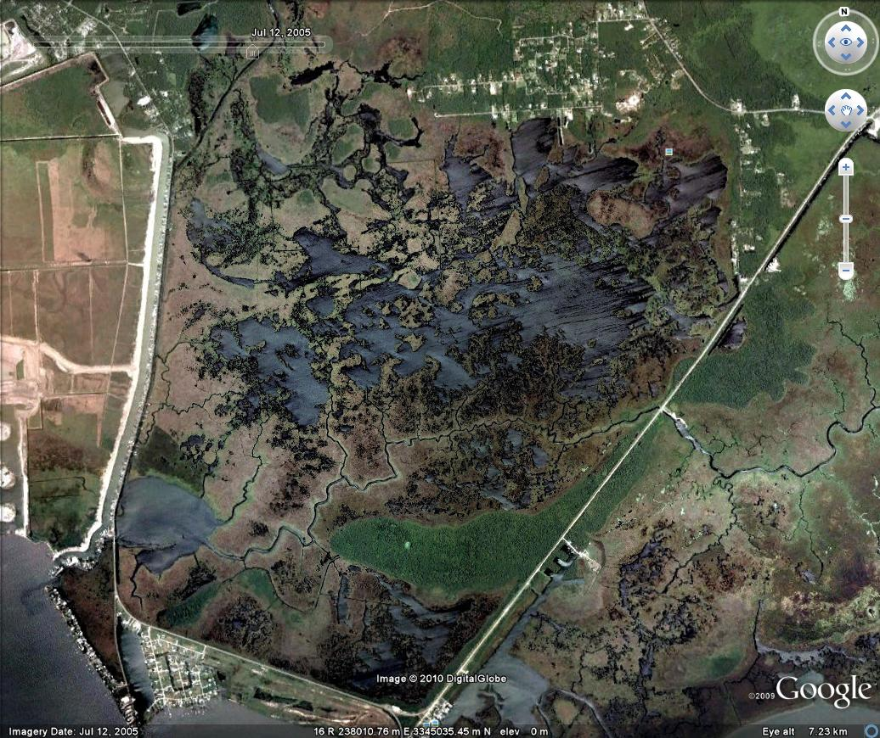
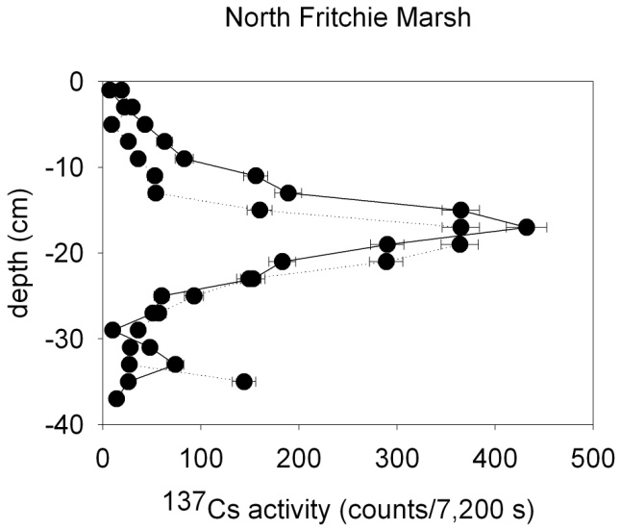
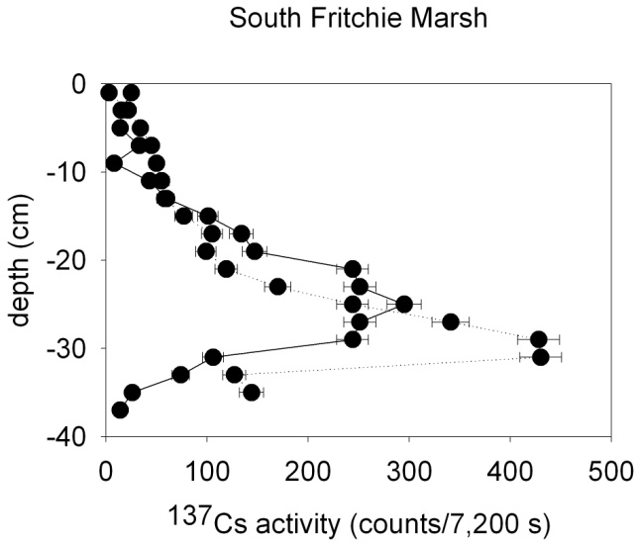
5.3 mm/yr
8.4 mm/yr

Slide 46
1st take home message
Spatial patterns in vertical accretion demonstrate that accretion accelerates in response to subsidence up to a limit.
Beyond some limit, accretion is inadequate to counter submergence (subsidence and global sea-level rise) and marshes convert to shallow open water over several decades. What limits accretion?

Slide 47
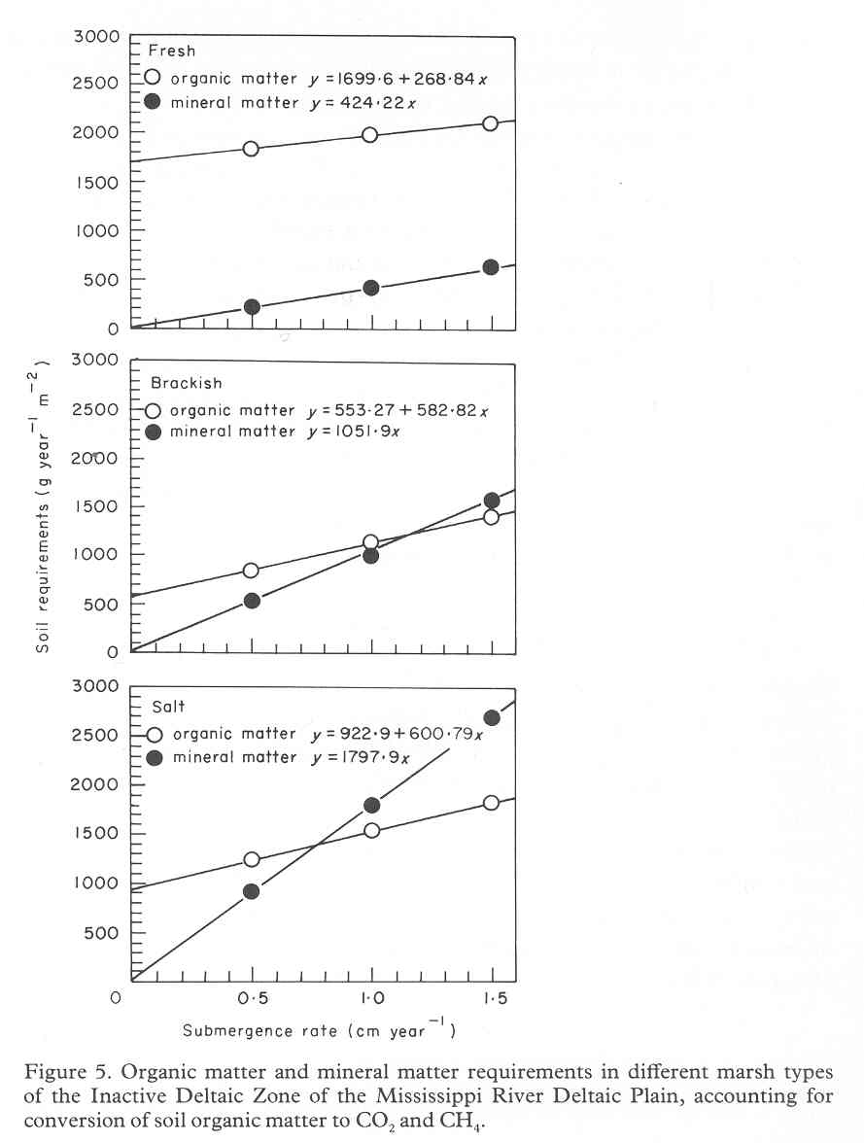
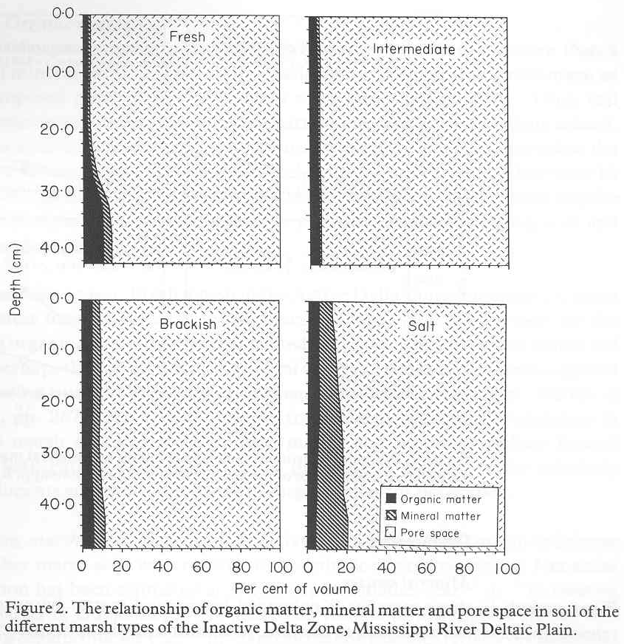
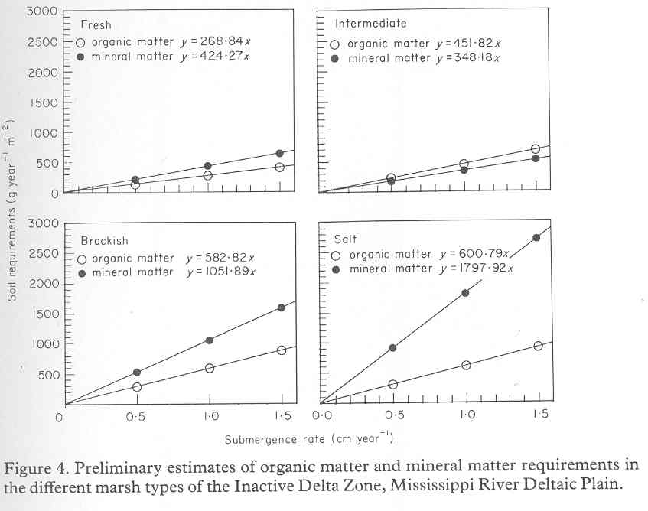
what’s in marsh soil?
(what’s the recipe?)
Nyman et al. 1990. Estuarine, Coastal and Shelf Science 31:57-69.

Slide 48
Marsh vertical accretion
Constituent | Switch on | Switch off | Reverse switch
roots and rhizomes | flooding | lack of flooding | aeration
sand, silt, and/or clay | flooding | lack of flooding | none*
* aerating mineral soils can lead to cat clays (acid sulfate soils)

Slide 49
Limiting Factors
Regarding chemical reactions: the limiting reactant is the reactant whose supply is depleted first.
Plant growth often limited by N or P.
Liebig’s Law of the Minimum (1840): each population increases until the supply of some resource (the limiting resource) no longer satisfies the populations requirement for it.

Slide 50
what limits vertical accretion?
accumulation of mineral sediments delivered by tides and storms
accumulation of organic matter produced by marsh vegetation

Slide 51
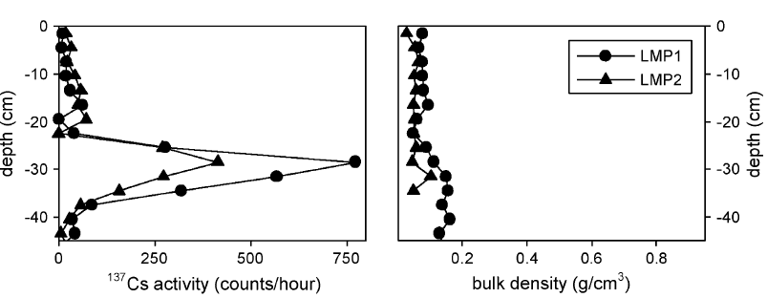

Slide 52
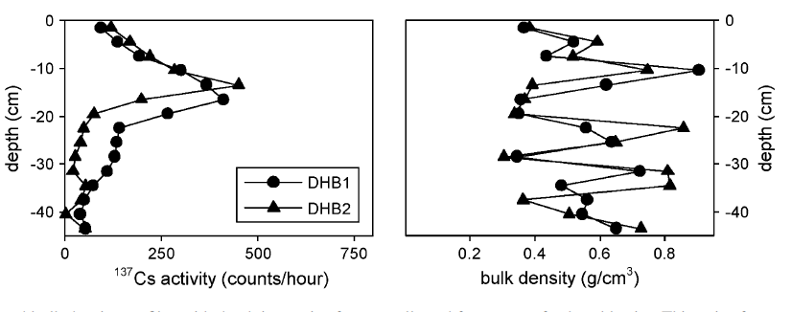

Slide 53
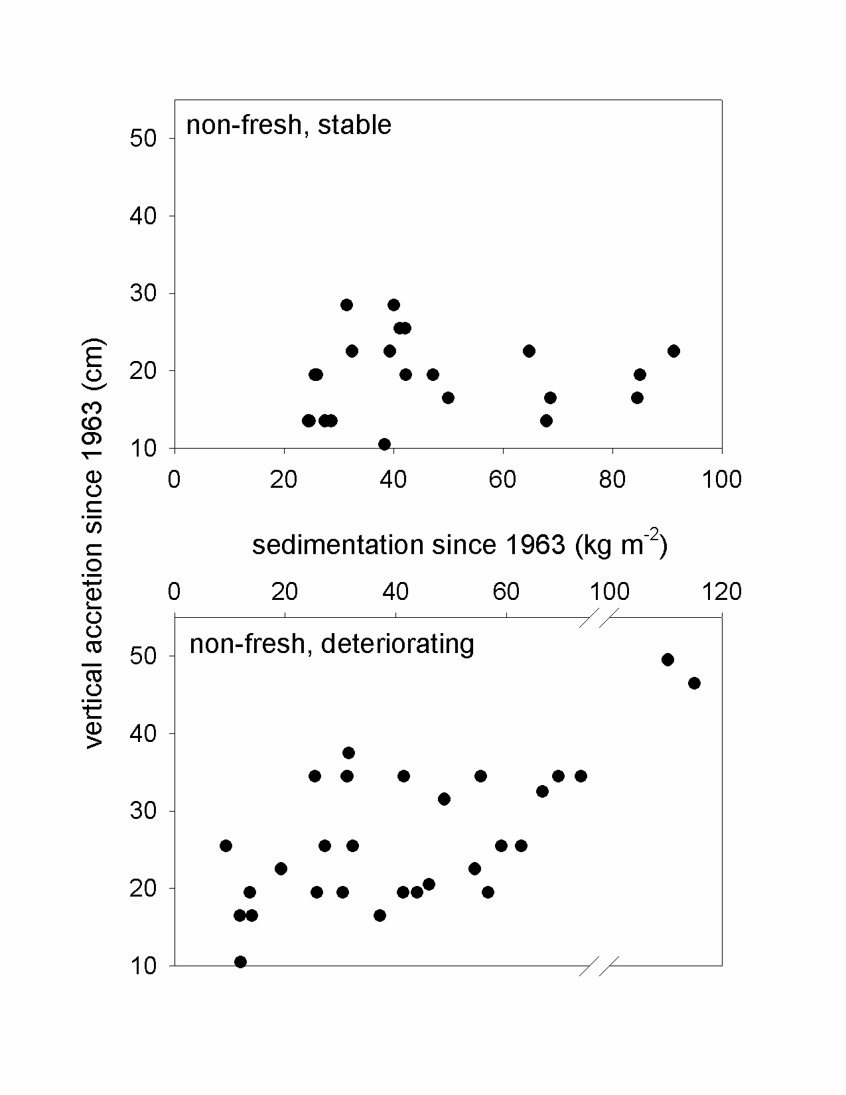
Nyman et al. 2006. Estuarine Coastal and Shelf Science 69:370-380. C

Slide 54
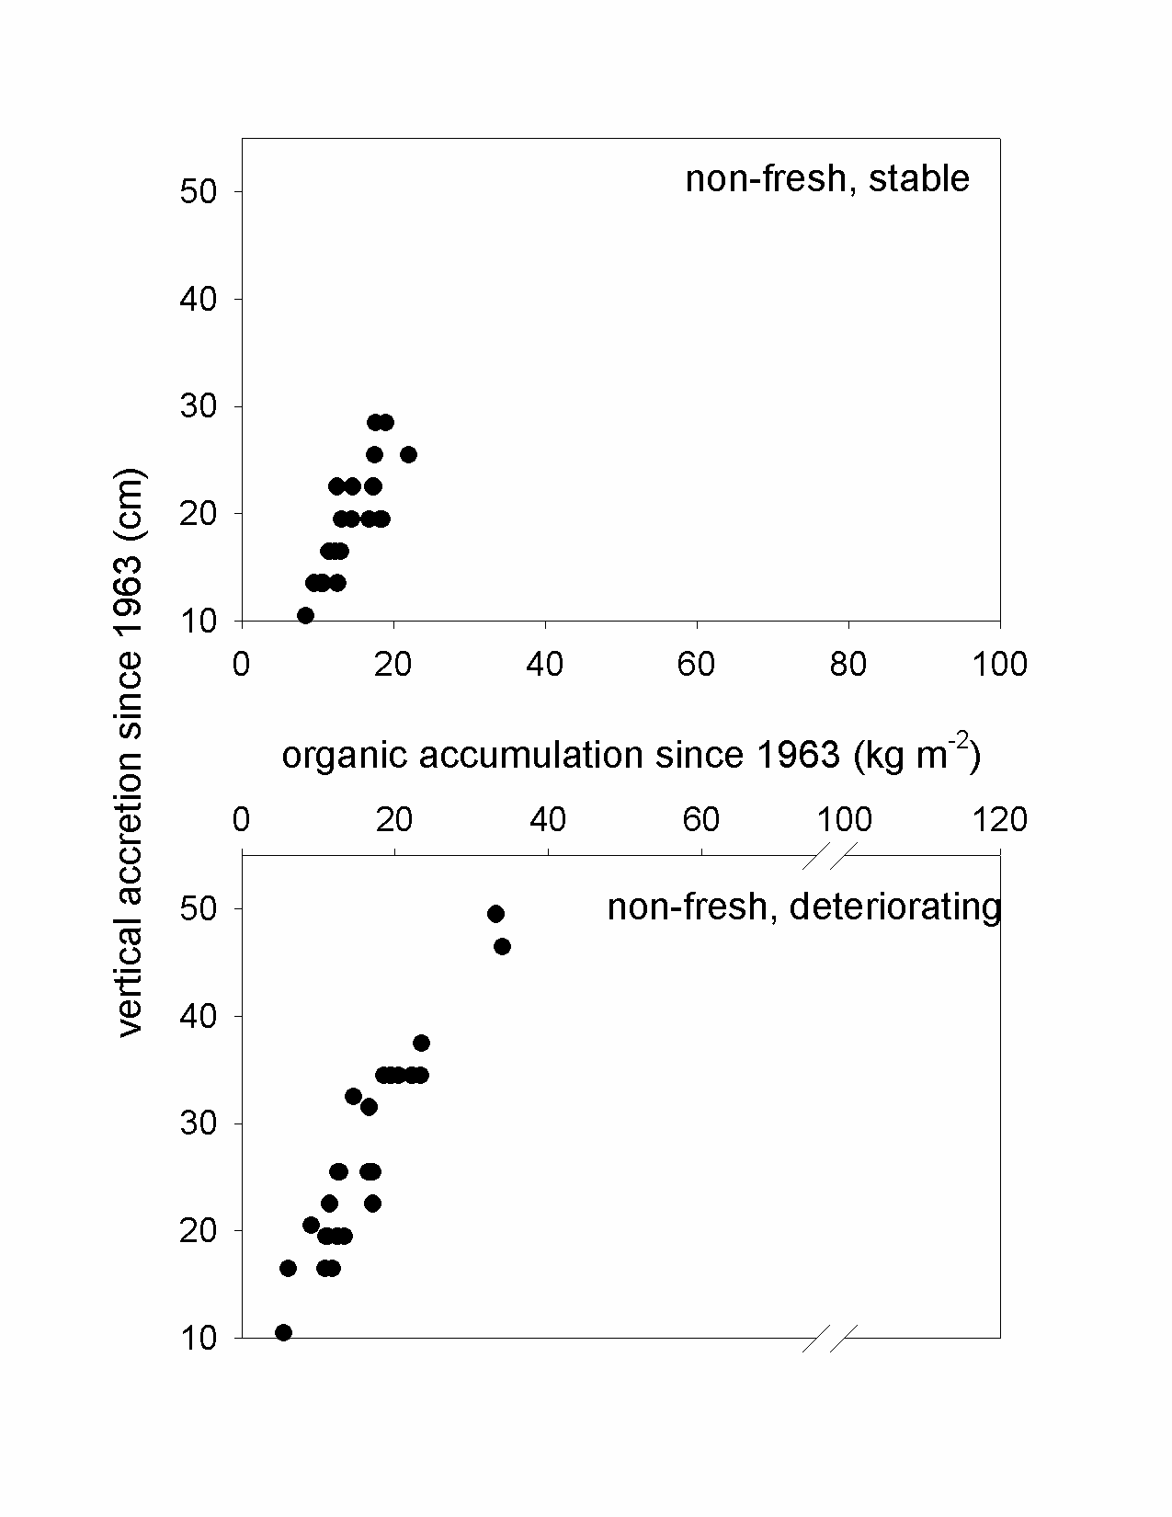
Nyman et al. 2006. Estuarine Coastal and Shelf Science 69:370-380.

Slide 55
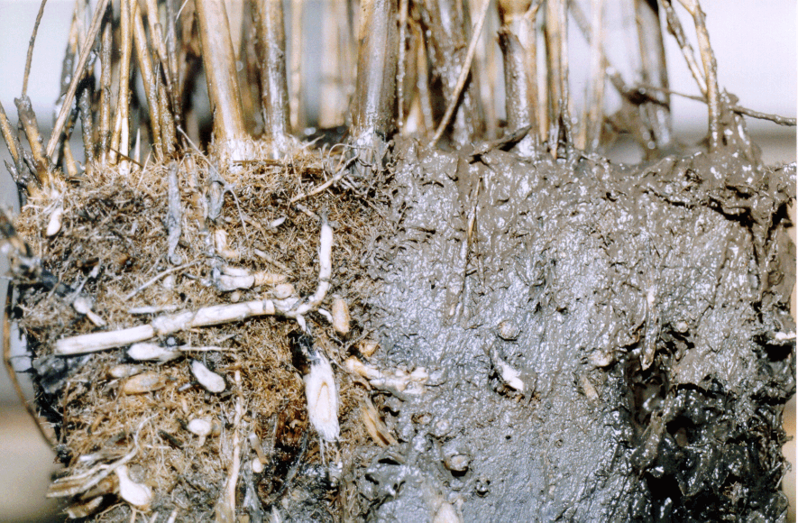

Slide 58
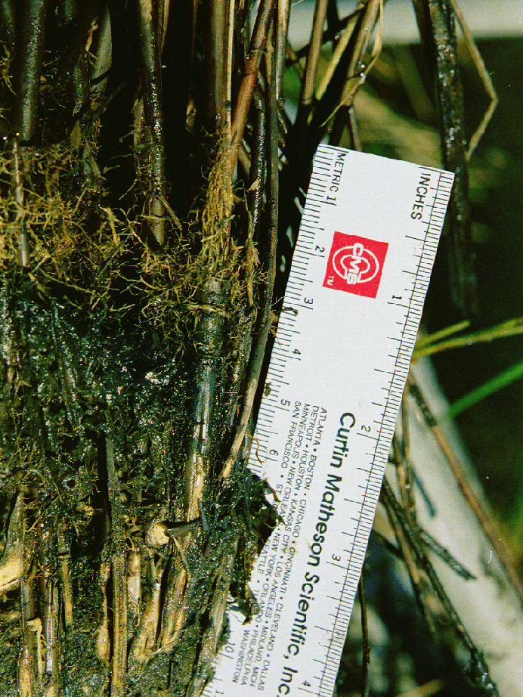
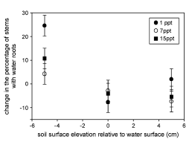

Slide 61
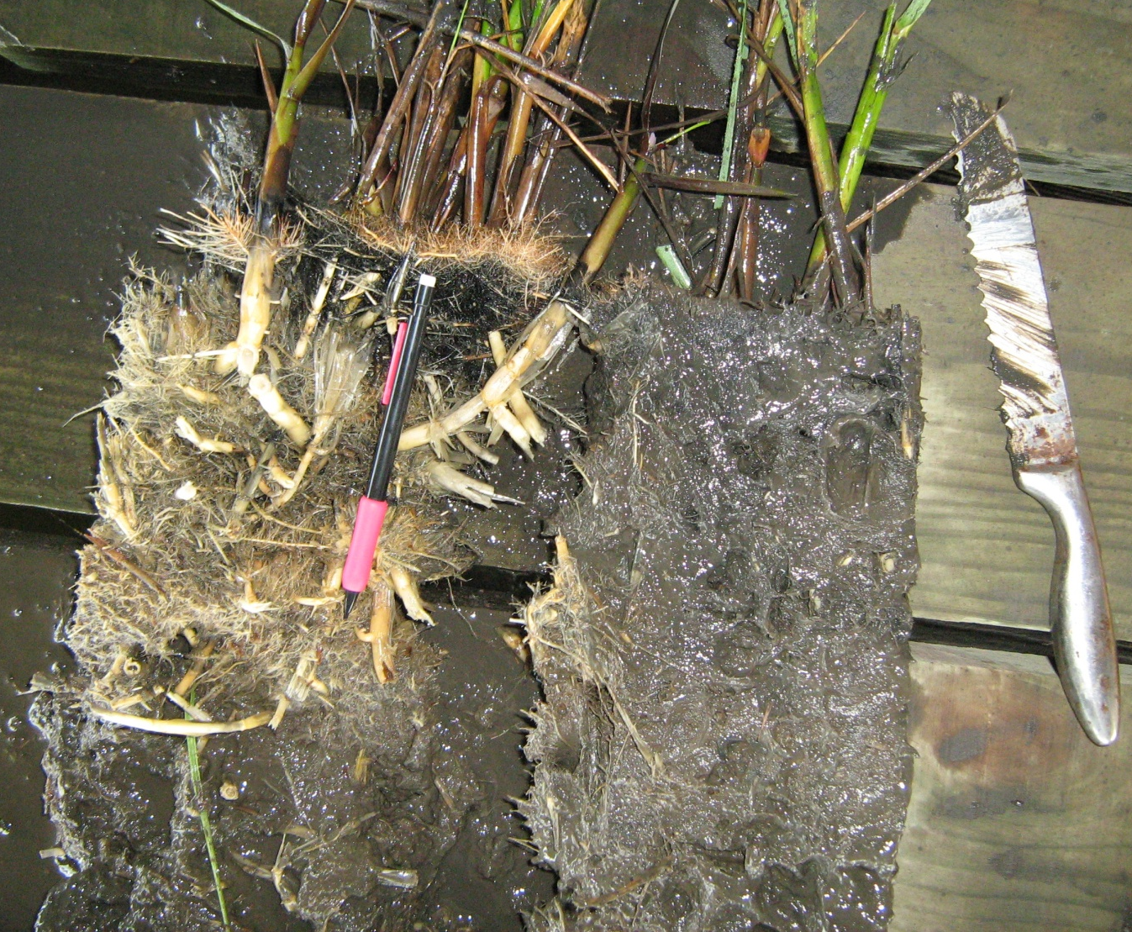

Slide 62
2nd take home message
Now clear that that many marshes, from tidal fresh to saline, from micro-tidal to macro-tidal, from Louisiana to Canada, depend upon organic matter produced by emergent vegetation to vertically accrete.
Roots, rather than stems and leaves, appear to control accretion via vegetative growth.

Slide 63
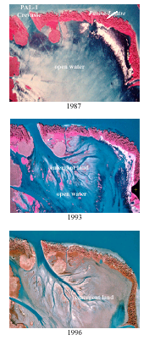
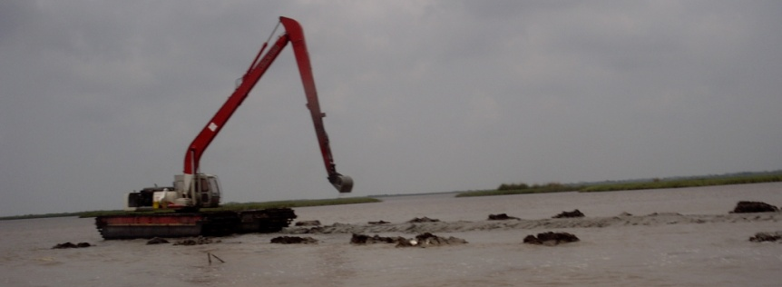
mineral sediments matter
1. except in the freshest water, only mineral sediments can create suitable conditions in deep, open water for emergent plants

Slide 64
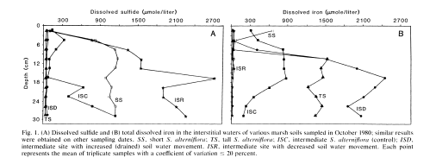
2. Spartina biomass is positively related to soil Fe and/or mineral sediment density
King et al. 1982. Science 218:61-63.

Slide 65


DeLaune and Pezeshki. 1988. Northeast Gulf Science 10:195-204.
Nyman et al. 1994. Earth Surface Processes and Landforms 19:69-84.

Slide 66


Slide 68





Slide 70
3rd take home message
Mineral sediments are needed to create, or recreate, wetlands in open water areas
Mineral sediments probably are important indirectly to marsh vertical accretion via vegetative growth by providing nutrients and moderating sulfide toxicity.
other factors that can limit plant production probably can limit vertical accretion too; i.e., low nutrient availability, high salinity, too much flooding

Slide 71
soil organic matter decomposition and marsh vertical accretion

Slide 72

soil organic matter decomposition and marsh vertical accretion
4.1 g N m⁻², 4.5 g P m⁻²
36 g N m⁻², 0.5 g P m⁻²
40 g N/m², 60 g P/m², and 40 g K/m². Fe, Mn, and Zn also were present in trace amounts.
Nyman. 1999. Microbial Ecology 37:152-162.

Slide 73
soils near Caernarvon do not decompose differently that soils far from Caernarvon

Slide 74



Slide 81

m

Slide 82


Slide 83
4th take home message
nutrient accumulation and addition rates typically observed in Louisiana had little affect on soil organic matter decomposition rates, but nutrient addition rates typically used in agricultural fields doubled soil organic matter decomposition rates.
even a little soil drainage can reverse decades of vertical accretion

Slide 84

how do you know if your marsh is accreting fast enough?

