Slide 1
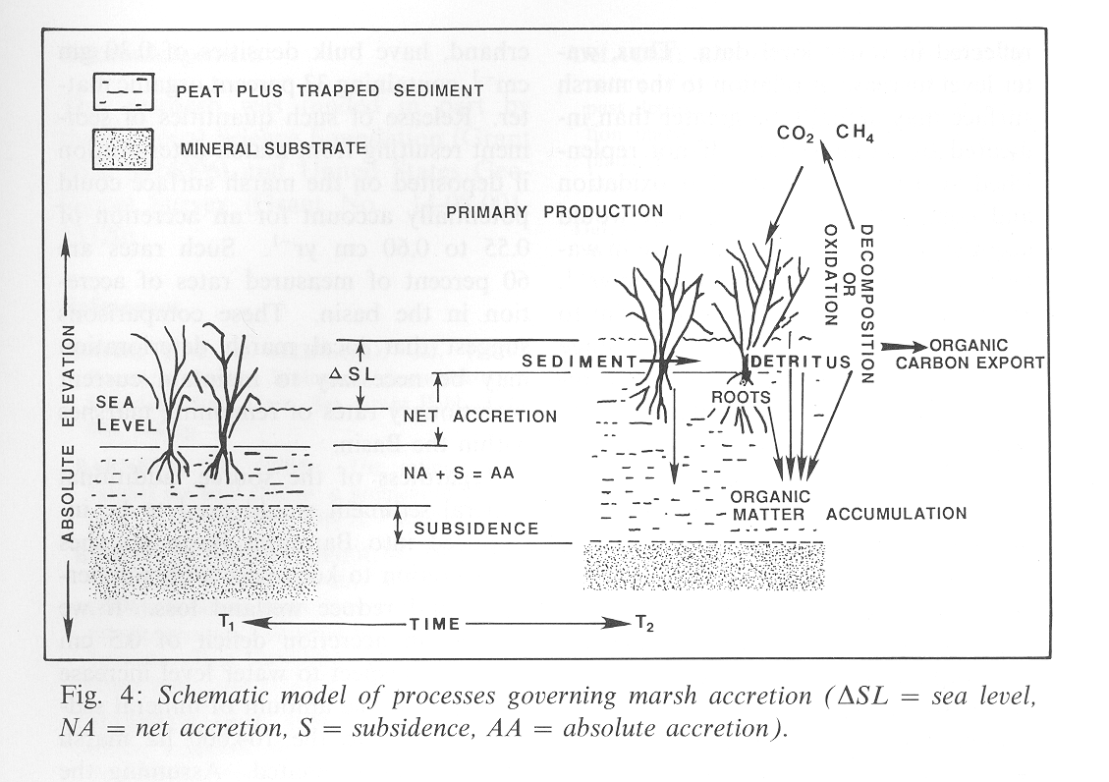
Workshop for Coastal Wetland Wildlife Managers
21 – 25 May 2018,
Rockefeller Refuge, Grand Chenier, Louisiana
pond
pond
modified from DeLaune et al. 1990. Catena 17:277-288

Slide 2
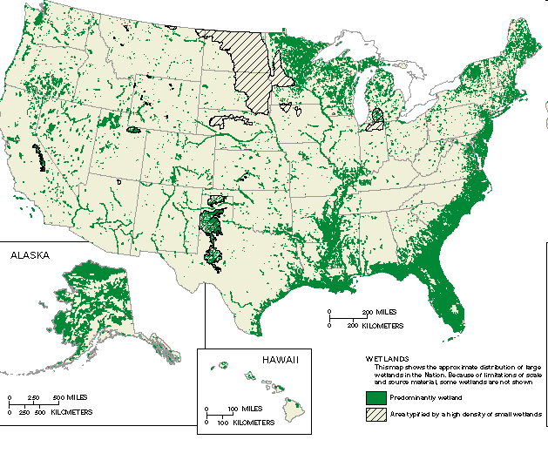

Slide 3
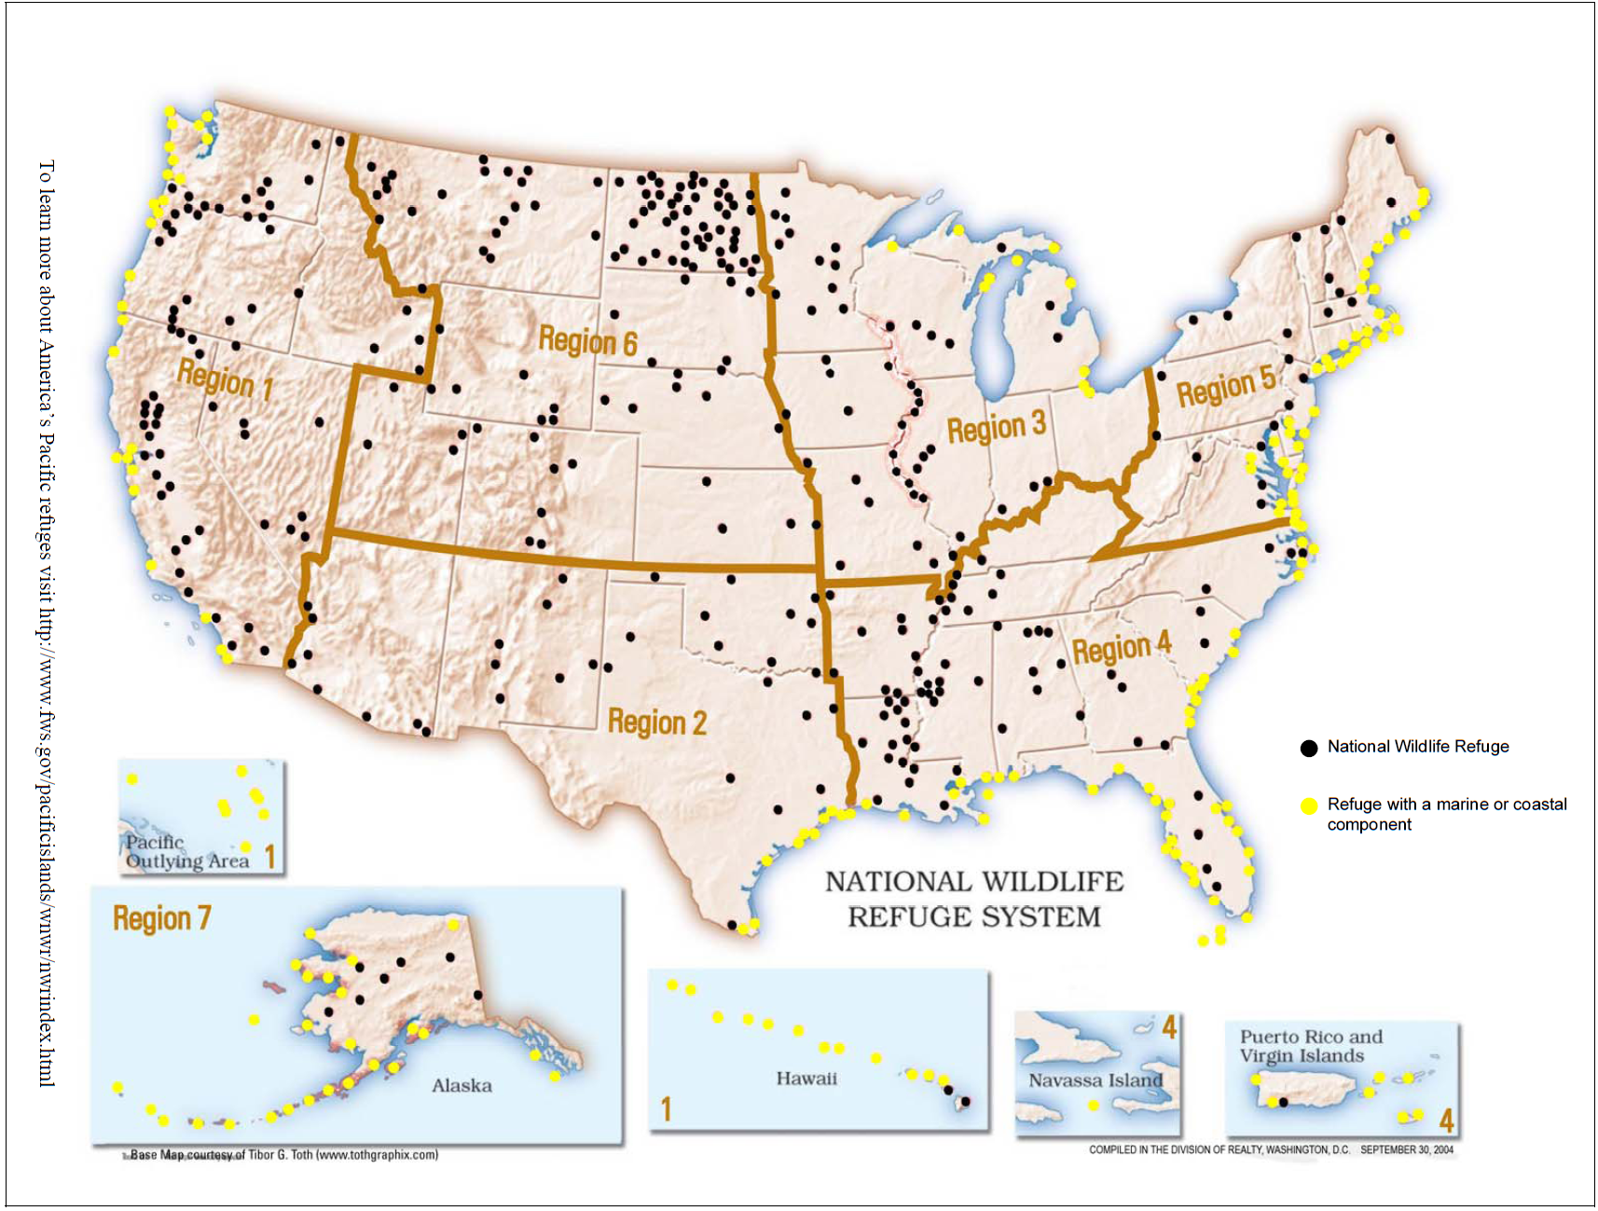
177 of the 547 federal wildlife refuges are coastal

Slide 4
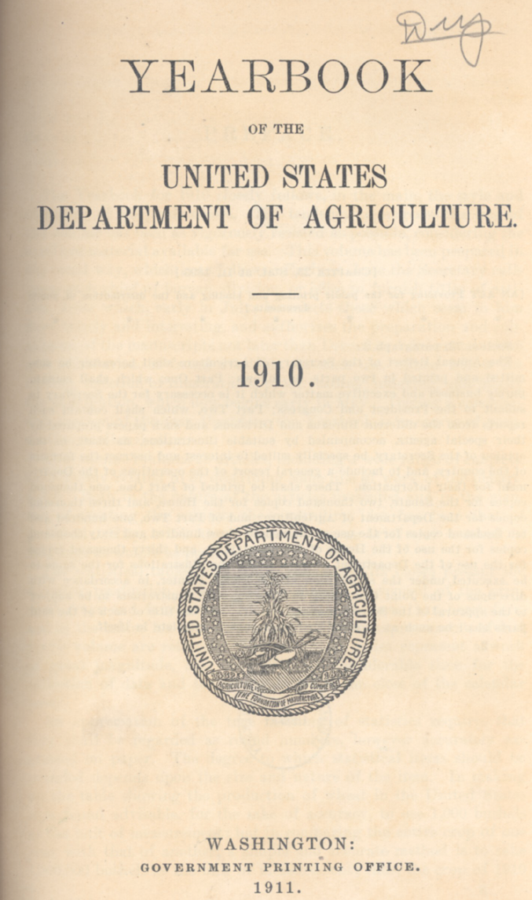
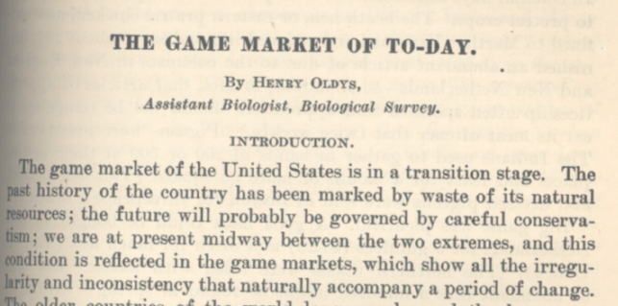
Oldys, H. 1911. The game markets of to-day. The yearbook of the Department of Agriculture. U.S. Department of Agriculture, Washington, D.C. pages 243-254.

Slide 5

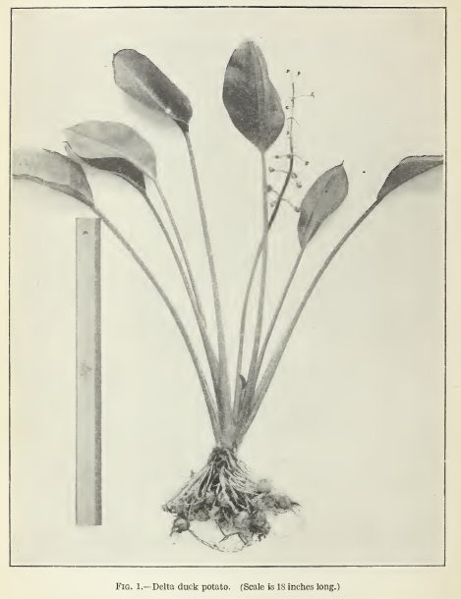
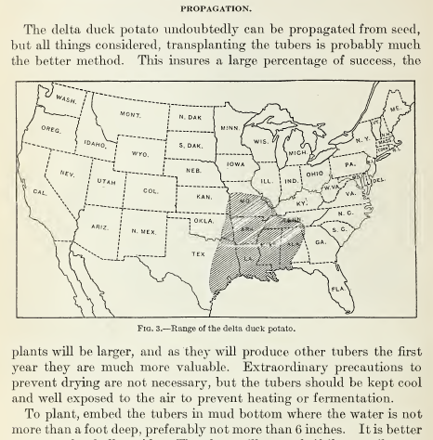

Slide 6
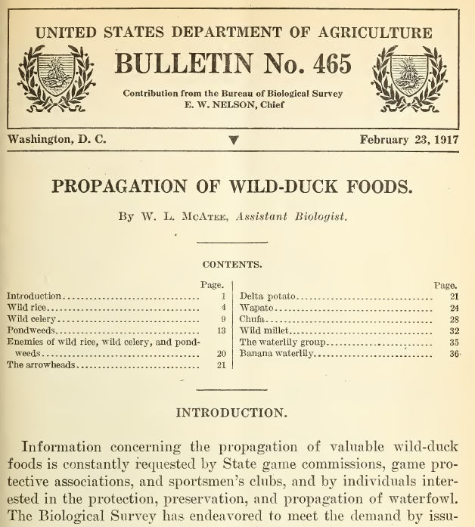

Slide 7
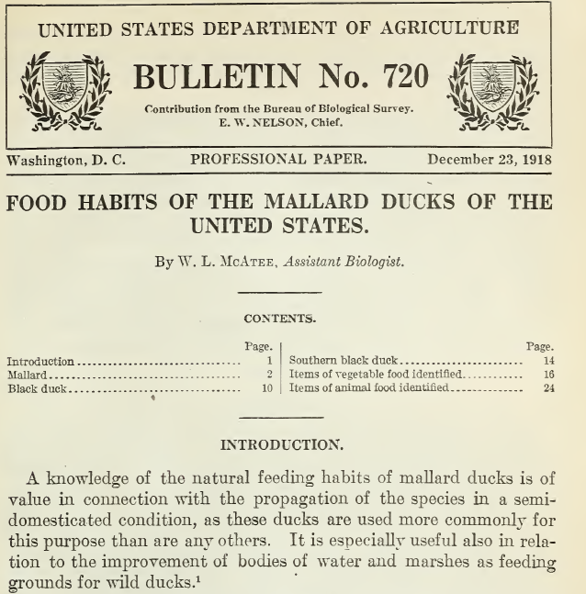

Slide 8
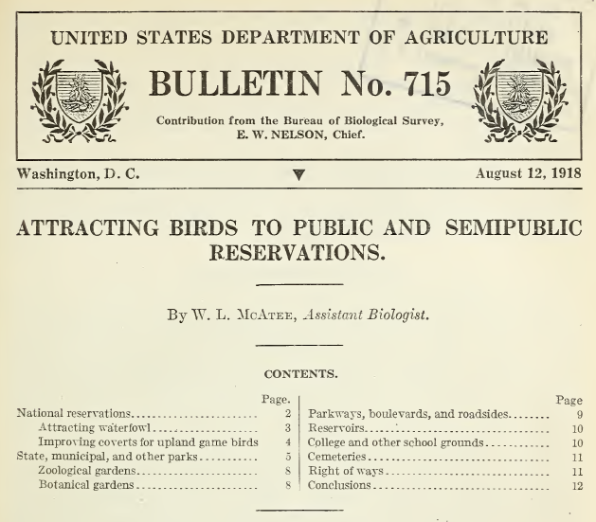
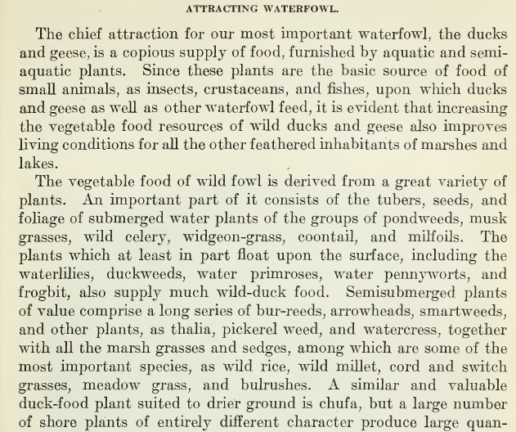

Slide 9
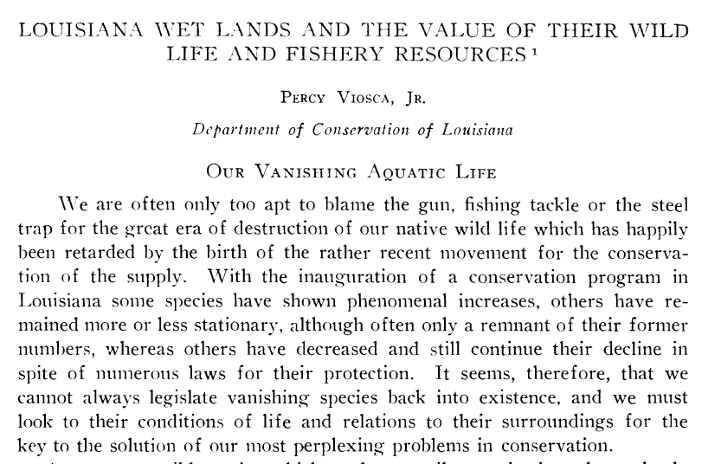
Viosca, Jr. P. 1928. Ecology 9:216-229.

Slide 10
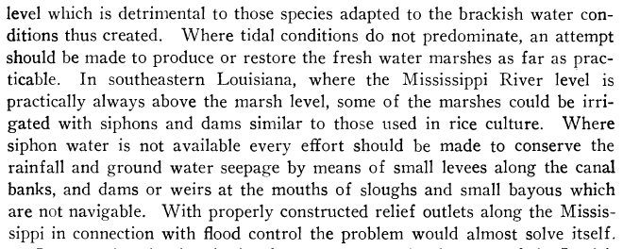
Viosca, Jr. P. 1928. Ecology 9:216-229.

Slide 11
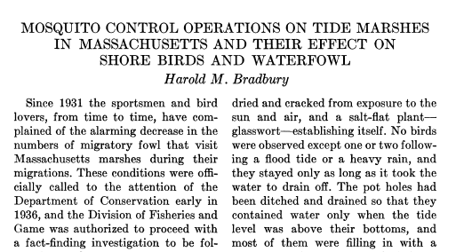
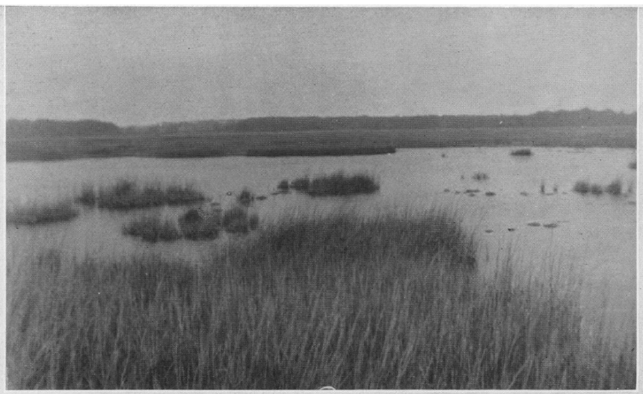
Bradbury, H.M. 1938. Journal of Wildlife Management 2:49-52.

Slide 12
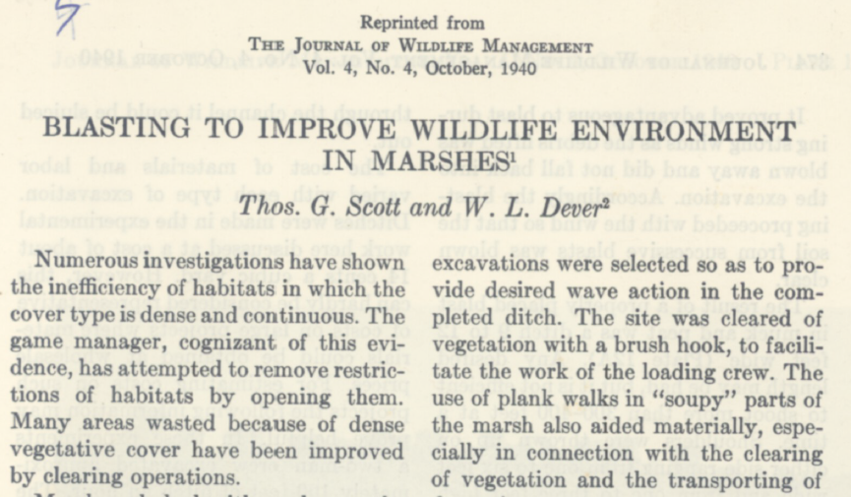

Slide 13
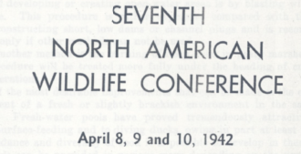
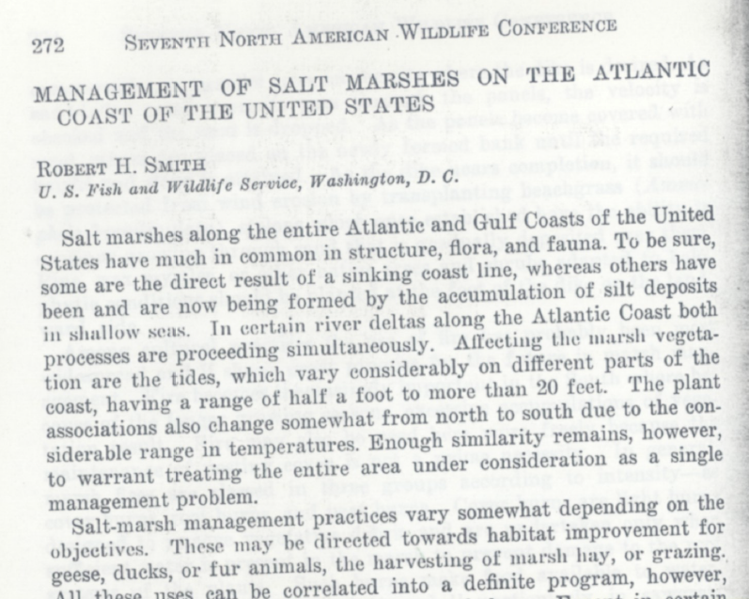

Slide 14
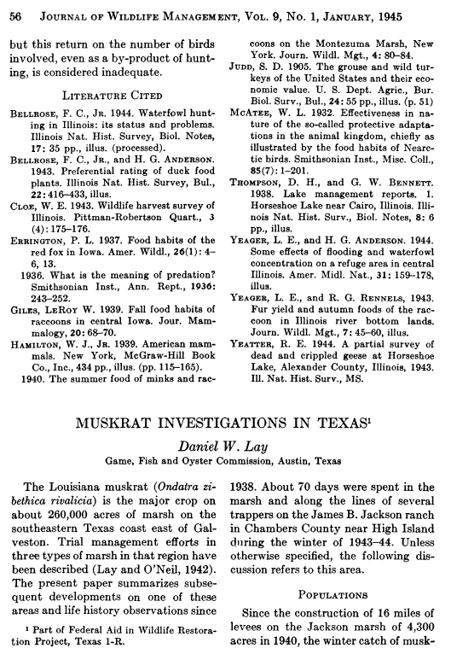

Slide 15
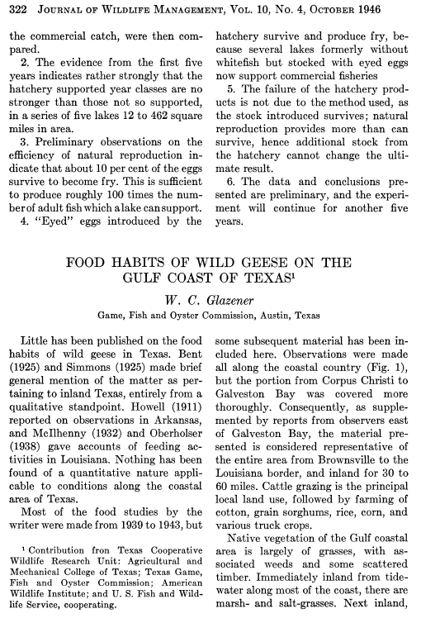

Slide 16
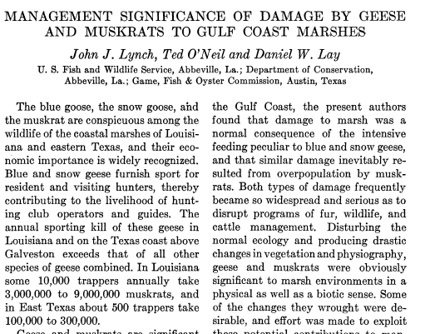

Slide 17
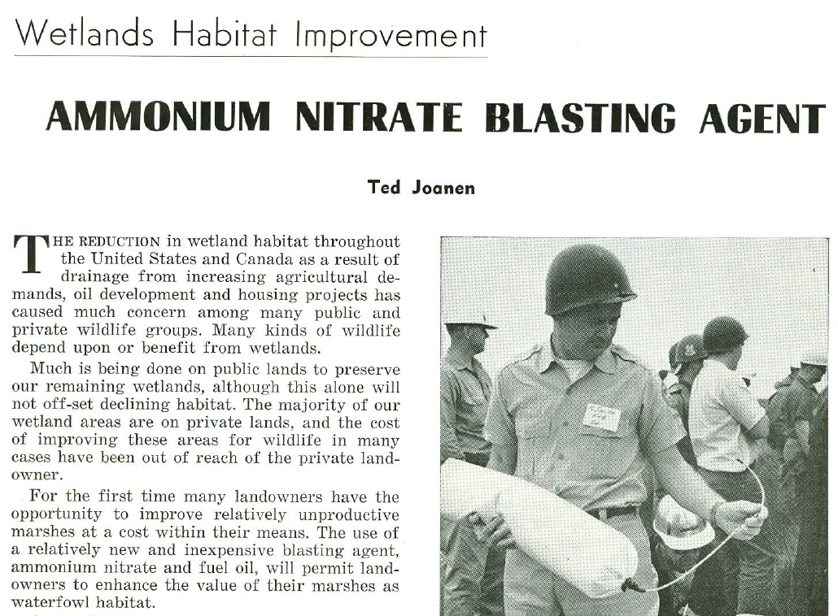
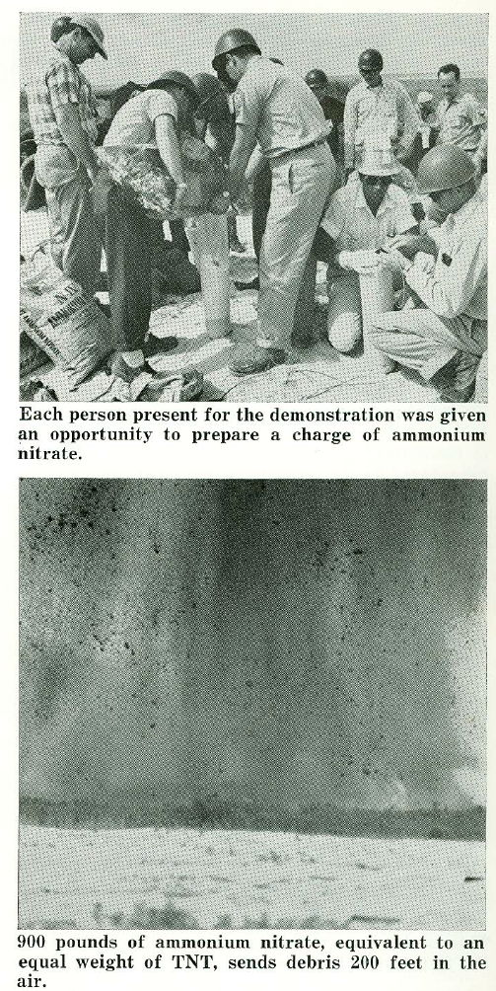
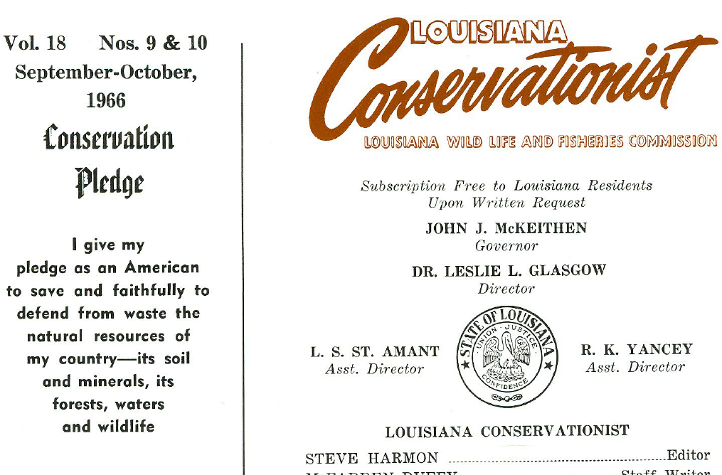

Slide 18
Today: Coastal Wetland Wildlife Managers apply ecological knowledge to favor vegetation that provides food and cover for a variety of wildlife.
The Future: One hundred years from now, Coastal Wetland Wildlife Managers will apply ecological knowledge to favor vegetation that creates elevation and provides food and cover for a variety of wildlife.

Slide 19
Workshop Topics
Vegetation Management
  Species composition
    Water Salinity/Depth Management
    Prescribed Fire
  Interspersion/edge
    Water Salinity/Depth Management
    Terraces
Erosion Management
Marsh Creation
Basics of Marsh Surface Elevation
  Sea level and Subsidence
  Marsh vertical accretion

Slide 20
Marsh Surface Elevation
Coastal marshes “experience” relative sea level rise (RSLR)
  relative sea level rise =
  local subsidence + global sea level rise
RSLR generally measured from tide gauges
Coastal marshes respond to RSLR either by
  vertically accreting
  drowning

Slide 21
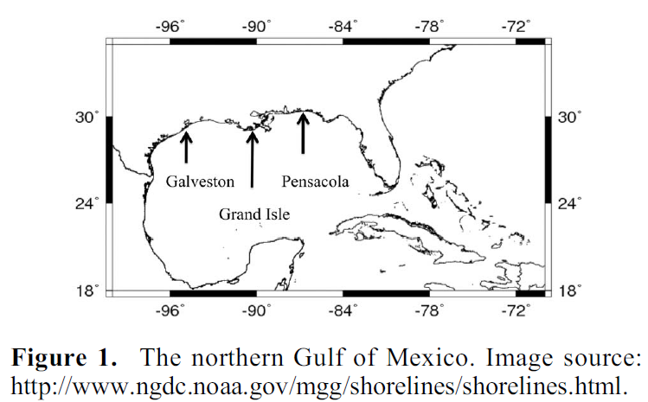
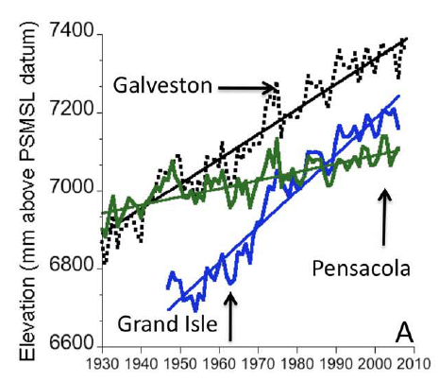
Kolker et al. 2011. Geophysical Research Letters 38:L21404
Galveston = 6.4 mm/yr
Grand Island = 9.3 mm/yr
Pensacola = 2.2 mm/yr
In the last 100 years, RSL rose…
Galveston 2.1 ft
Grand Isle 3.0 ft
Pensacola 0.7 ft
Notes:
After 100 years…. Galveston 2.1 ft Grand Isle 3.0 ft Pensacola 0.7 ft

Slide 22
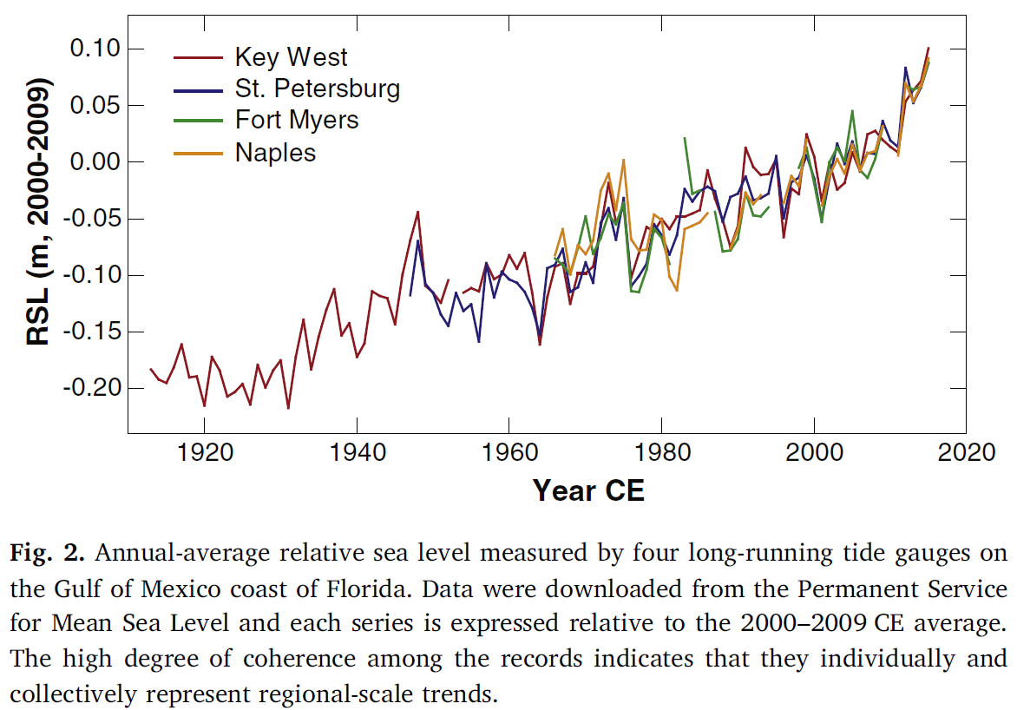
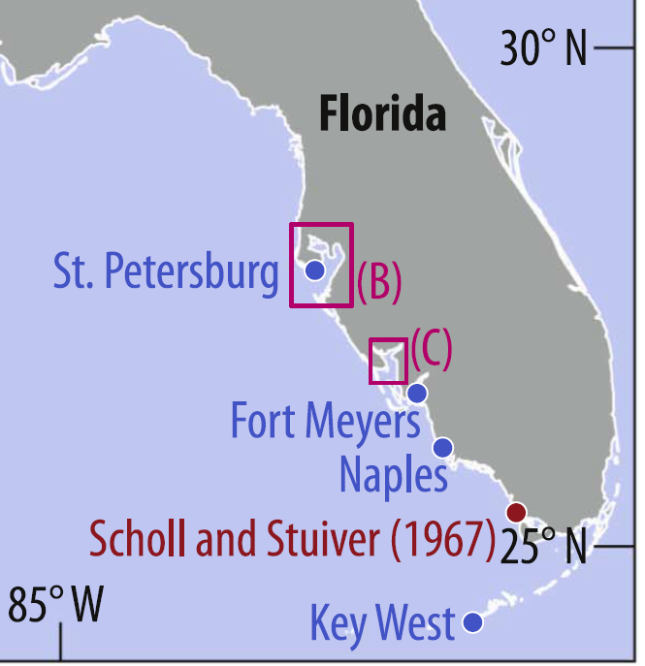
Gerlach et al. 2017 Marine Geology 390:254-269.
Relative sea level rise accelerated from 1.3 mm/yr to 2.0 mm/yr.
In the last 100 years, RSL rose at least 1.3 feet
Notes:
At least 1.3 feet of rise in 100 years

Slide 23
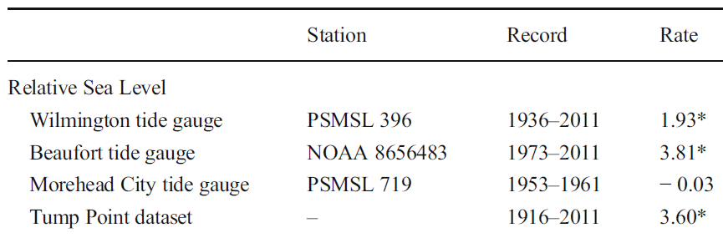
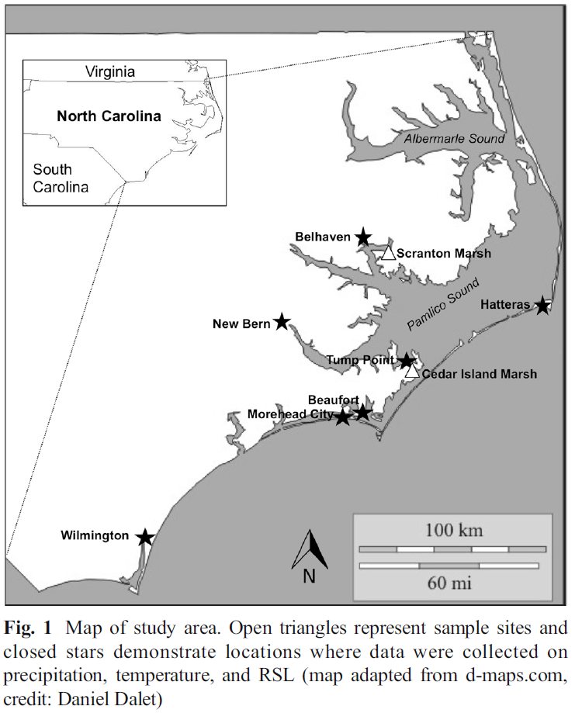
Jararell et al. 2016 Wetlands 36:607-619.
In the last 100 years, RSL rose at 0.6 to 1.3 feet
Notes:
After 100 years, 0.6 to 1.3 feet

Slide 24
Relative sea level has risen by very different amounts in different places
Marshes that have survived the last 100 years have vertically accreted different amounts in different places.
  Why?
  Has this affected wildlife abundance, management practices, and/or management effectiveness?
  Can we manage the factors that cause these differences in Relative Sea Level Rise?
  Can we improve the effectiveness of our management by planning for these differences?

Slide 25
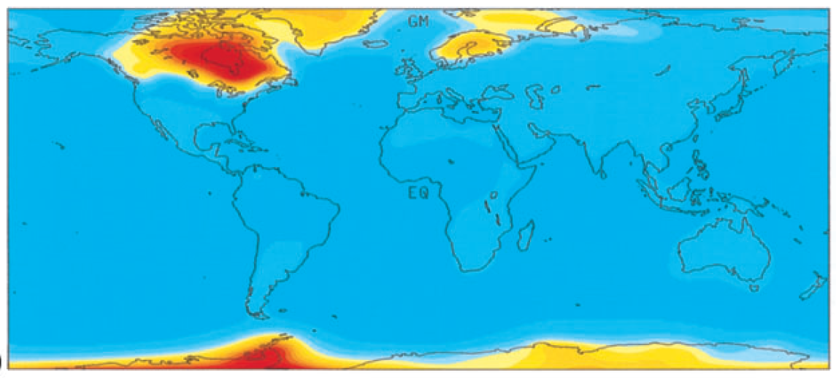
Areas covered by glaciers during the last ice ageare rising; i.e. “rebounding.” Areas far from glaciers are “collapsing.”
Differences in rebound/collapse are not responsible for differences in RSLR on previous slides.
Mitrovica et al. 2001. Geophys J. Int. 147:562-578

Slide 26
Areas covered by glaciers
  were compressed during the ice age
  are “rebounding” now
Areas not covered by glaciers
  “bulged” during the ice age
  are “collapsing” now
Differences in rebound/collapse are not responsible for differences in RSLR on previous slides

Slide 27
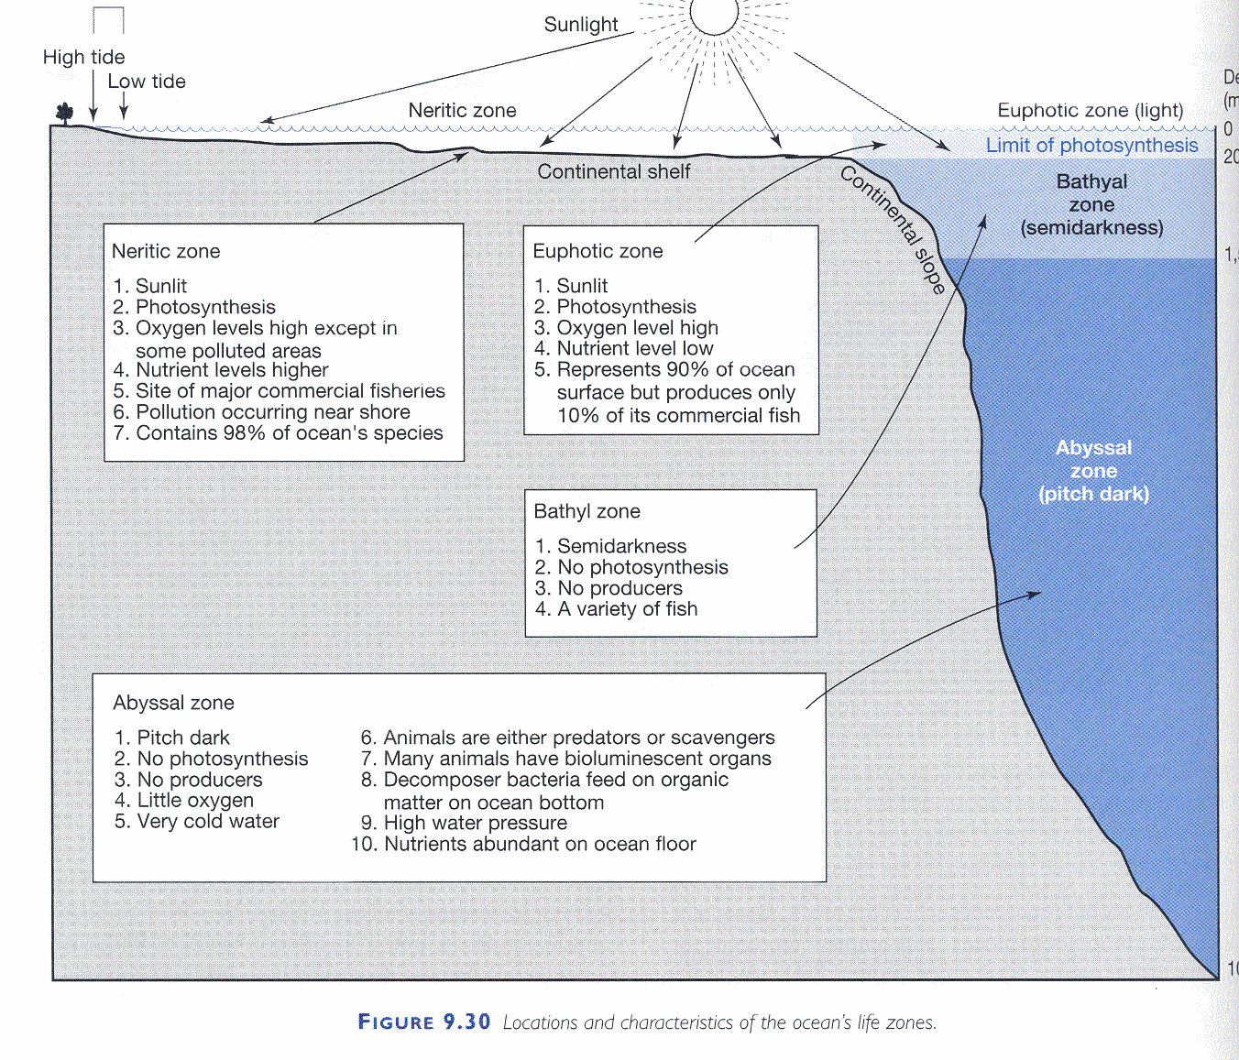
Sea level was ~300 feet lower during the last ice age (120,0000 to 20,000 years ago)
Rivers dug valleys (~300 feet deep).
Sea level rose rapidly while the glaciers melted (20,000 to 7,000 years ago)
Rivers dug valleys filled with seawater or river sediments.

Slide 28
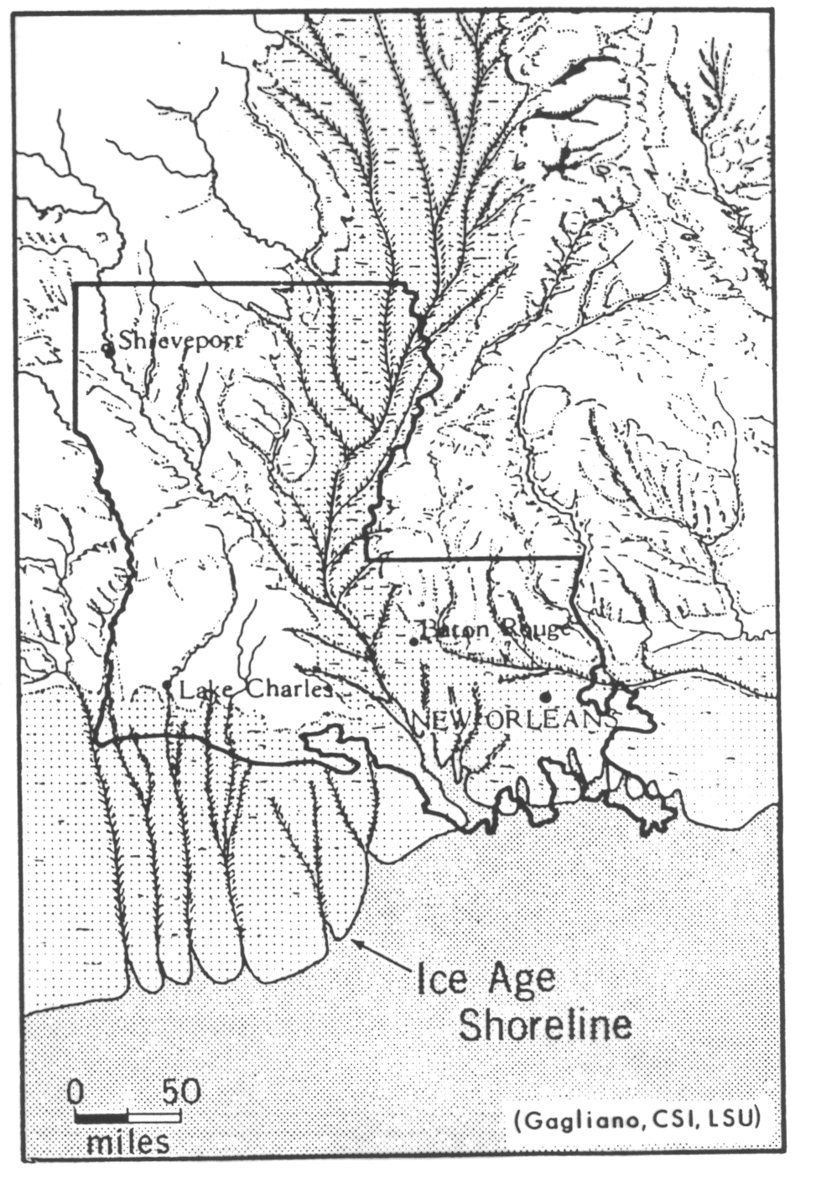
The Miss. River cut a deep (200 – 400 ft deep) valley during the last ice age (80,000 to 20,000 years ago).
As ice age ended (20,000 – 10,000 years ago) sea level rose quickly.
From 10,000 years until recently, sea level rose only (0.1 – 0.2 mm/yr).
We need to consider SE and SW LA separately.

Slide 29
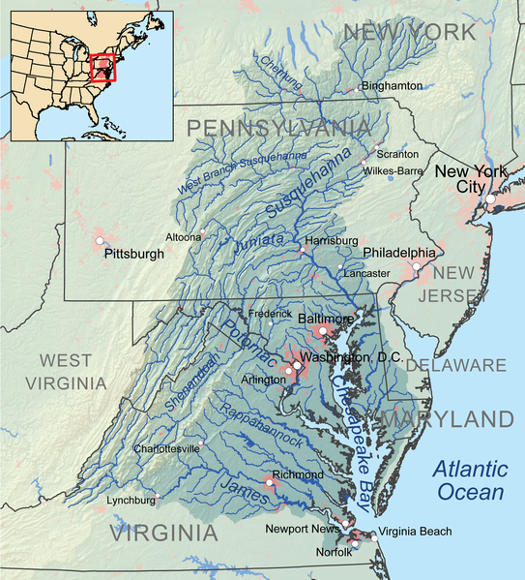
Notes:
Chesapeake is about 170 miles long

Slide 30
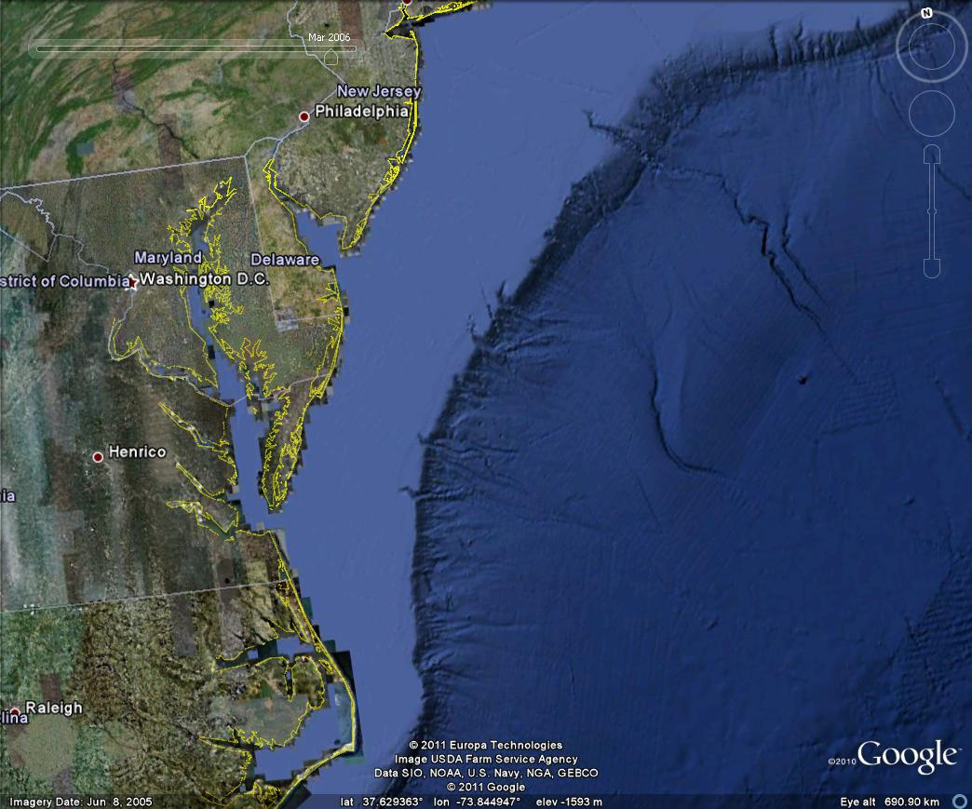

Slide 31
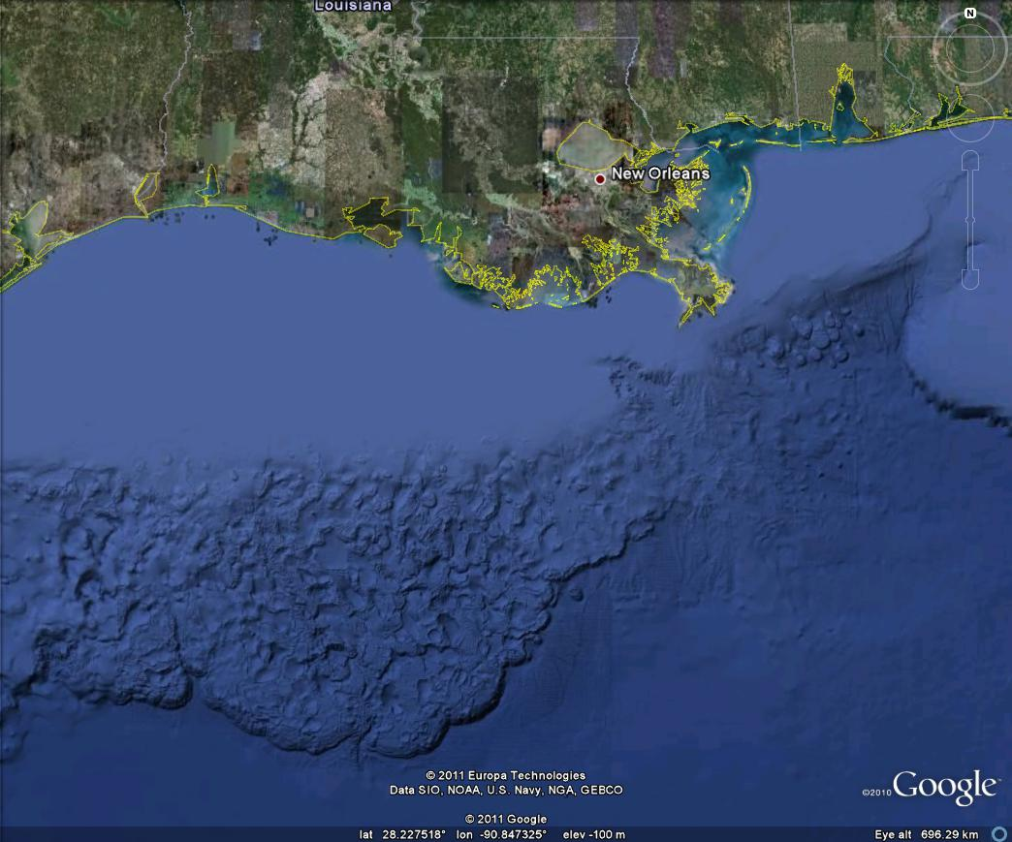

Slide 32
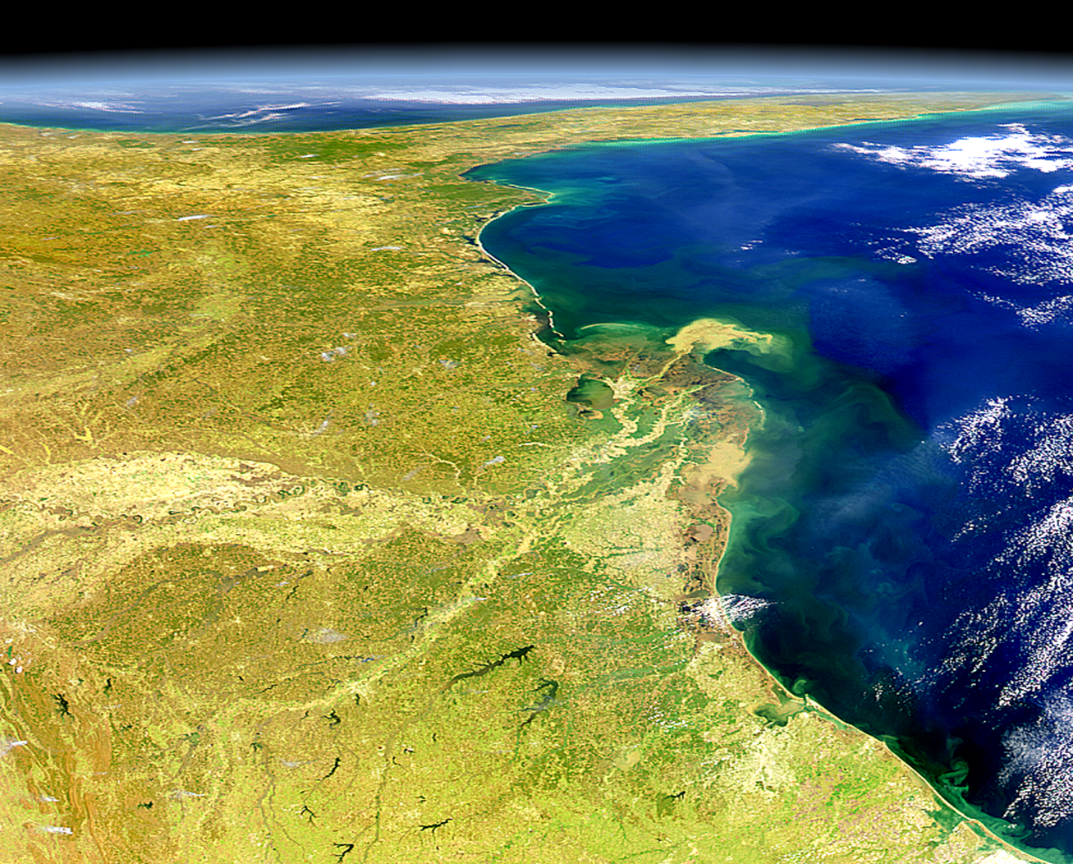

Slide 33
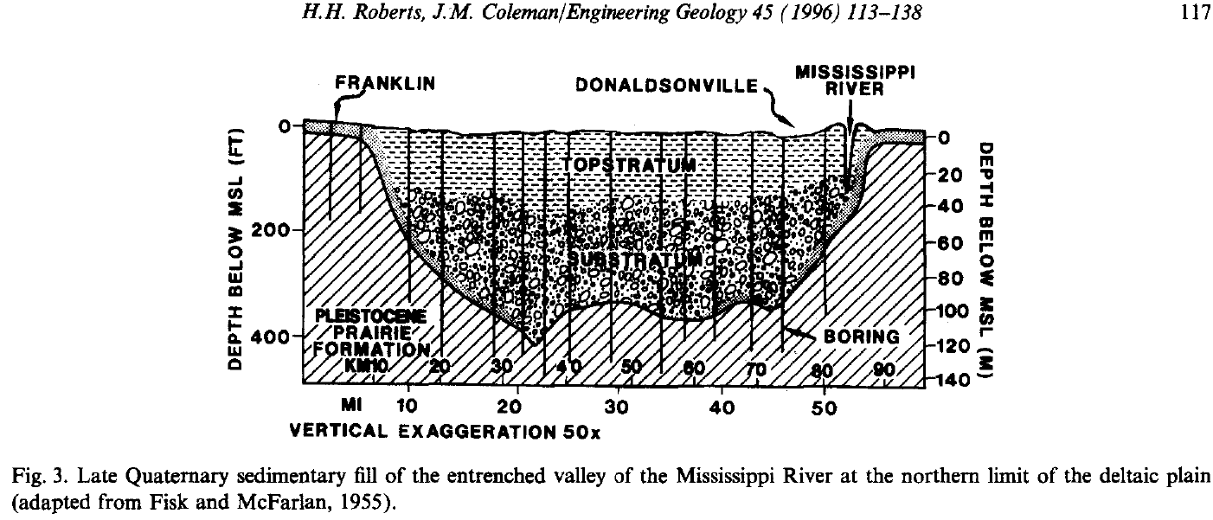
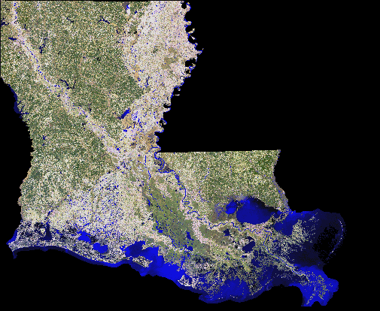

Slide 34
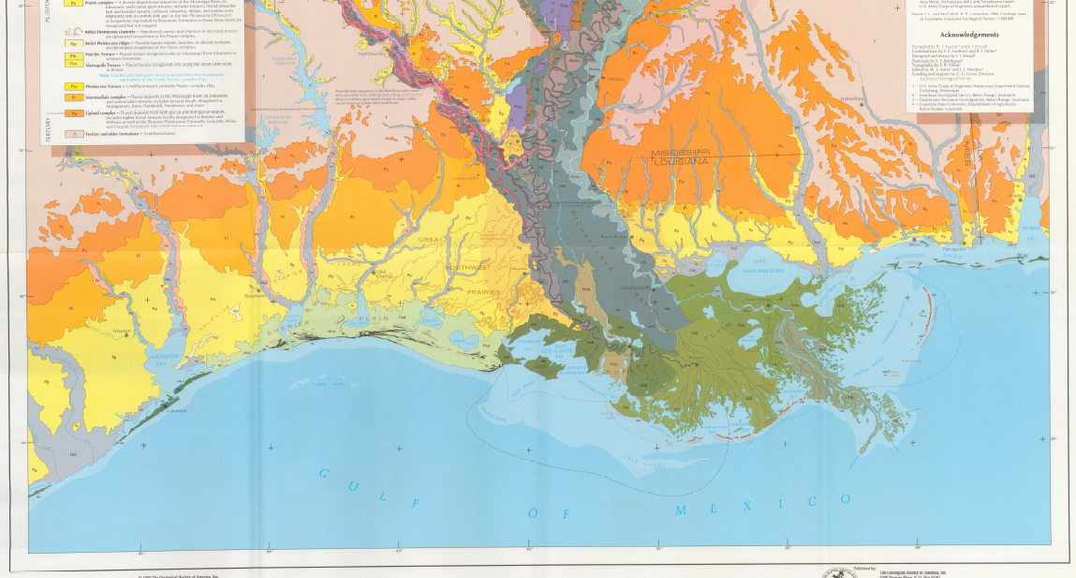
Saucier and Snead 1989. Quaternary Geology of the Lower Mississippi Valley. Geological Society of America

Slide 35
Relative sea level has risen by very different amounts in different places
Marshes that have survived the last 100 years have vertically accreted different amounts in different places.
  Why?
  Has this affected wildlife abundance, management practices, and/or management effectiveness?
  Can we manage the factors that cause these differences in Relative Sea Level Rise?
  Can we improve the effectiveness of our management by planning for these differences?

Slide 36
Marsh Surface Elevation
In the last 100 years, some coastal marshes have vertically accreted enough to offset up to 0.93 m (~3ft) of RSLS.
Within the 100 years, many coastal marshes will experience similar or faster RSLR.

Slide 37
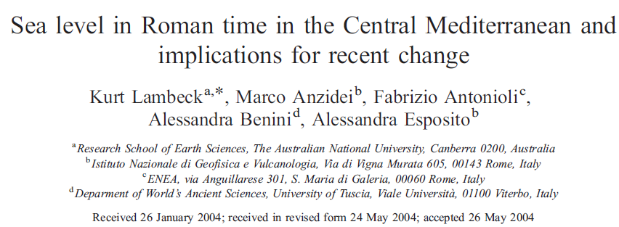
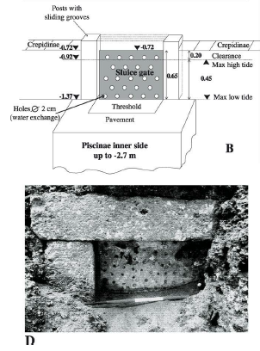
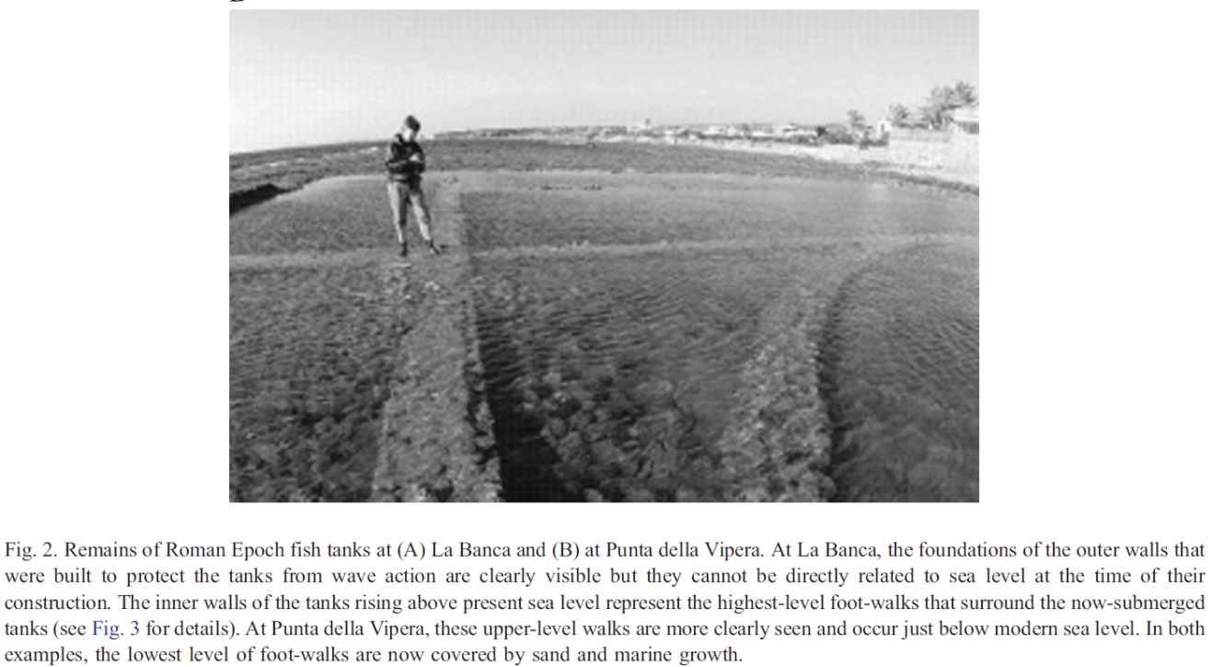

Slide 38
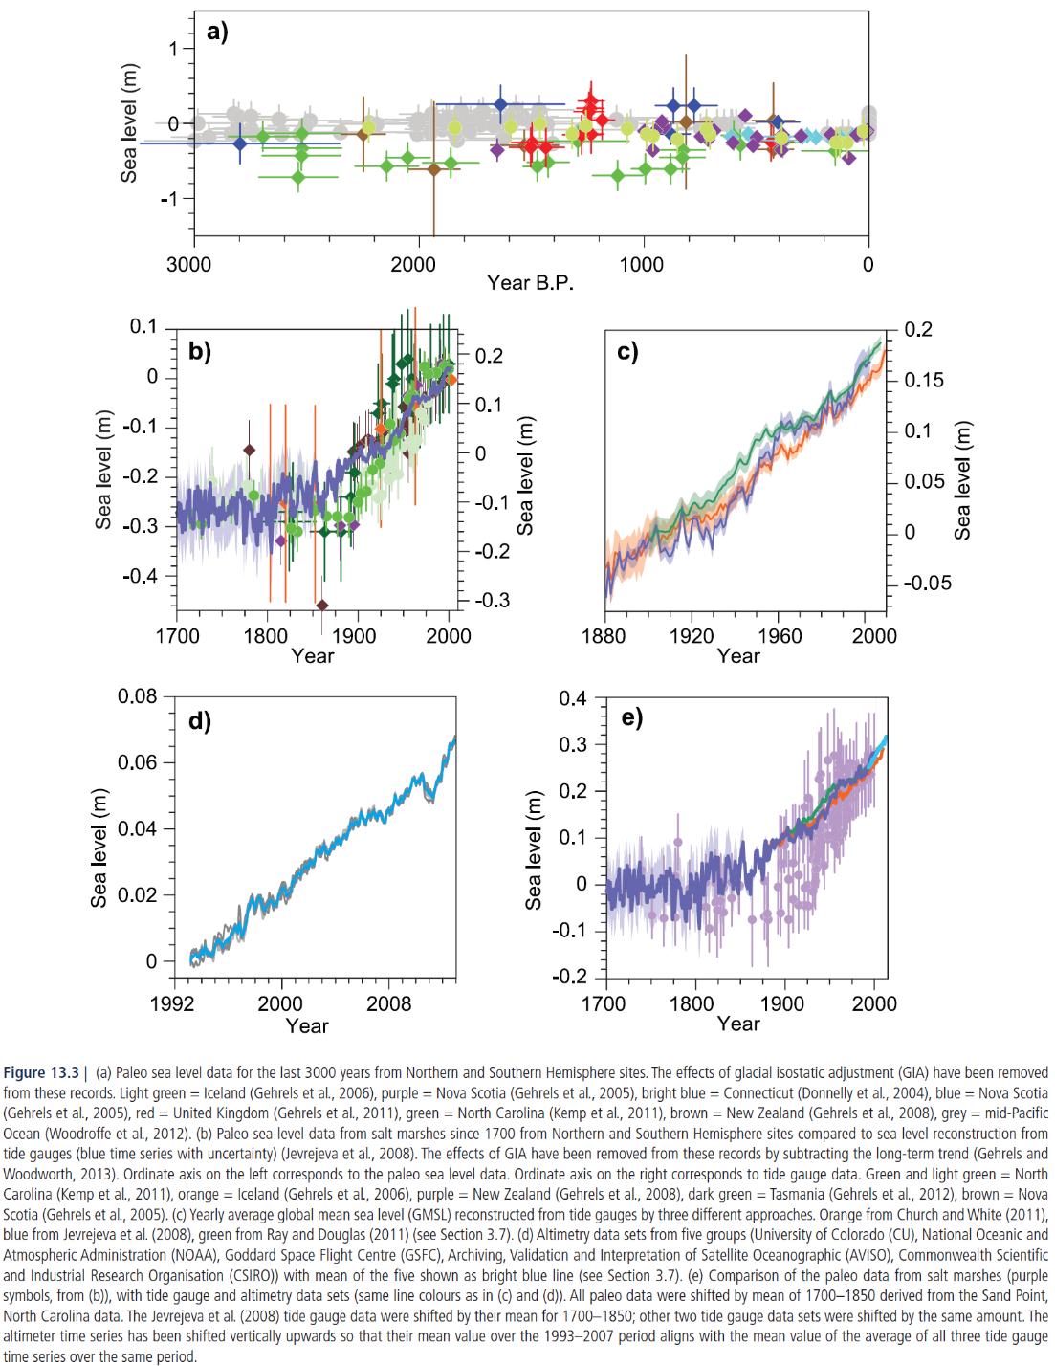
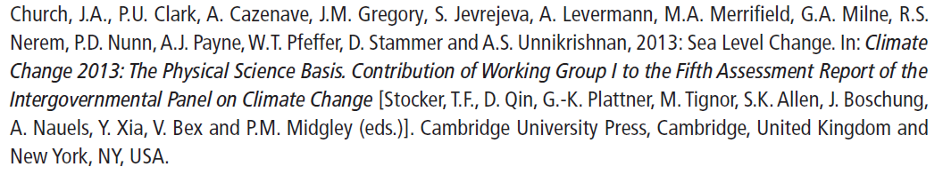

Slide 39
Sea level has risen 15-20 cm since most coastal refuges and management areas were created.
In the last 100 years, this has increased caused 0.5 to 0.6 ft of RSLR

Slide 40
Sea level has risen 15-20 cm since most coastal refuges and management areas were created.
In the last 100 years, this has caused 0.5 to 0.6 ft of RSLR

Slide 41
Sea level has risen 15-20 cm since most coastal refuges and management areas were created.
In the last 100 years, this has increased caused 0.5 to 0.6 ft of RSLR

Slide 42
Sea level has risen 15-20 cm since most coastal refuges and management areas were created.
In the last 100 years, this has increased caused 0.5 to 0.6 ft of RSLR

Slide 43
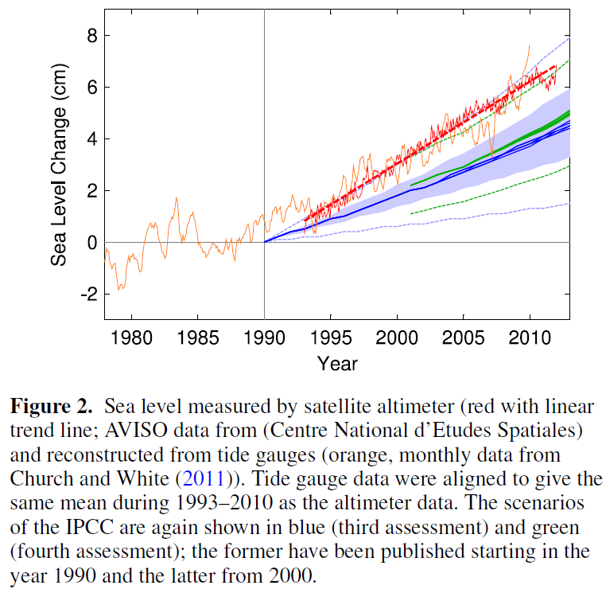
Rhamstorf et al. 2012. Environmental Research Letters 7(2012)044035 (5pp)
Notes:
3rd/Blue = 2001; 4th/Green = 2007

Slide 44
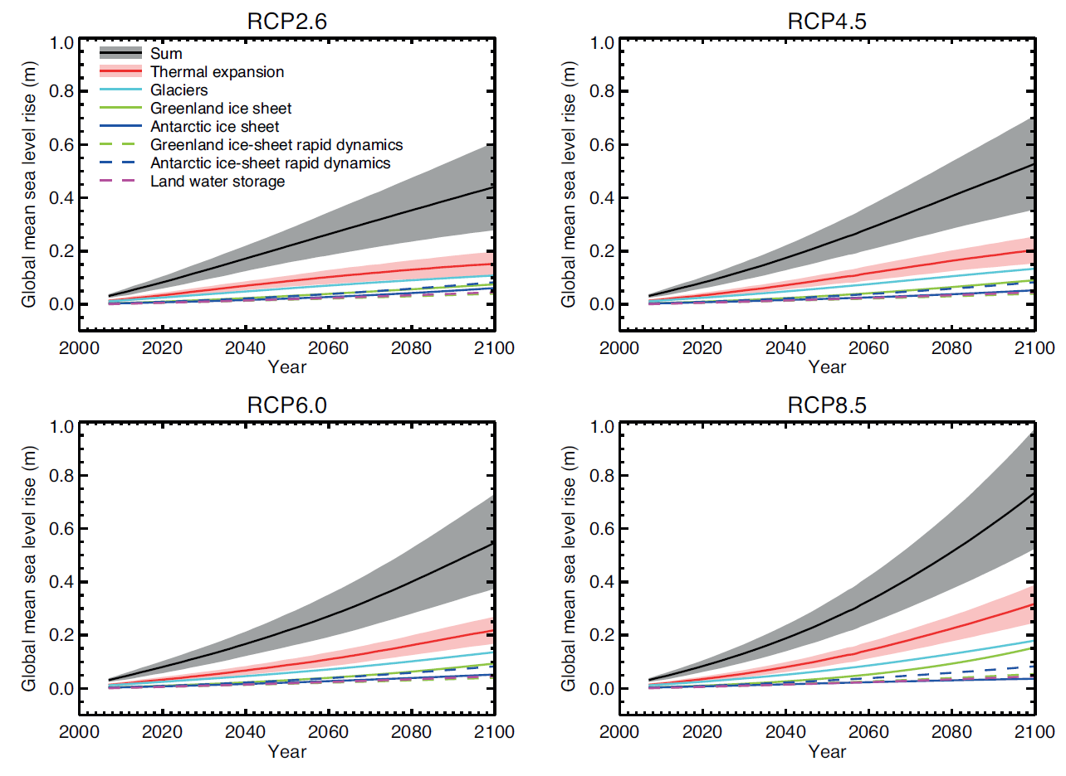
next IPCC review due in 2022
Rhamstorf et al. 2012. Environmental Research Letters 7(2012)044035 (5pp)
The biggest problem with climate change is not change; the problem is that we can’t yet predict the change.
Notes:
3rd/Blue = 2001; 4th/Green = 2007; 5th = 2013

Slide 45
Marsh Surface Elevation
In the last 100 years, a few coastal marshes have vertically accreted enough to offset up to 0.93 m (~3ft) of RSLS.
Within the 100 years, many coastal marshes will experience similar or faster RSLR.

Slide 46
Coastal Wetlands

Slide 47
Regional variation:
  Gulf coast: 14,193 km²
  Atlantic coast: 9,815 km²
  Pacific coast: 375 km²
Marsh Types: reportedly classified according to salinity and tides, but actually according to dominant plant species
  for this workshop, please avoid using terms such as “salt marsh” and “fresh marsh.” Instead, please describe wetlands by the dominant plant species such as “Spartina patens” or “Phragmites” or “Avicenna.”

Slide 48
Description
salt water, tides, and global sea-level rise

Slide 49
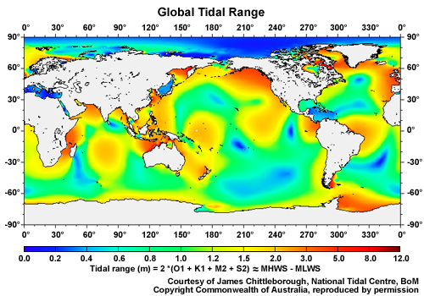

Slide 50
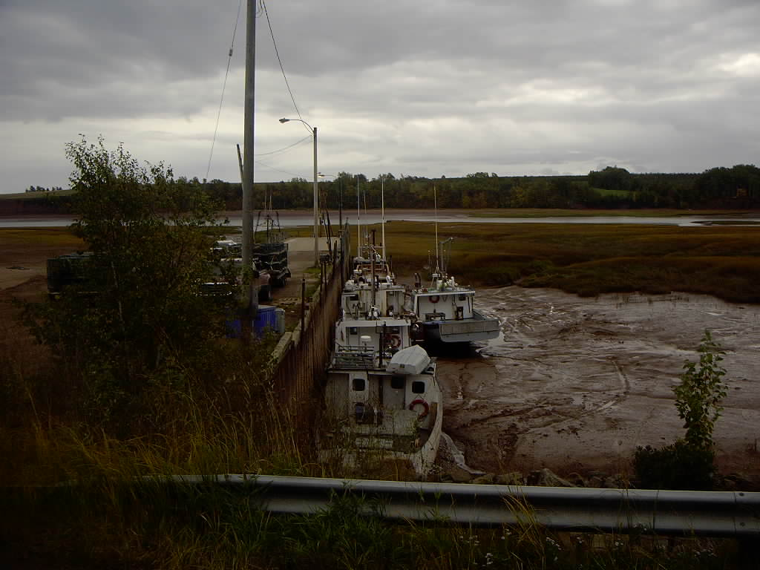

Slide 51
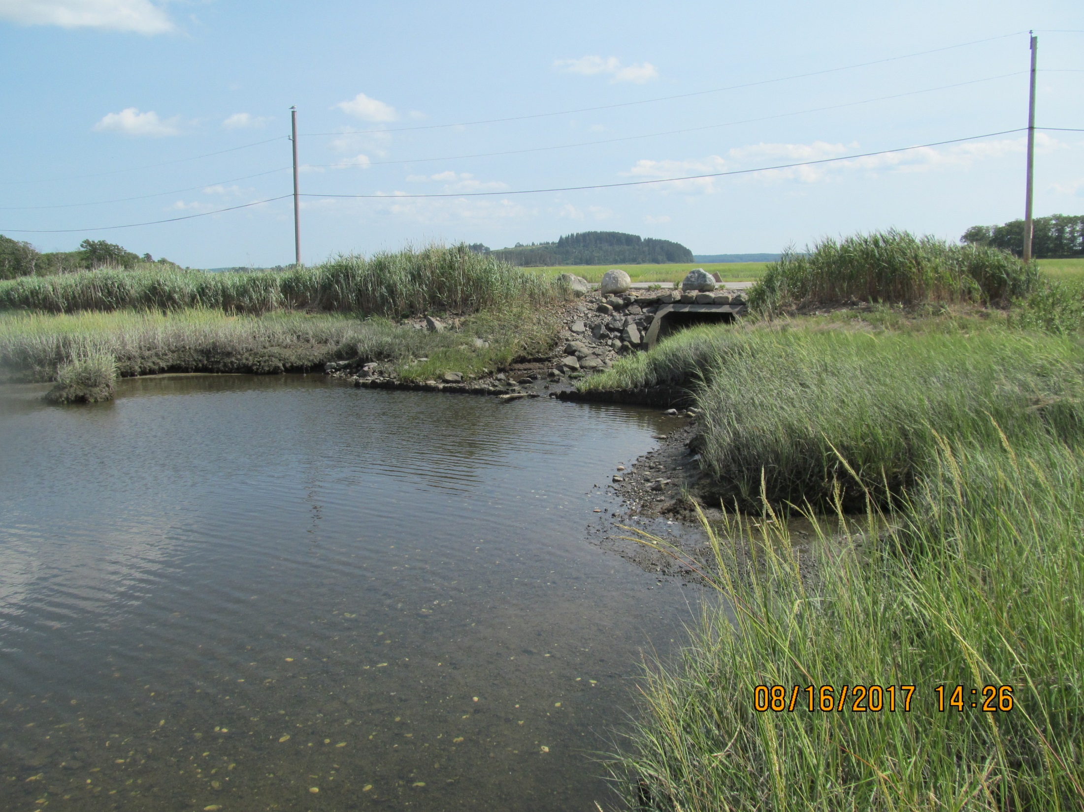
Great Marsh, Massachusetts, USA

Slide 52

Great Marsh, Massachusetts, USA

Slide 53


Slide 57
Notes:
C&D = S. alt and J. roemer (Morris pub and personal comm)

Slide 58
Notes:
E = Phragmites in NY (Montalto et al. 2006)

Slide 59
Regional variation:
  Gulf coast: 14,193 km²
  Atlantic coast: 9,815 km²
  Pacific coast: 375 km²
Marsh Types: reportedly classified according to salinity and tides, but actually according to dominant plant species

Slide 60

fresh
intermediate
brackish
saline

Slide 61


Slide 62


Slide 63

this map shows coastal forests and the most common marsh classification system in coastal Louisiana
  fresh marsh
  intermediate marsh
  brackish marsh
  saline marsh
different types of marshes support different types of fish and wildlife

Slide 64
Coastal alterations
alterations to fresh water and salt water inflow/outflow will alter vegetation composition and abundance, which will alter niches, which will alter wildlife species composition and abundance

Slide 65



Coastal alterations
Human features that traverse the coast, such as navigation channels, generally replace low salinity wetlands with high salinity wetlands (aka salt-water intrusion but marine intrusion is a better term because naturally hyper-saline can have their salinity reduced to 35 ppt if they are artificially connected to the ocean).

Slide 66

Coastal alterations
Human features that traverse the coast, such as navigation channels, generally replace low salinity wetlands with high salinity wetlands (aka salt-water intrusion but marine intrusion is a better term because naturally hyper-saline can have their salinity reduced to 35 ppt if they are artificially connected to the ocean).

Slide 67

Coastal alterations
Human features in the coastal zone that run parallel to the coast, such as roads, generally replace high salinity wetlands with low salinity wetlands (aka freshwater impoundment).

Slide 68

Coastal alterations
Human features such as ditches and canals, ….

Slide 69

Coastal alterations
Human features such as ditches and canals, ...

Slide 70


Slide 71


Slide 72


Slide 73
draining coastal wetlands; the problems with soils
acid sulfate soils (only coastal wetlands)
  pH gets very low (high acidity) because of high concentrations of sulfuric acid (H₂SO₄)
  related to oxidation of chemicals formed under anoxic condition (FeS) when soil was a typical wetland
loss of elevation (only organic soils)
  soil organic matter decomposes very fast
  related to oxidation of soil organic matter that decomposed very slowly when soil was a typical wetland

Slide 74




Slide 75



Slide 76




Slide 77

MARSH VERTICAL ACCRETION
Global Sea-Level Rise
1 mm/yr in 1950’s to 2 mm/yr today

Slide 78


Slide 79

subsidence: spatially variable; the region in this photograph is subsiding fast enough that structures such as docks, roads, and houses become too low to use before they wear out.

Slide 80


Slide 81

this marsh is vertically accreting fast enough to offset global sea-level rise and regional subsidence

Slide 82

this marsh is not vertically accreting fast enough to offset global sea-level rise and regional subsidence; it may be accreting faster than the marsh in the previous picture but subsiding even faster

Slide 83
marsh vertical accretion
Notes:
delta lobe cycle creates subsidence, so subsidence as well as gslr; travel a few km and subsidence differs
delta lobe cycle also creates wetland loss (18 ha/day from 1930-1990; 44.5 ac/day from 1930-1990)

Slide 84
Limiting Factors
Regarding chemical reactions: the limiting reactant is the reactant whose supply is depleted first.
Plant growth often limited by N or P.
Liebig’s Law of the Minimum (1840): each population increases until the supply of some resource (the limiting resource) no longer satisfies the populations requirement for it.
What limits vertical accretion?

Slide 85


Slide 86


Slide 90
Marsh vertical accretion
Limiting factor | Switch on | Switch off | Reverse switch
roots and rhizomes | flooding | lack of flooding | aeration
sand, silt, and/or clay | flooding | lack of flooding | none*
* aerating mineral soils can lead to cat clays (acid sulfate soils)

Slide 91
what limits vertical accretion?
accumulation of mineral sediments delivered by tides and storms
accumulation of organic matter produced by marsh vegetation

Slide 92


Slide 93


Slide 94


Slide 95

vertical accretion of these marshes varies with organic matter accumulation but not mineral sediment accumulation

Slide 96


Slide 99


Slide 102


Slide 103
vertical accretion of emergent marsh varies with organic matter accumulation but not mineral sediment accumulation
only mineral sediment accumulation can convert deep open water to emergent marsh (mineral accretion converts open water to marsh; organic accretion then offsets subsidence and sea-level rise)
Notes:
delta lobe cycle creates subsidence, so subsidence as well as gslr; travel a few km and subsidence differs
delta lobe cycle also creates wetland loss (18 ha/day from 1930-1990; 44.5 ac/day from 1930-1990)

Slide 104
Notes:
E = Phragmites in NY (Montalto et al. 2006)

Slide 105
Marsh vertical accretion
Limiting factor | Switch on | Switch off | Reverse switch
roots and rhizomes | flooding | lack of flooding | aeration
sand, silt, and/or clay | flooding | lack of flooding | none*
* aerating mineral soils can lead to cat clays (acid sulfate soils)

Slide 106
In many marshes, vertical accretion of emergent marsh varies with organic matter accumulation but not mineral sediment accumulation. In some marshes, vertical accretion varies with mineral sediment accumulation.
only mineral sediment accumulation can convert open water to emergent marsh (comes first)
Notes:
delta lobe cycle creates subsidence, so subsidence as well as gslr; travel a few km and subsidence differs
delta lobe cycle also creates wetland loss (18 ha/day from 1930-1990; 44.5 ac/day from 1930-1990)

Slide 107


Slide 108

verify/challenge: IPCC

Slide 109


Slide 110


Slide 111


Slide 112


Slide 113


Slide 114


Slide 115

verify/challenge
http://www.examiner.com/climate-change-in-national/snow-extent-northern-hemisphere-reaches-second-highest-level-44-years

Slide 116


Slide 117

http://climate.rutgers.edu/snowcover/index.php

Slide 118
climate change
climate change will alter wildlife and plant communities
unpredictable nature of change is the problem
Unpredicted climatic changes will decrease efficiency of numerous activities (crop production, infrastructure maintenance), which will reduce funds for natural resource management.

