Slide 1
Are There 100 Acts of Congress Everyone Should Know?
James R. Stoner, Jr. & Hunter Holliday
Louisiana State University
Prepared for a virtual poster session of the American Political Thought section of the American Political Science Association
October 1, 2021

Slide 2
The question in the background:
Has Congress lost the legislative power?
Dominance of other branches over the law
Courts and judicial activism
The Executive and the Administrative State
Political Science diagnoses
T. Mann & N. Ornstein, The Broken Branch (Oxford, 2006)
R. Bauman & T. Kahana, The Least Examined Branch (Cambridge, 2006)
Think Tank Projects
Federalist Society, “Article One Initiative”
AEI/R Street & New America: Legislative Branch Capacity Working Group
T. LaPira, L. Drutman, & K. Kosar, Congress Overwhelmed (Chicago, 2020)
OUR IDEA: Look at the substance of legislation, not the legislative process:
What has Congress done successfully in the past?
What might be learned for successful legislative action now?

Slide 3
The Survey:
What was asked?
156 major acts of Congress were identified by the primary researcher (Stoner), drawing on Stephen W. Stathis, Landmark Legislation (CQ Press, 2014) and David Mayhew, Divided We Govern (Yale, 2005), cross-checked by the secondary researcher (Holliday) through textbook indexes
Participants were asked to rank each act as “extremely important,” “very important,” “moderately important,” “slightly important,” and “not at all important”
At the end of the survey, participants were asked to rank the factors that led them to judge an act important
Also, they were asked about themselves (academic position, principal field of study, decade of birth)
How was it asked?
Computer-based survey, software by Qualtrics
Who was asked?
Colleagues and professional contacts of the primary researcher; members of the APSA Law & Courts and Legislative Studies sections; members of the conlawprof listserv; members of the American Historical Association through their online Forum; teachers who read the iCivics Newsletter or the Jack Miller Center Newsletter
Well over 1000 scholars and teachers subscribe to these lists; 249 surveys were recorded; about 133 were completed
When were they asked?
Survey opened May 18, 2021, and closed June 30, 2021

Slide 4
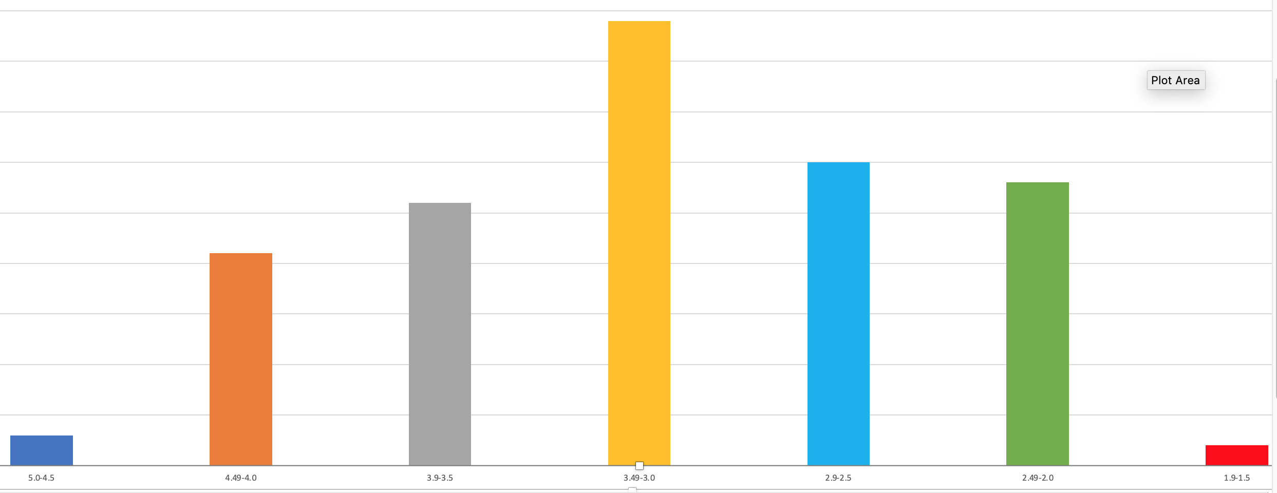
Distribution of Acts by Importance

Slide 5
The Extremely Important Acts (4.5 - 5.0)

Slide 6
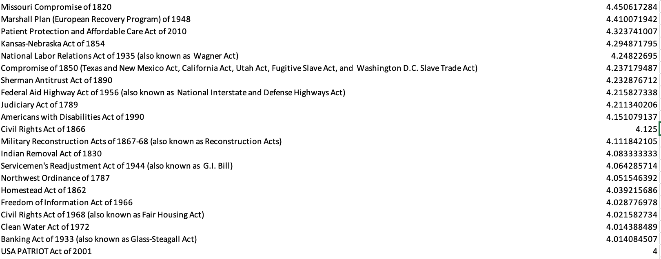
The Very Important Acts (4.0 - 4.5)

Slide 7
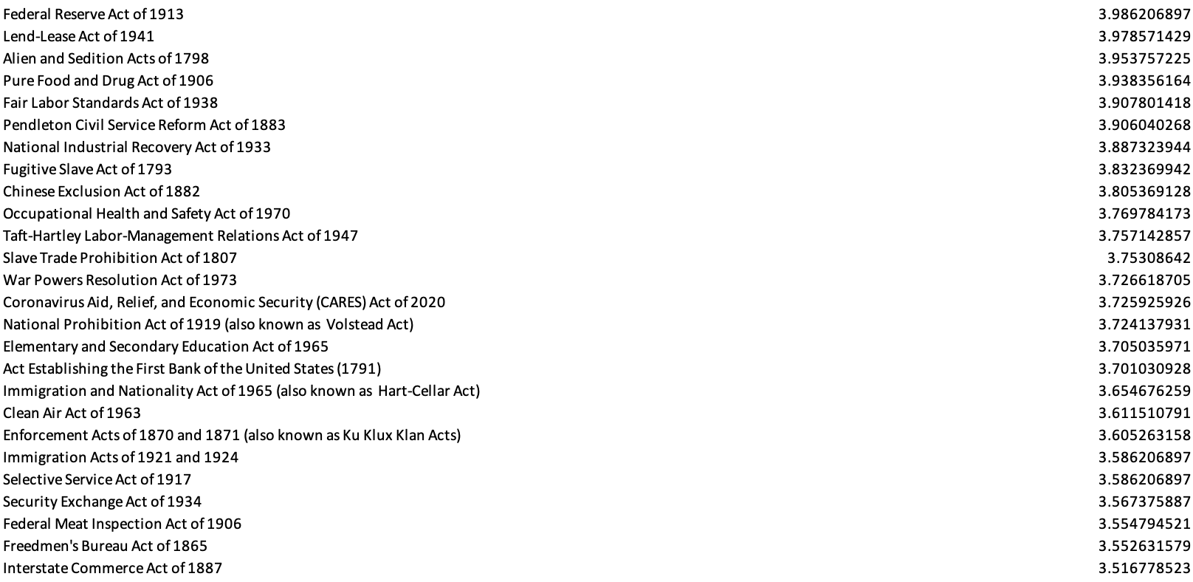
The Rather Important Acts (3.5 - 4.0)

Slide 8
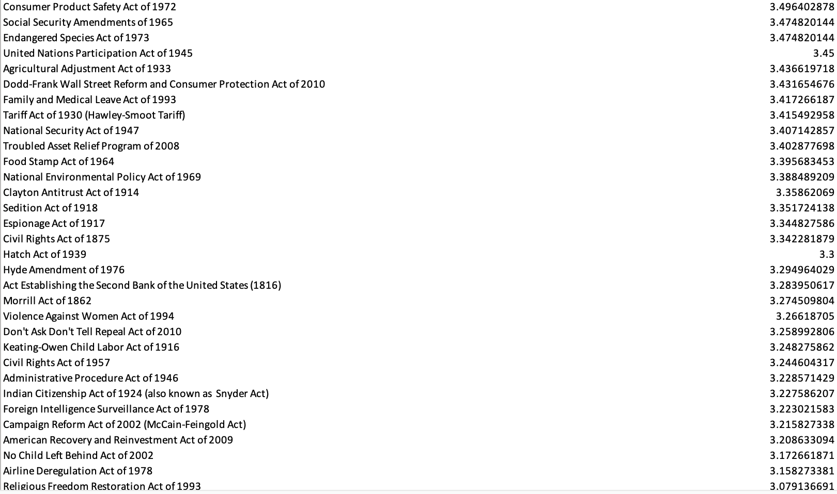
The Moderately
Important Acts
(3.0 - 3.5)

Slide 9
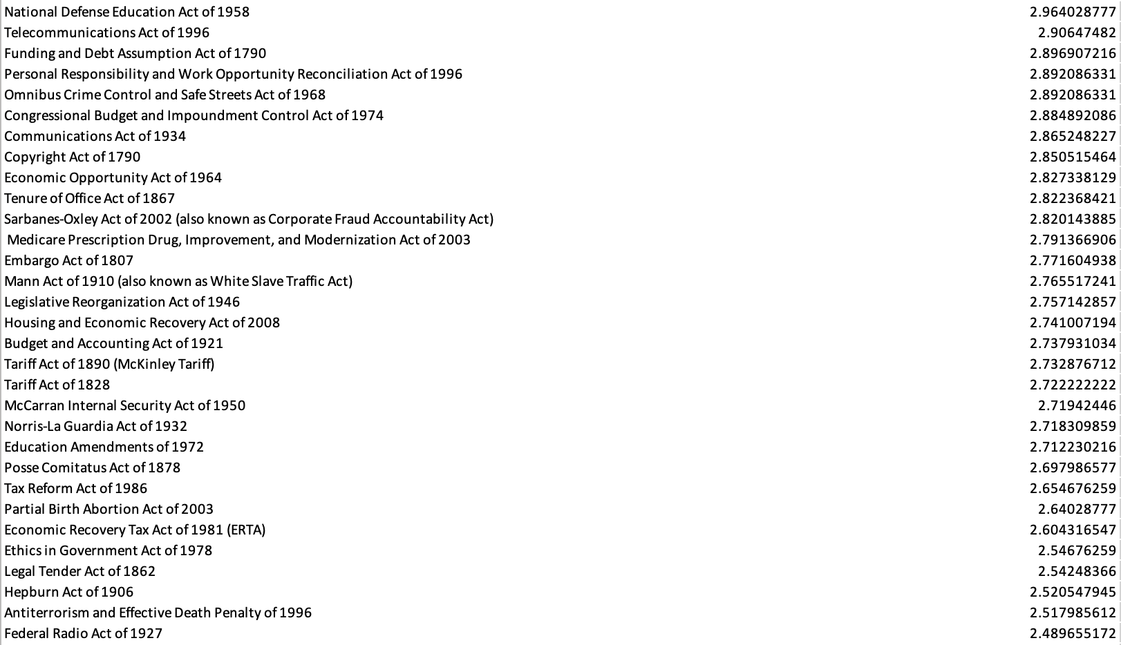
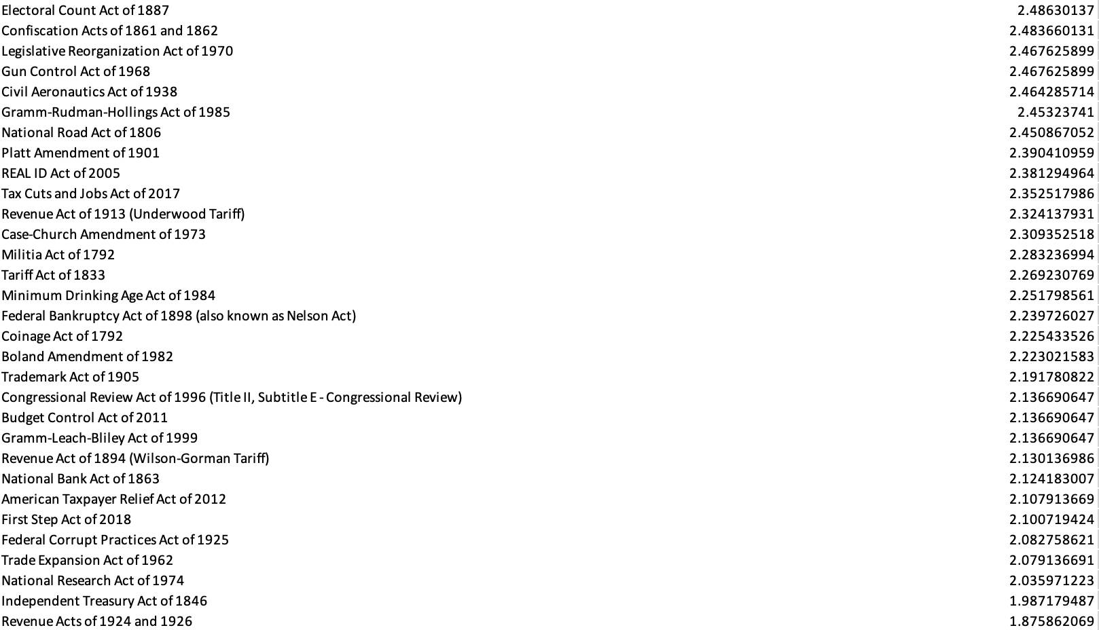
The Less Important Acts (1.8 - 3.0)

Slide 10
Omitted Acts
Excluded by the survey designers:
acts establishing government agencies (usually)
acts admitting states to the Union (usually)
declarations of war or force authorizations
routine revenue or spending acts
minor subsequent amendments to important acts
early versions of important acts
Constitutional amendments
Recommended by participants:
69 additional acts, some falling into the categories above
other acts recommended by more than one participant:
Yellowstone National Park Act of 1872, Dawes Act of 1887, Judiciary Act of 1925, Reapportionment Act of 1929, TVA Act of 1933, Rule Enabling Act of 1934, McCarran-Walter (Immigration and Nationality) Act of 1952, Age Discrimination in Employment Act of 1967, Controlled Substance Act of 1970, Pregnancy Discrimination Act of 1978

Slide 11
Different Kinds of Acts
Acts of Purely Historical Interest
Superseded, expired: Fugitive Slave Act of 1793, Alien & Sedition Acts of 1798, Missouri Compromise of 1820, Indian Removal Act of 1830, Lend-Lease Act of 1941, Marshall Plan of 1948
Held unconstitutional: Civil Rights Act of 1875, Agricultural Adjustment Act of 1933
Repealed: Chinese Exclusion Act of 1882, Smoot-Hawley Tariff of 1930, Glass-Steagall Act of 1933
Acts raising revenue
Acts authorizing spending
Acts regulating immigration and naturalization
Acts regulating the value of money
Acts relating to the post office, roads, patents & copyrights
Acts regulating commerce
Acts defining crimes
Acts governing the military
Acts structuring government and its processes

Slide 12
Criteria of Importance
At the end of the survey, we asked participants to rank the criteria they used in assessing the importance of the acts they had just ranked, giving them six choices and then asking them to list others. Here are the responses for our six [# ranking this first/ # ranking this second/ # ranking this third / etc.] :
Influence on American politics and political history [44/41/18/8/10/6]
Influence on American Government and its structures [43/35/31/13/4/3]
Influence on American public policy [28/30/34/27/8/2]
Influence on American jurisprudence (S.Ct. doctrine) [1/11/32/42/28/13]
Influence on foreign affairs [0/1/5/20/68/29]
Innovativeness [2/7/8/16/10/71]
Other suggestions fell into several categories, some overlapping those above
Influence on American society or people’s lives
Long-term impact or effect
Historical impact or historical crisis

Slide 13
Participants by Position
Q161 Please Describe Yourself:
1. College or university faculty (active or retired):
110 (81.48%)
2. High school faculty (active or retired):
14 (10.37%)
3. Graduate Student:
6 (4.44%)
4. Other
5 (3.70%)

Slide 14
Participants by Field
Q162 Please indicate your principal field of study:
1. Political Science or Civics
72 (53.73%)
2. History
45 (33.58%)
3. Other (mostly Law)
17 (12.69%)

Slide 15
Participants by Age
Q163 Please indicate the decade in which you were born
1. Before 1950
21 (15.79%)
2. 1950s
20 (15.04%)
3. 1960s
31 (23.31%)
4. 1970s
27 (20.30%)
5. 1980s
24 (18.05%)
6. 1990s
9 (6.77%)

Slide 16
Items for future research and analysis
If kinds of legislation were categorized, would importance be easier to assess and would the results be more satisfying?
Are there measures of the impact of legislation that might be correlated with the judgments of importance registered here?
Can we learn from the 100 most important acts when Congress is likely to succeed in legislation? When it is likely to fail?
Can we discern any elements that describe and account for legislative success? (…for legislative failure?)
Are there any characteristics of more successful acts that might guide Congress in drafting legislation?
Can we find any evidence for the perceived decline of Congress in recent years?
Would sophisticated analysis of the data should significant variation in responses by different groups of survey respondents?

